Slide 1
Long-Term Changes on Magnetic Island Fringing Reefs
Presented by Sea Research: Tony and Avril Ayling
May 2022

Slide 2
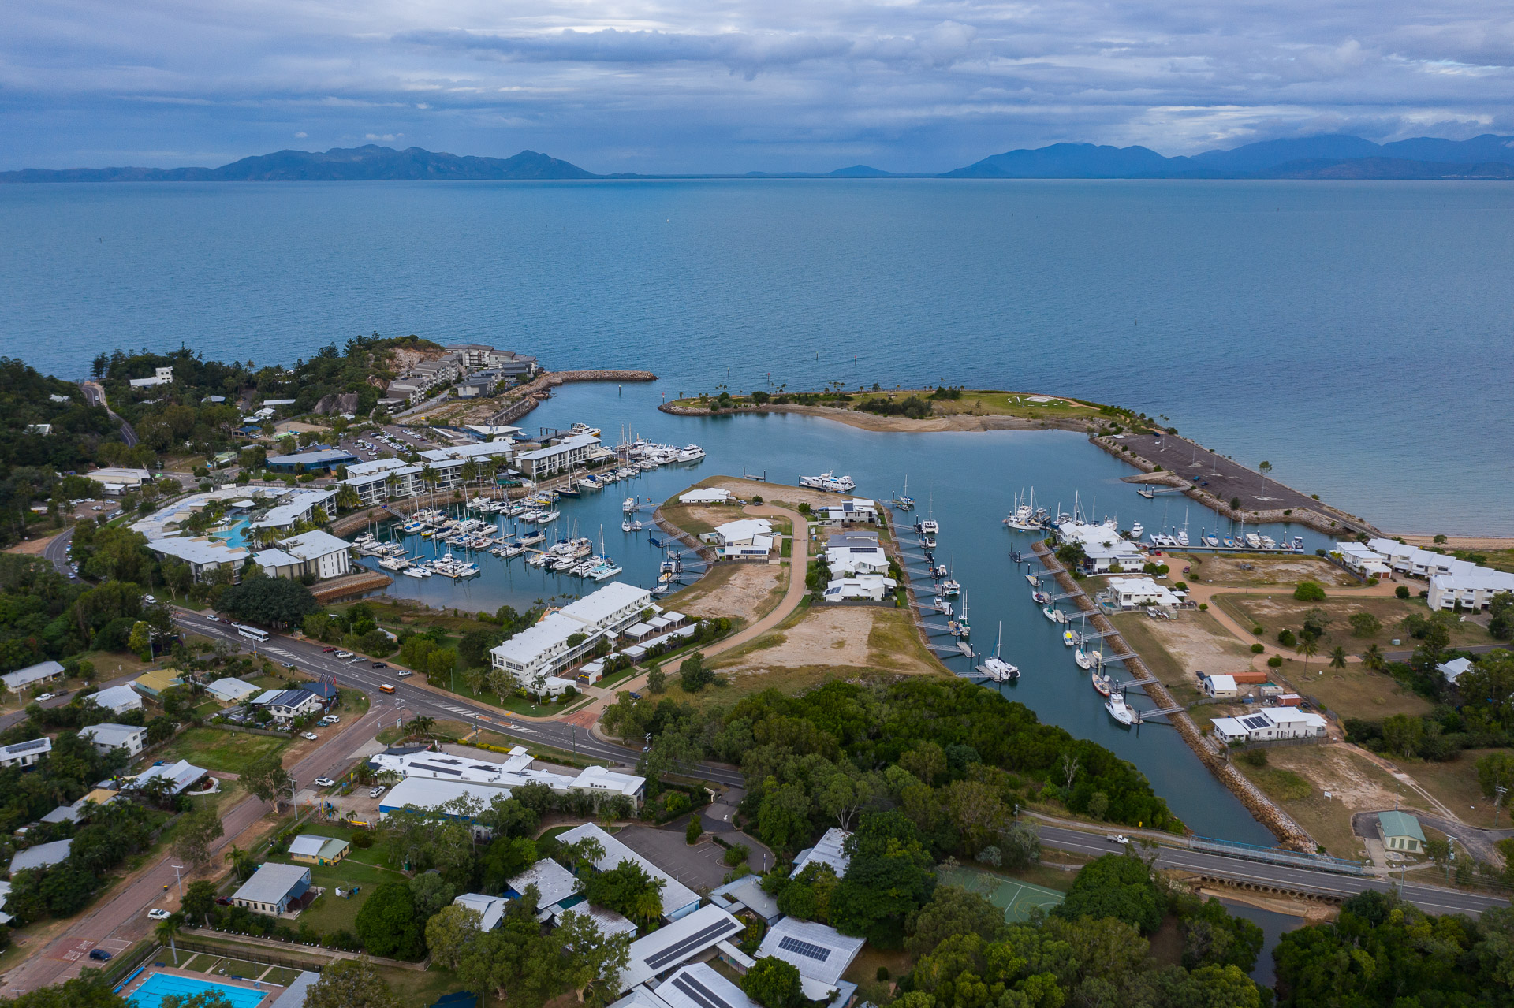
Nelly Bay Harbour

Slide 3
Sea Research Experience:
We first dived on the reef in 1974
Set up a Marine Biological Consulting business in 1980
Carried out reef-wide coral and fish surveys for the GBRMPA between 1983-1986, visiting over 200 reefs
Extensive fringing reef coral monitoring programs starting in 1985
First surveys on Magnetic Island reefs in 1988
Dredge impact coral monitoring at many locations including Magnetic Island over past 20 years

Slide 4
Magnetic Island Coral Surveys:
First baseline Dec 1988-Feb 1989 for Magnetic Quays Marina
Redid these surveys 15 times between baseline in 1988-89 and 2006 for five different projects
Full resurvey Feb 2022 for Magnetic Is Community Development Ass.

Slide 5
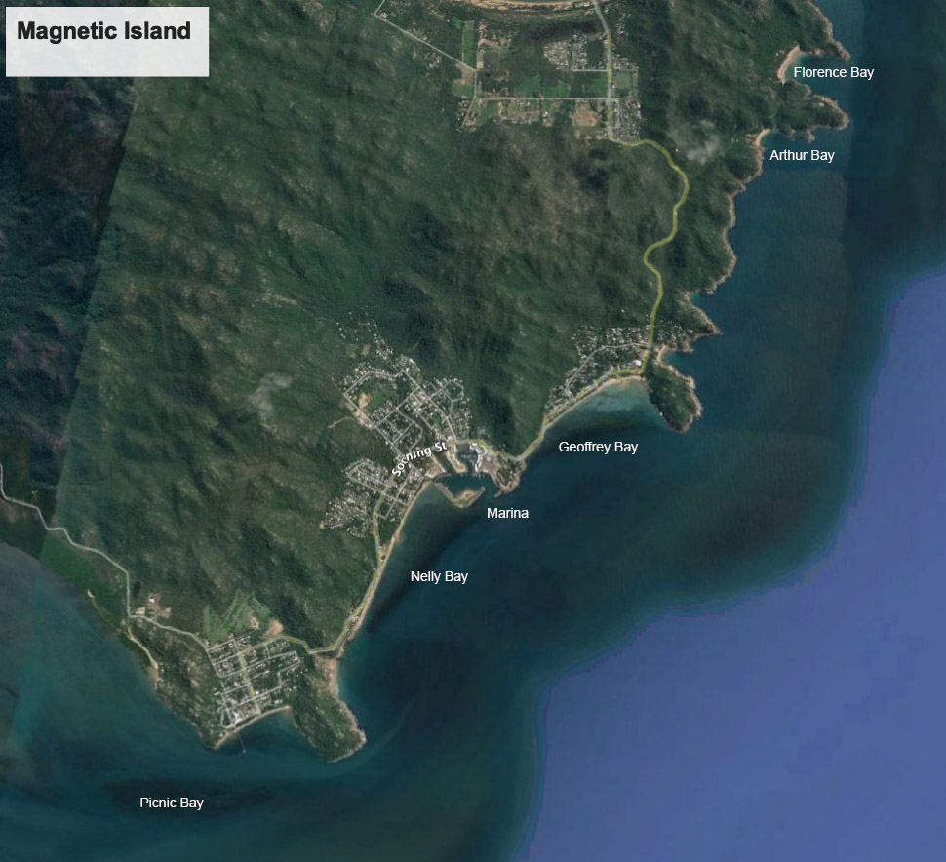
Coral surveys in five bays on eastern side of island

Slide 6
Methods:
Coral monitoring based on multiple sites of four 20m permanently marked transects
Transects marked with stakes every five metres (do not harm the reef)
27 sites in five bays first set up in late 1988: 108 transects!
Sites on the reef slope mostly around 5m depth but some shallower
Coral measured using line-intersect or video/photo techniques
Lots of help over the years but corals were actually measured by Sea Research for all 17 surveys so minimal observer bias

Slide 7
What events have impacted Magnetic Island reefs?
Coral bleaching and floods: early 1998
TC Tessi: March 2000 – caused overall 38% reduction in coral cover
Coral bleaching: summer 2002 – caused overall 13% reduction in coral
Strong winds, warm water, floods: 2008-2009 wet season
TC Yasi: 2011 – hit at low tide, 85 knot winds
Townsville floods: 2019 – affected Picnic Bay, limited other locations
Coral bleaching: early 2020 – small impact but bad in Geoffrey
Coral bleaching: early 2022 – small impact but bad in Geoffrey

Slide 8
Tropical Cyclone Tessi: March 2000
March 2000 pre-cyclone: Average coral cover 54.1%; Algae 20%
April 2000 post-cyclone: Average coral 33.4%; Algae 10% Coral down 38%; Algae down 50%

Slide 9
Mass Coral Bleaching: 1998, 2002
September 2001 pre-bleaching: Average coral cover 40.2%
June 2002 post-bleaching: Average coral cover 34.9% Coral down 13%

Slide 10
Mass Coral Bleaching: 2020, 2022
Early 2020: small impact in most bays but bad in Geoffrey. Evidence of partial colony death
February 2022: small impact in most bays but lots bleaching in Geoffrey with some partial coral death

Slide 11
Freshwater flooding: 1998, 2019
Picnic Bay December 2006: 38% coral cover, Turbinaria and Acropora common
February 2022: 15% coral cover, most Turbinaria and Acropora dead probably from freshwater 2019 floods

Slide 12
Nelly Bay Coral Changes:

Slide 13
Geoffrey Bay Coral Changes:

Slide 14
Florence and Arthur Bays Coral Changes:

Slide 15
Problems?
Pity we don’t have comparable, comprehensive, reliable quantitative surveys prior to 1988. We need a time machine!
Would have been nice to have more regular comprehensive surveys covering big gap from 2006 to 2022
Would be good to have ongoing monitoring on this scale……

Slide 16
Summary:
Magnetic Island reefs have experienced severe impacts about every 5 years since 1988.
In 17 years between 1989 and 2006 the three major impacts caused an average 11% absolute coral cover reduction
Coral recovery rates have been about 4% per year suggesting a 20% increase in 5 years of no impacts, well below the average 5 year impact rate of 11%
But other small impacts constantly affect these reefs and 2022 coral cover was 5% below that recorded in 1989.
Frequency and severity of impacts may be increasing.
Coral cover 2022 was 37.3%, very close to overall average from previous 16 surveys of 36.2%.
To make reliable statements about what is happening on coral reefs we need lots of surveys from lots of sites over as long a period as possible!

Slide 17
Thank you!

