Slide 1
The official citizen-science and science-for-management program for the Great Barrier Reef

Slide 2
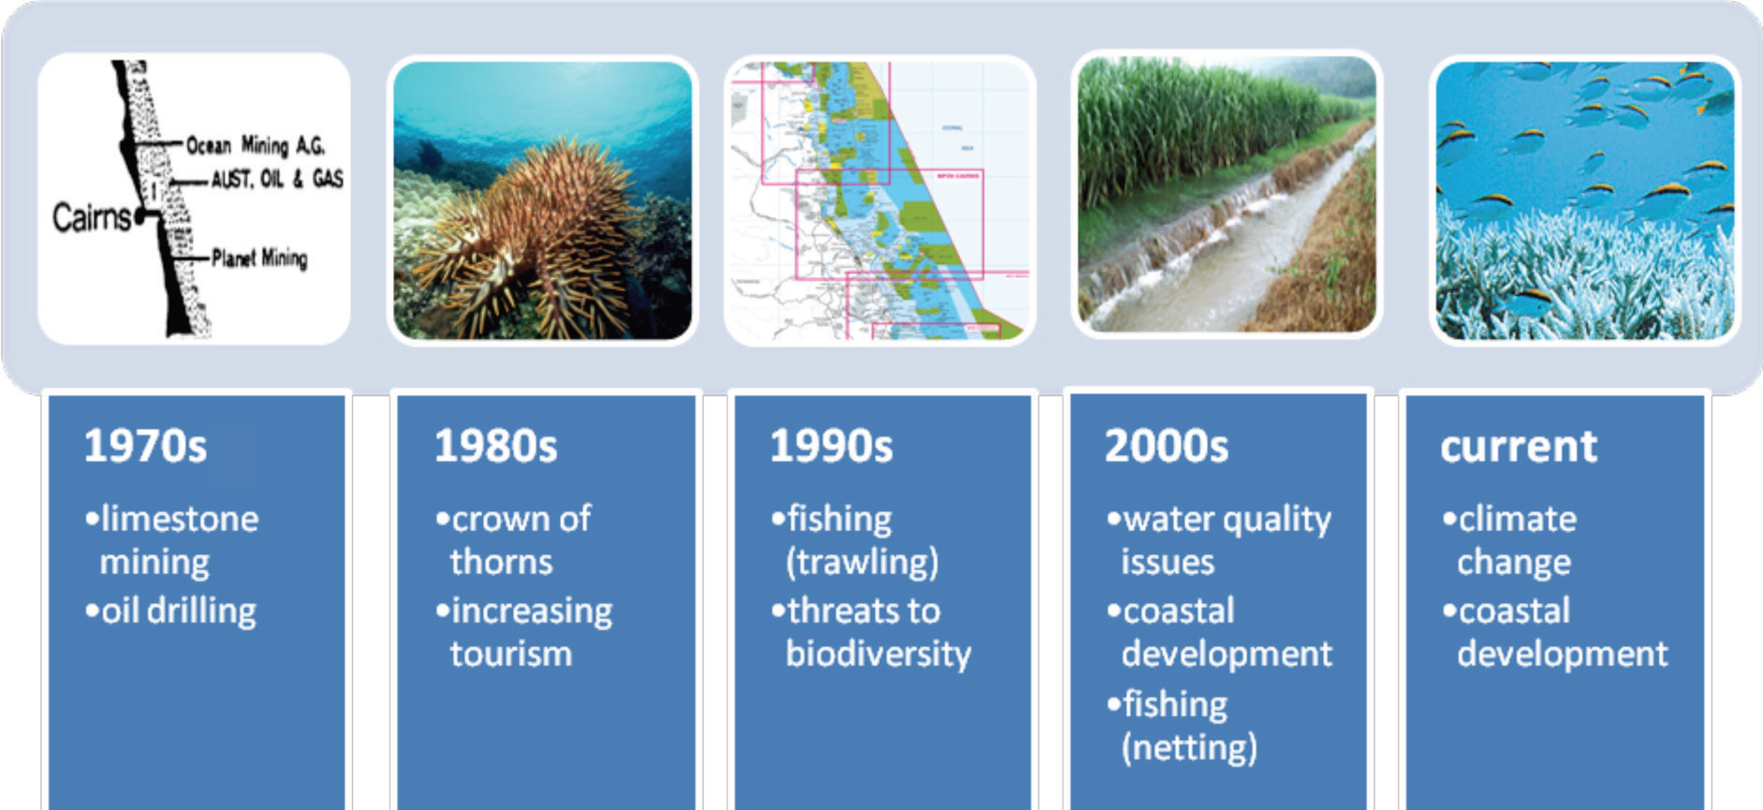
A range of impacts increasing over time
The official citizen-science and science-for-management program for the Great Barrier Reef

Slide 3
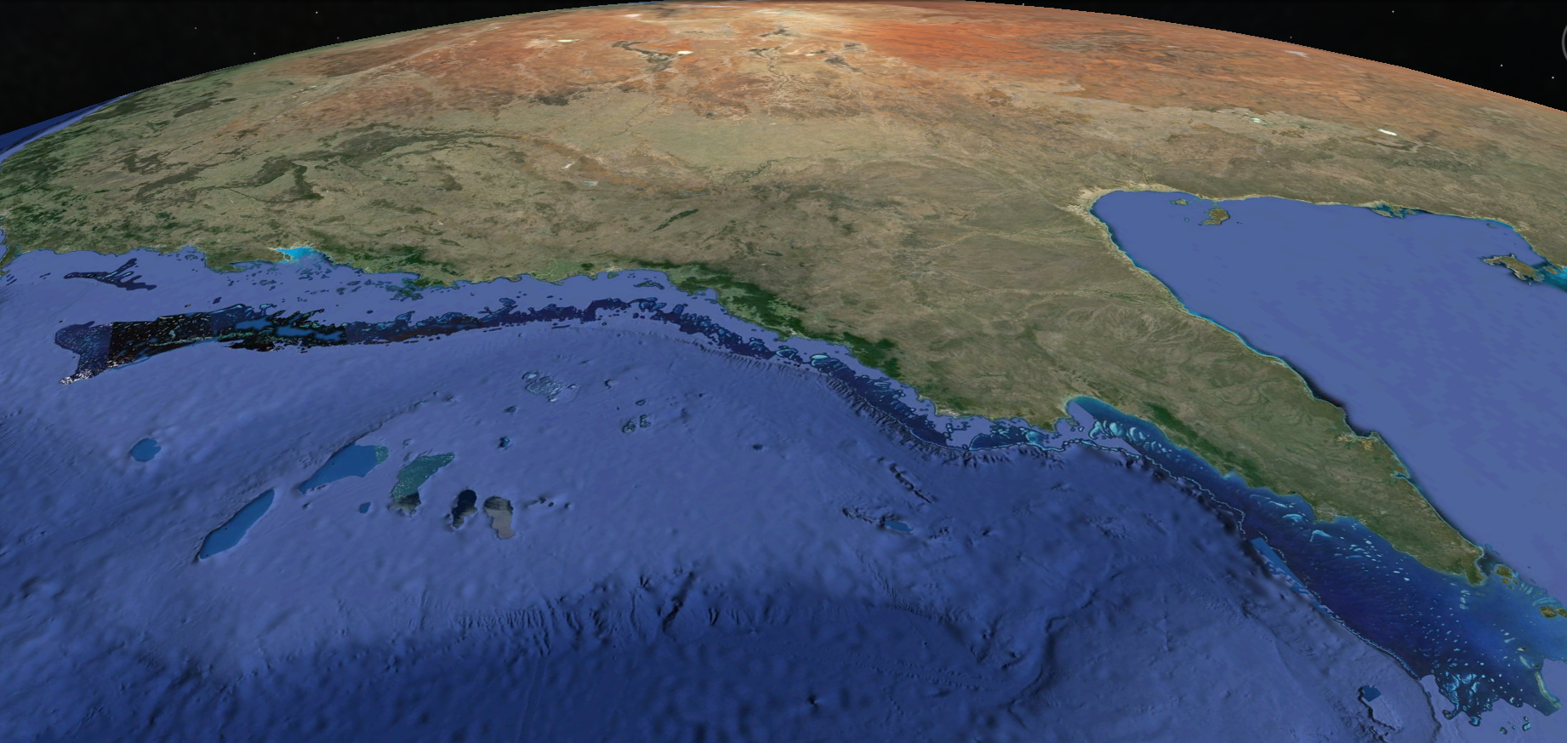
How can we keep an eye on something this big?
Notes:
Not only are the impacts varied and cumulative, the area covered is monstrous – 345,000 square kilometres – we cannot do it alone.
This image is taken from an equivalent height of 600km into space.

Slide 4
#1 Australian Institute of Marine Science
Long term monitoring program (LTMP)
Rigorous structured science
30 years of data
Only scientists can do it
<10% of reefs
1 – 3 year sample gaps

Slide 5
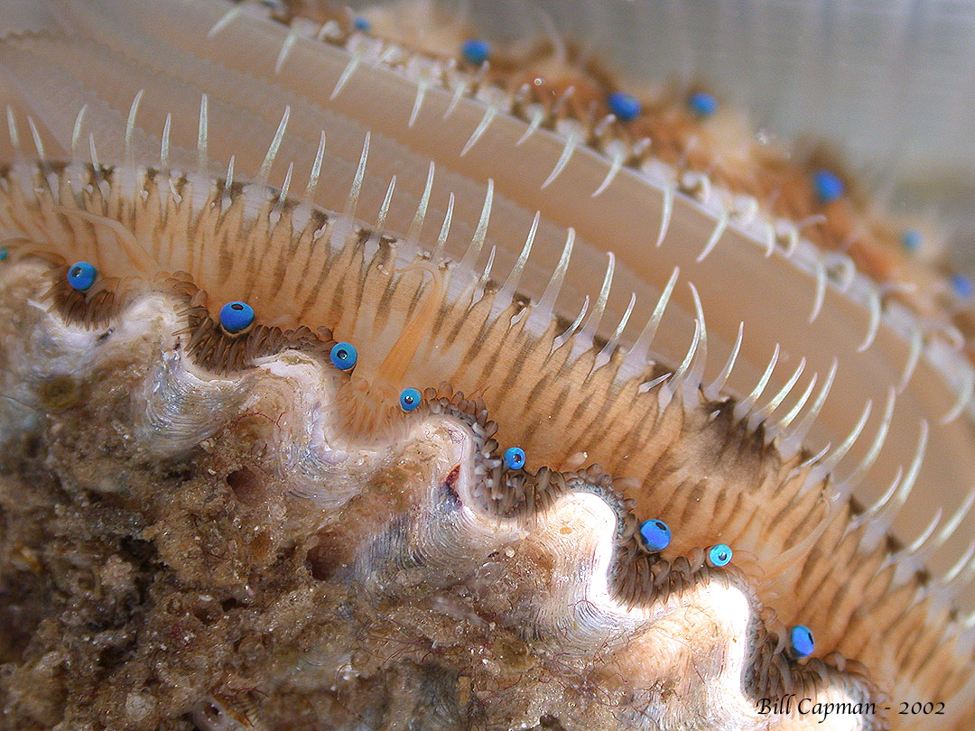
The more eyes the better to fill the gaps
Although these eyes may or may not produce clear images, the ability to sense an object moving with speed allows the scallop to shut immediately or swim away. Simple observations can be important.

Slide 6
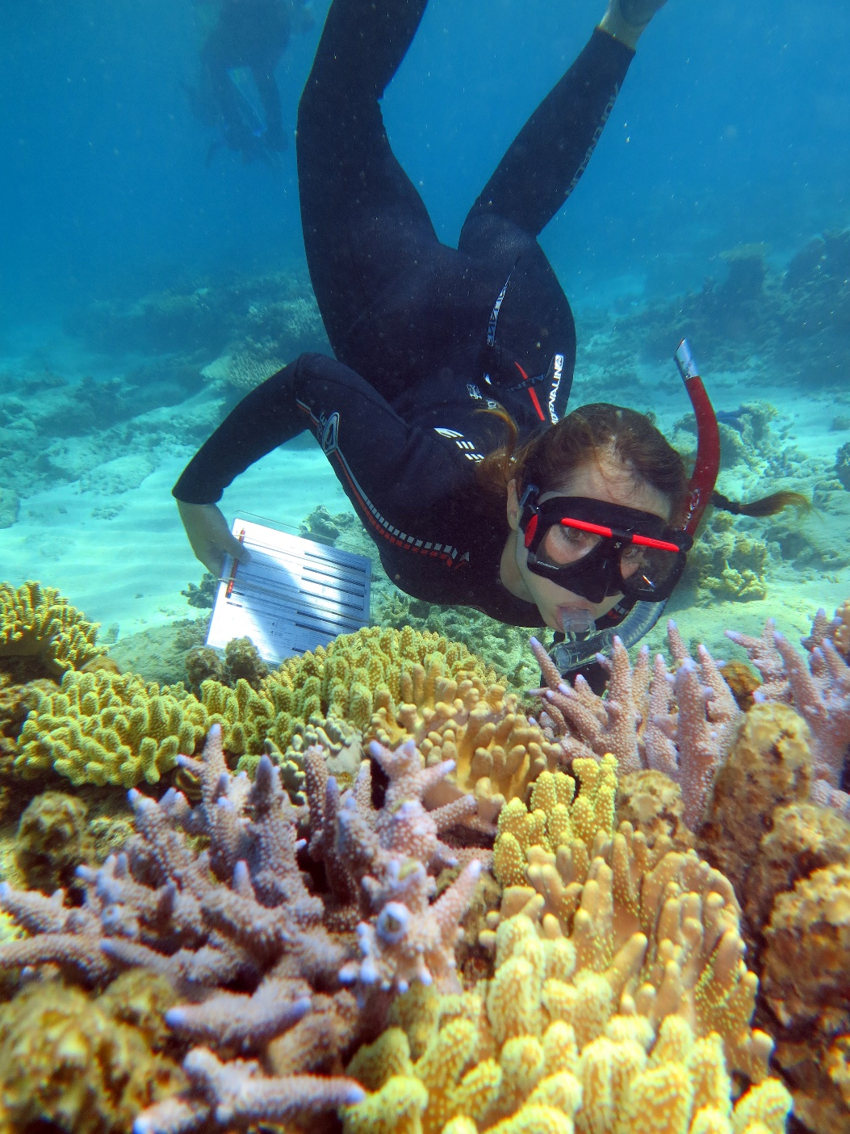
Citizen Science
‘Marine citizen science is increasingly popular and can offer an immersive educational experience, beyond factual learning, that empowers people to share information about and increase support for marine science and conservation’ (Dean et al 2018).

Slide 7
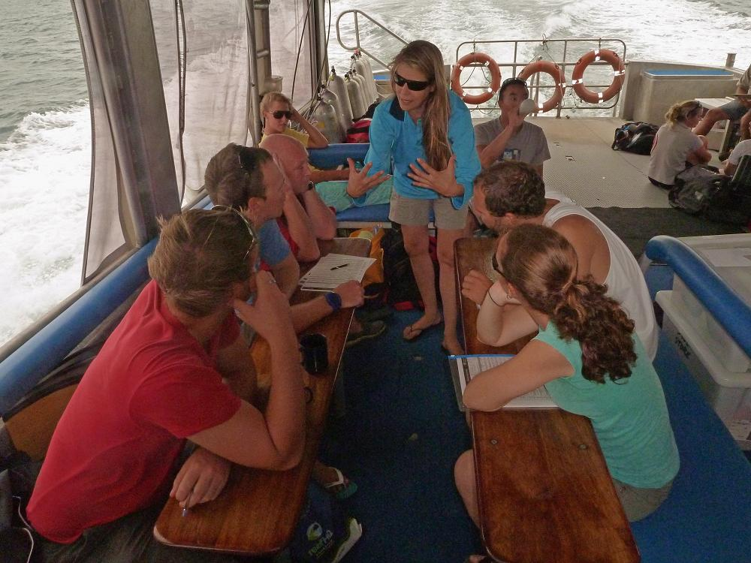
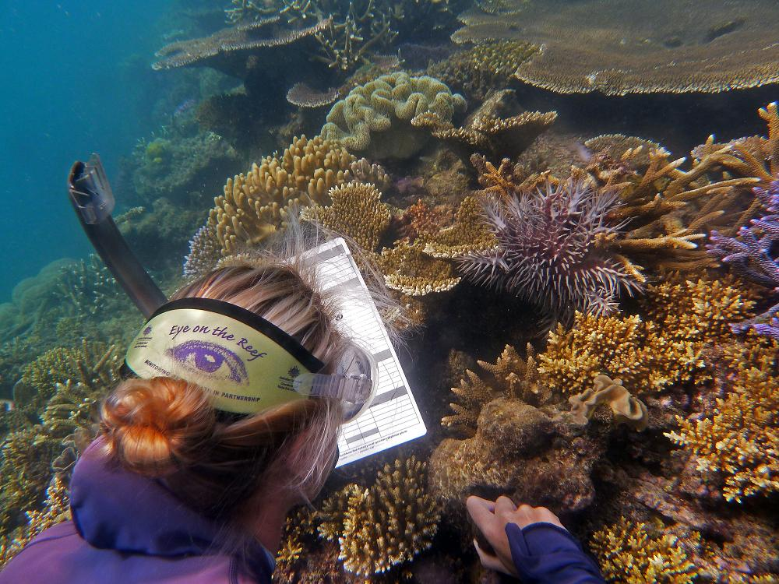
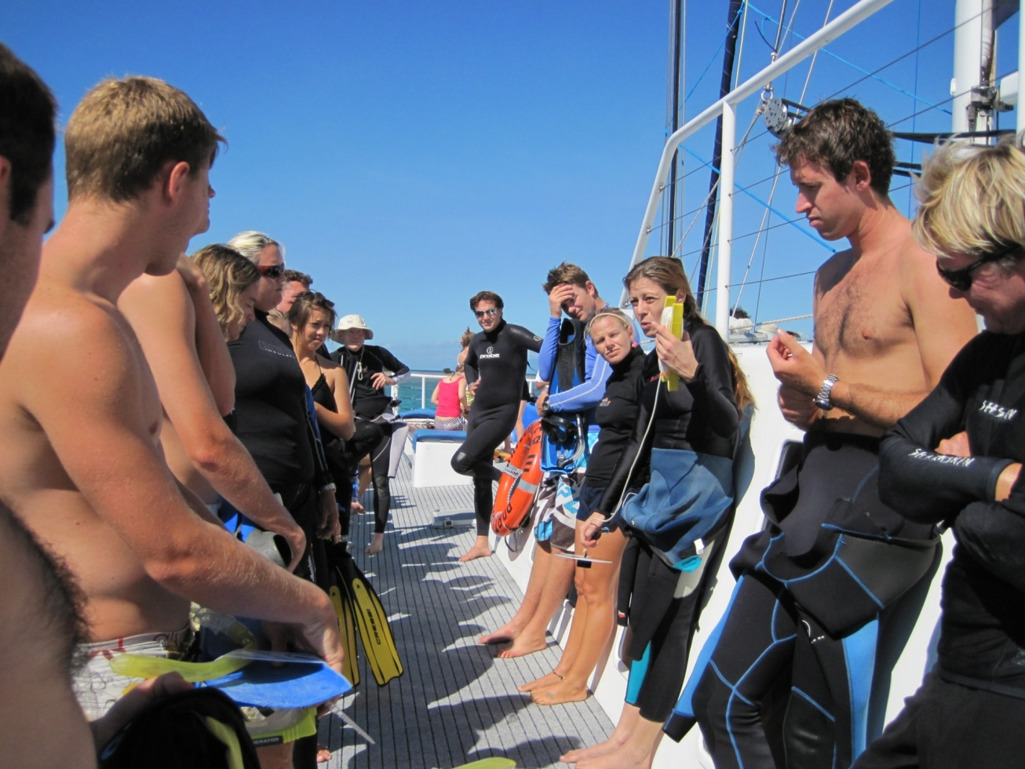
The Eye on the Reef Program
Vision:
The world's best stewardship based reef health assessment and monitoring program that builds stakeholder capacity and delivers accurate, timely and valuable information directly to the managers of the Great Barrier Reef.

Slide 8

A way for everyone to be involved
REEF INDUSTRIES
FISHERS
TECH SAVY YOUTH
BOATIES
OCCASSIONAL VISITORS
SNORKELLERS
RESEARCHERS
Notes:
We created a way for everyone to be able to plug in somewhere and make a contribution, regardless of how much time, knowledge or swimming ability you have

Slide 9
Reef Knowledge Types – Different methods for different eyes
RHIS
QPWS & GBRMPA
100+ reef experiences
15 minutes x 3
Professional Tools > Science-for-Management
Weekly Tourism
Trained Tourism Crew
50+ reef
experiences
30 minutes
Rapid Monitoring
< 50 reef experiences
15 minutes
Community Tools > Citizen Science
Anyone…
No reef
experience
2 minutes
Sightings Network

Slide 10
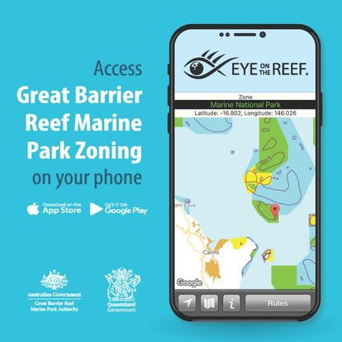
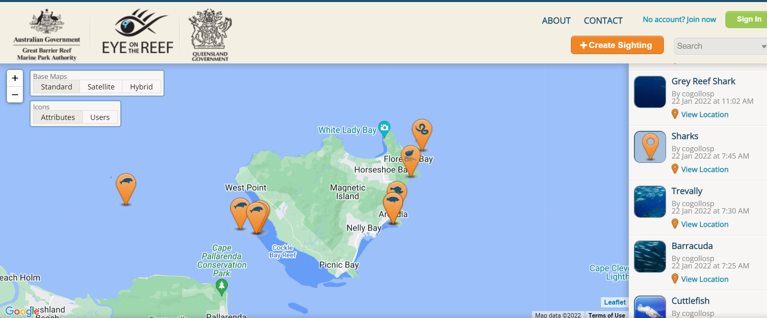
Citizen Science - Sightings Network
Eye on the Reef App & Wildlife Map
2022 sightings @ Maggie
FREE on Android and iPhone
19 000 Sightings since 2007
Report what you see whilst on the water
Create & save sightings out of range
Buffer around GPS position (privacy)
270 species included
COTS reporting tool
Can also report illegal activities and see the zoning
Interactive web map that can be searched by anyone

Slide 11
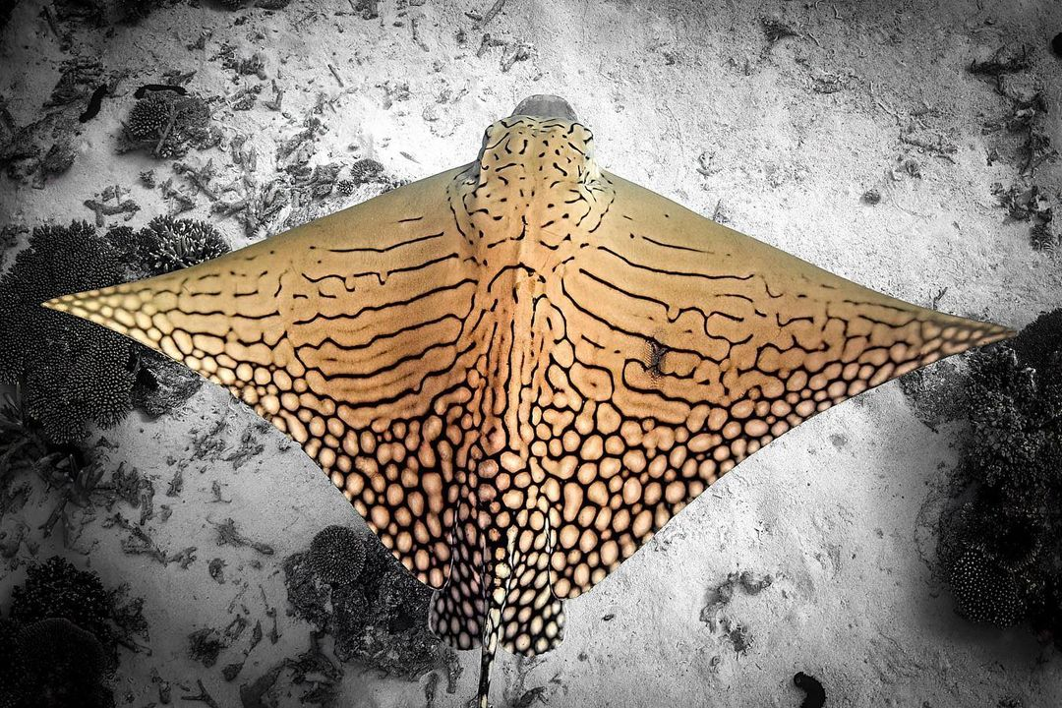
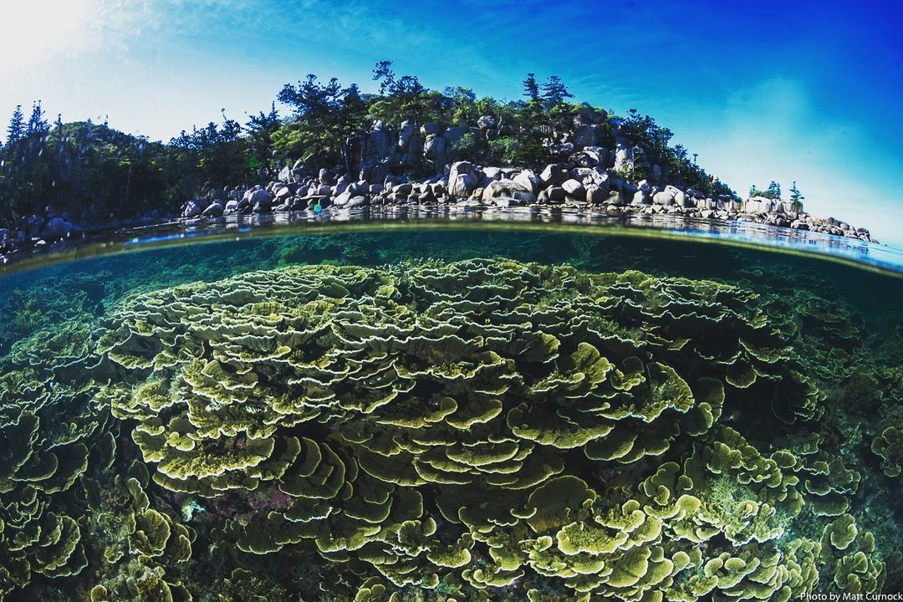
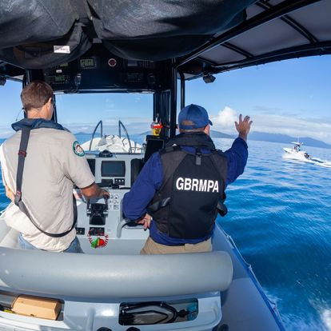
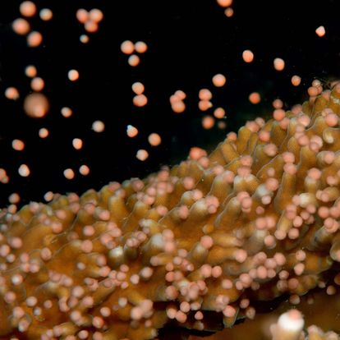
© Lady Elliot Island
Shared on our social media
97k followers
© Matt Curnock

Slide 12
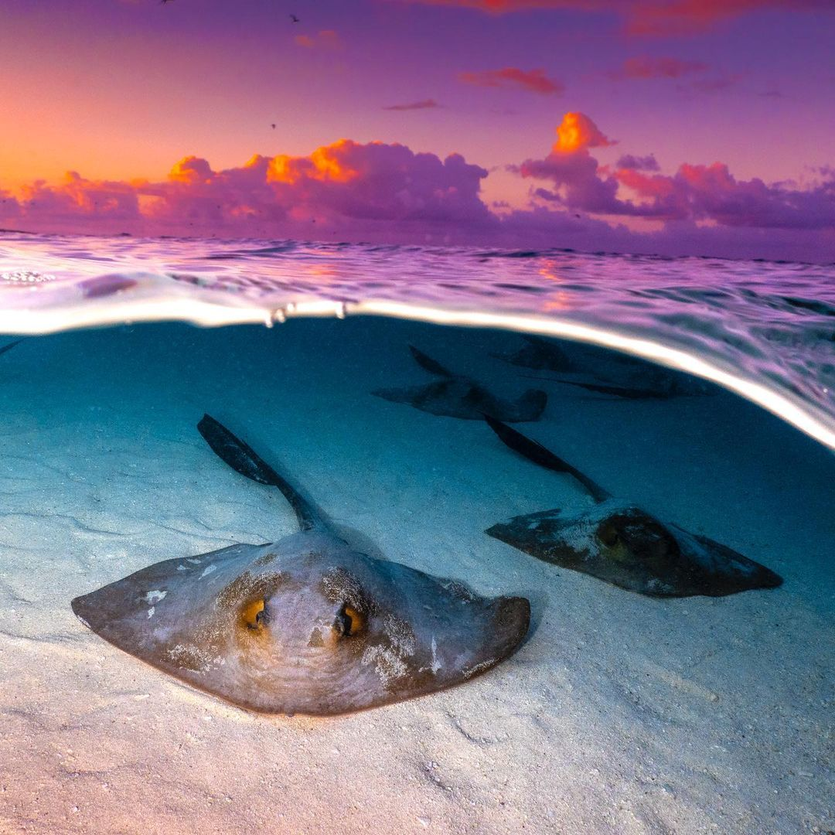
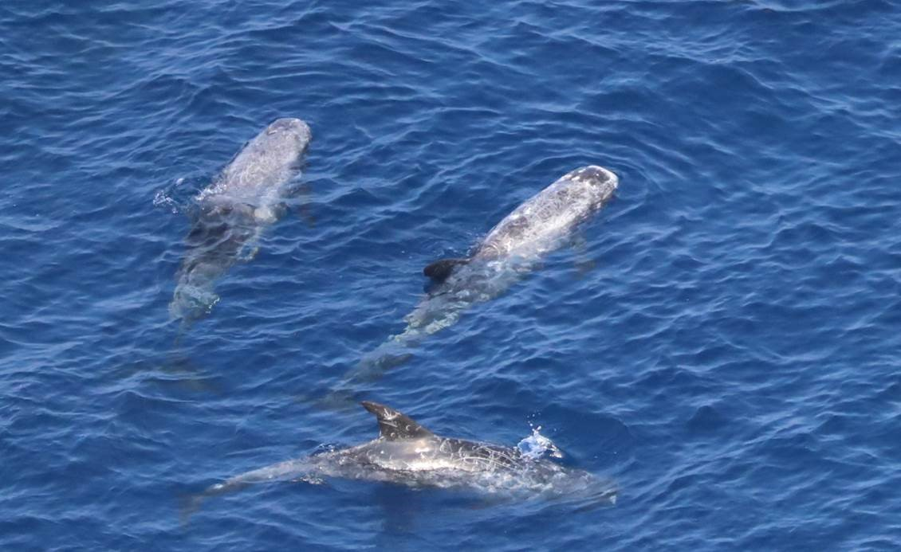
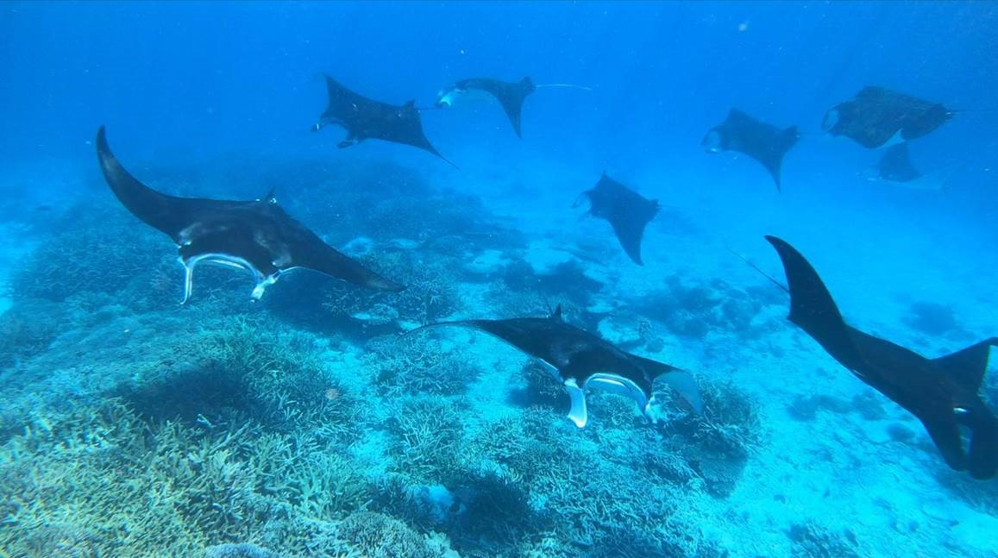
Credit Heron Island

Slide 13
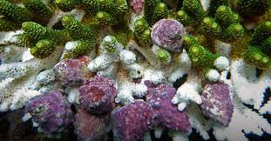
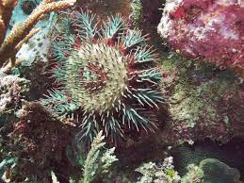
Monitoring and responding to impacts

Slide 14
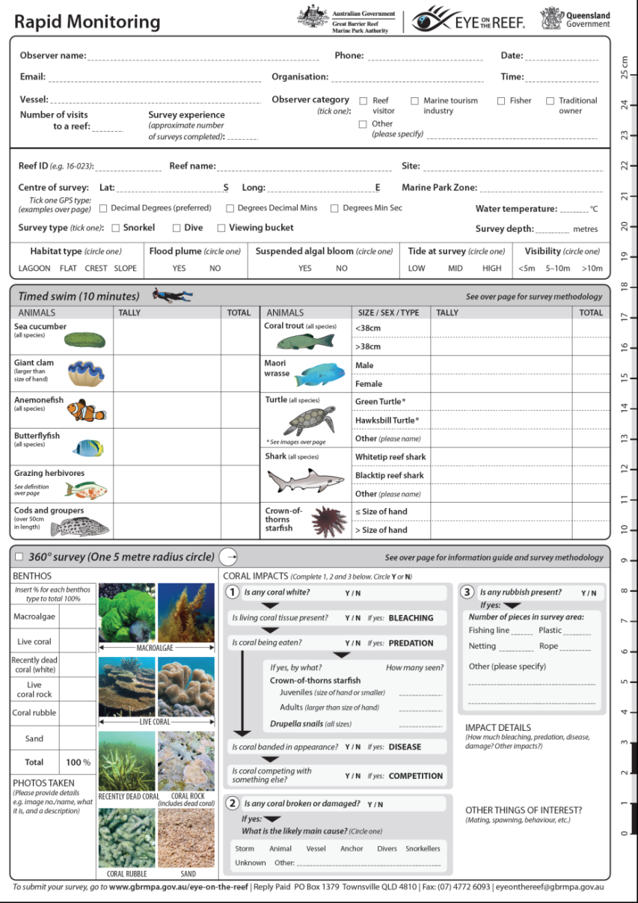
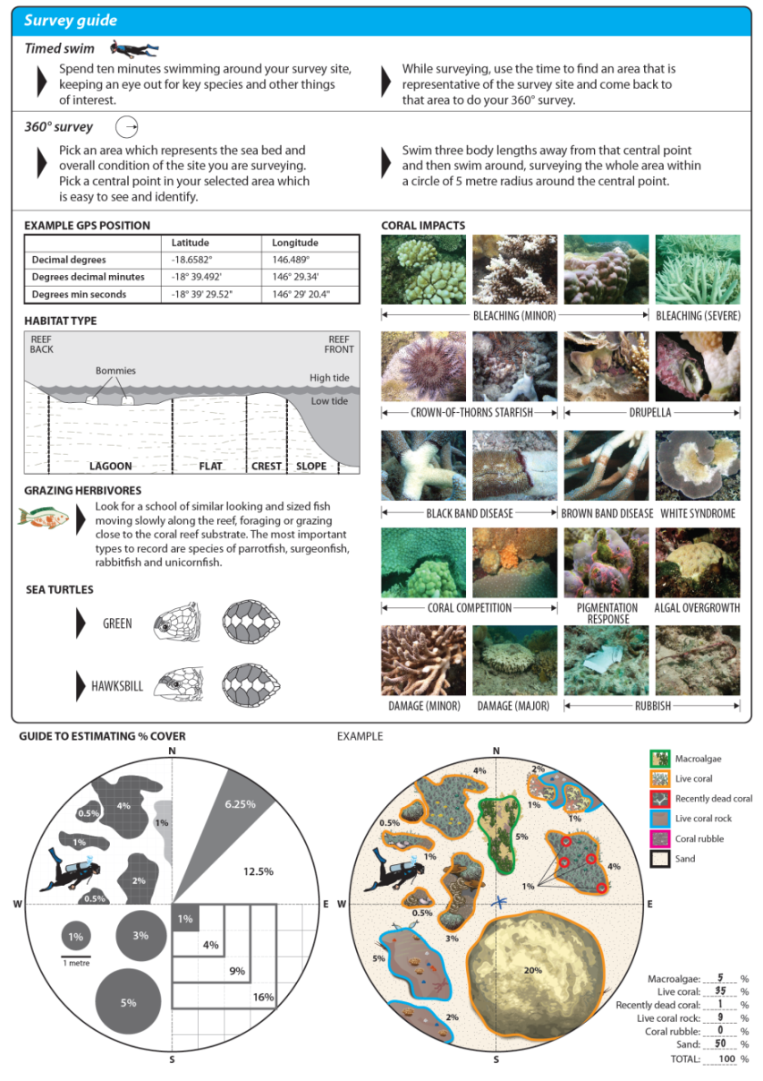
Citizen Science – Rapid Monitoring
Reporting reef health status by the community
Two method combination
User group flexible
Crucial impact and species list
Cheat-sheet guide on reverse
Online multimedia course & certificate
Official online data entry login
Underwater slate & mini-slate guides

Slide 15
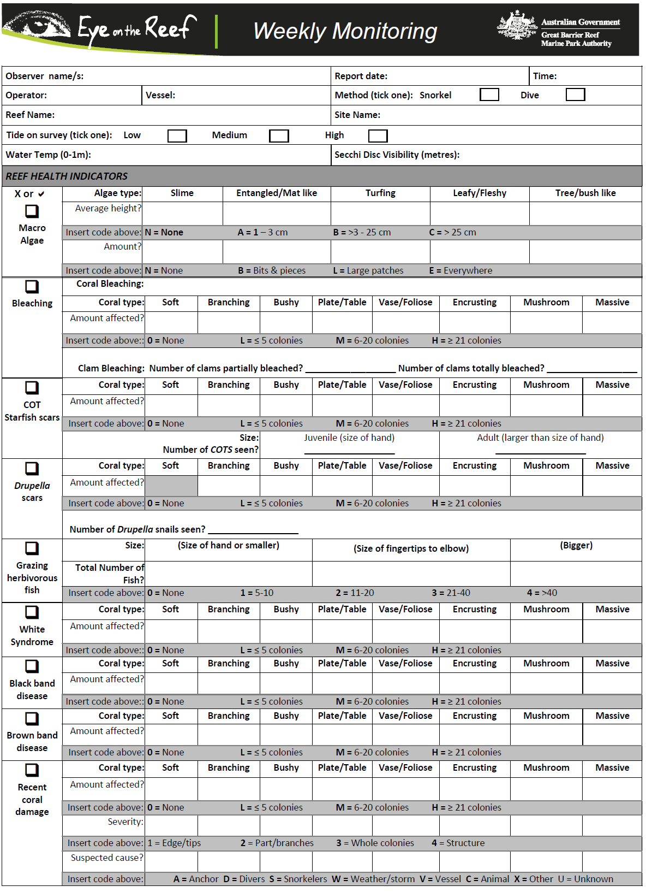
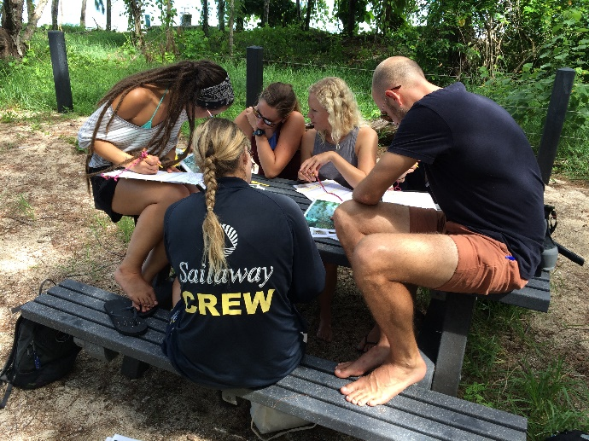
Science-for-Management – Tourism Weekly
Dive Site trend, early warning & tourism staff training
Tourism Industry specific
Timed-Swim method
Highest frequency survey in Marine Park
Early warning to science and management
Trend of reef health at representative sites
Online multimedia course & certificate
Printed 60 page colour manual
Official online data entry login
Online data visualisation for site trends
Underwater slate & mini-slate guides

Slide 16
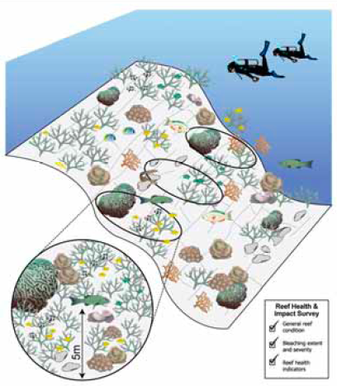
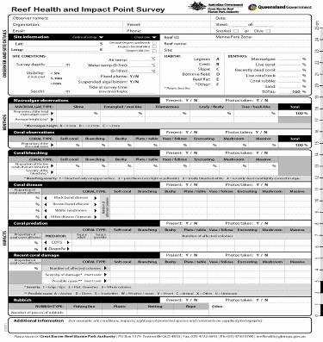
Science-for-Management – R.H.I.S
Ecosystem-wide status & Impact assessment
Primary survey tool for management
High level experience requirement
Detailed and complex visual survey
Online multimedia course & certificate
Official online data entry login
Notes:
Since 2009, the GBRMPA and the Queensland Parks and Wildlife Service (QPWS) have collected in-water reef health and impact information from the Great Barrier Reef (the Reef) in the form of Reef Health and Impact Surveys (RHIS).
Quantitative survey methodology completed as a point survey (5 m radius) – 5-10mins to complete – standardised area increases accuracy of site assessment and allows for between reef comparisons.
Since 2009 –QPWS 11,307 RHIS from 833 reefs, GBRMPA – 3,653 surveys from 323 reefs

Slide 17
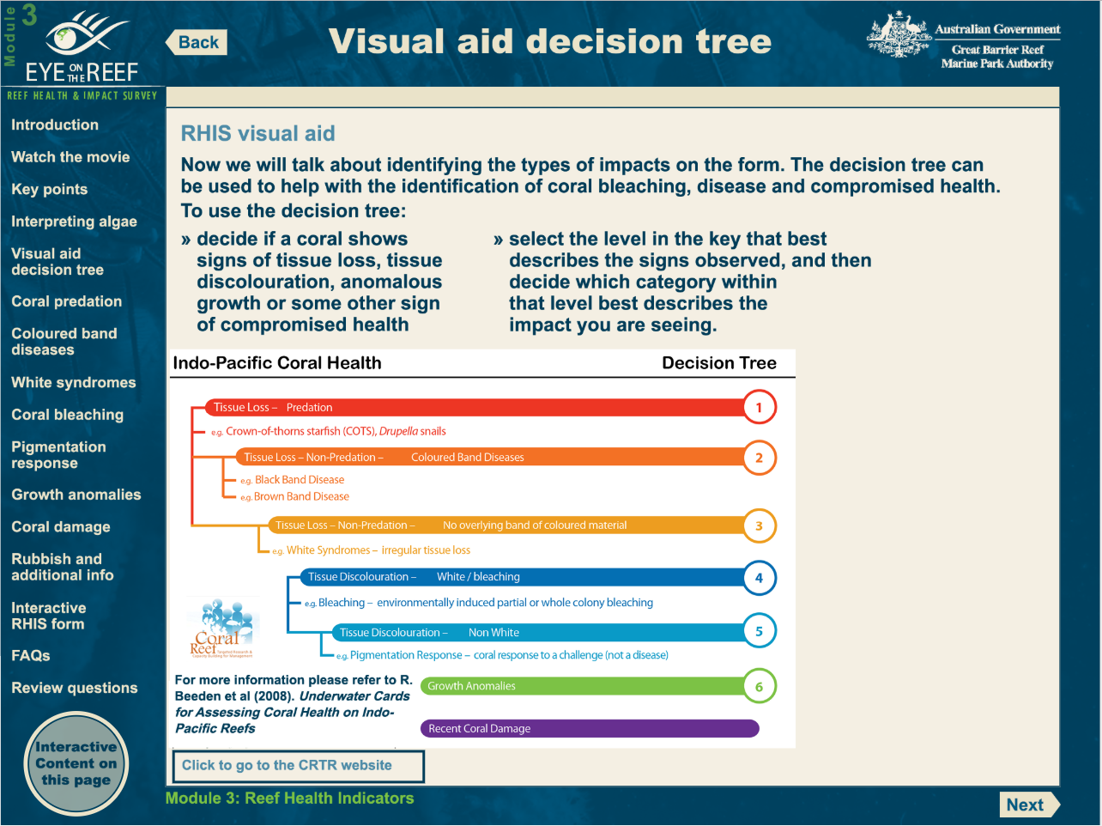
Online Training
Rapid Monitoring
Tourism Weekly
R.H.I.S

Slide 18
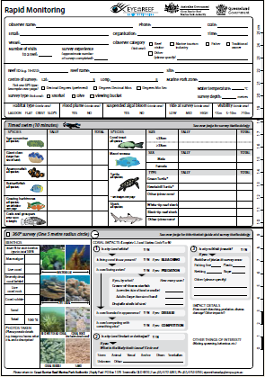
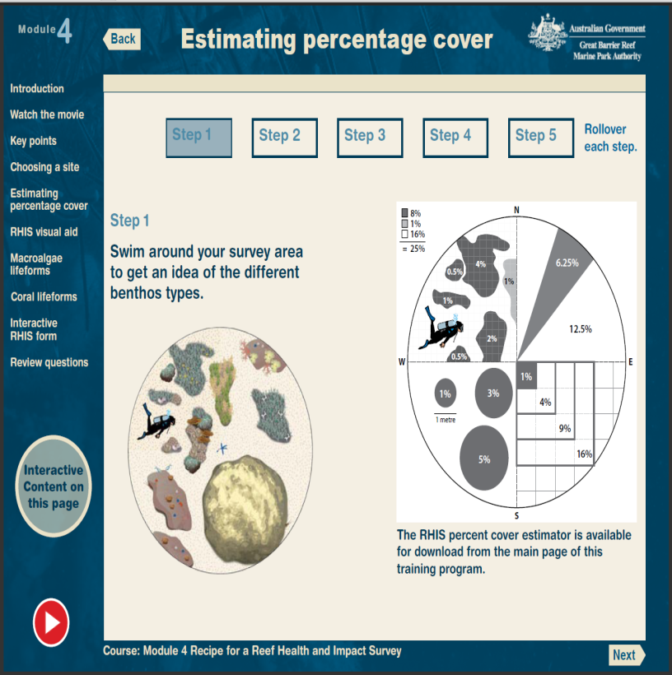
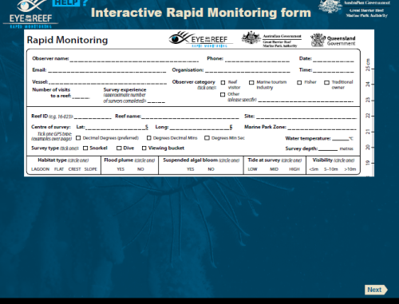
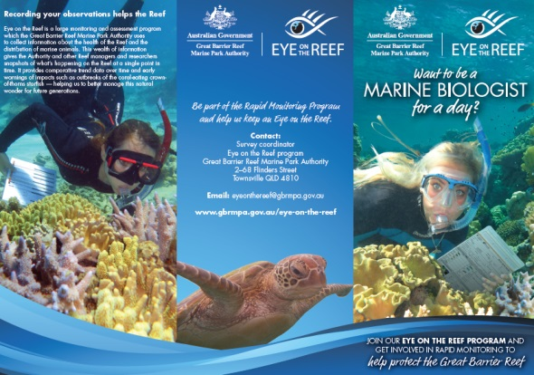
Rapid Monitoring Training Tools
Self-guided Monitoring Form
Online training course
Interactive PDF Monitoring Form
Engaged Citizens
Notes:
Tourism crew should be true Underwater Guides, a way forward with making the GBR experience fully immersive and competitive with cheaper destinations.
NOTE: Only experienced crew (mainly with Tourism Weekly) are succesful at providing this experience AND returning useful data.

Slide 19
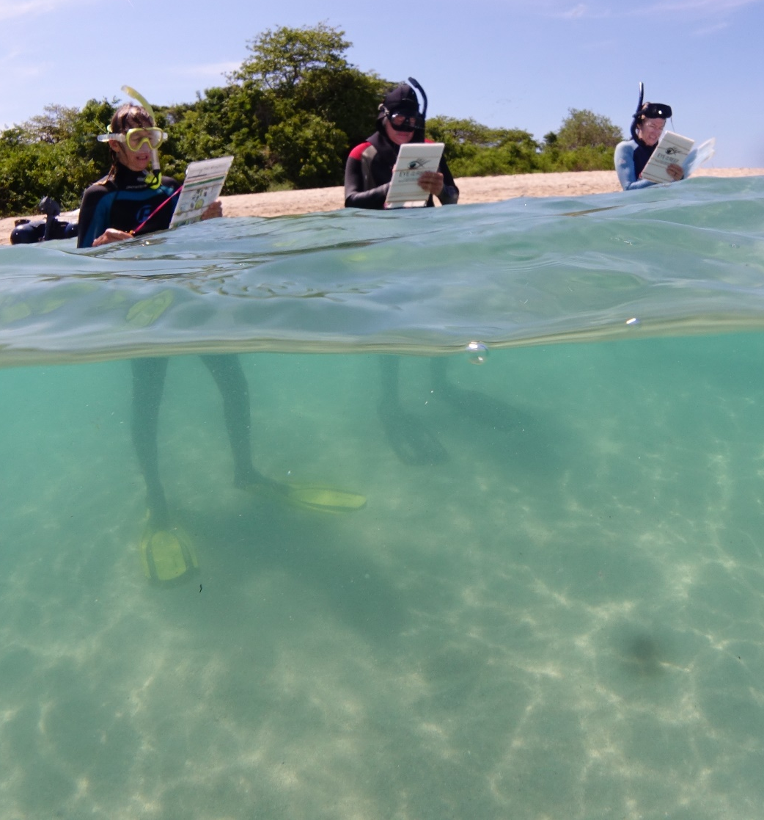
In-water Training
For Eye on the Reef Citizen-science methods:
Sightings - no training required
Rapid Monitoring - if required
For Eye on the Reef Science-for-Management methods:
Tourism Weekly - Register to join up and attend quarterly training by GBRMPA staff
R.H.I.S: Register to join up and attend official training camps with GBRMPA and/or QPWS staff.

Slide 20
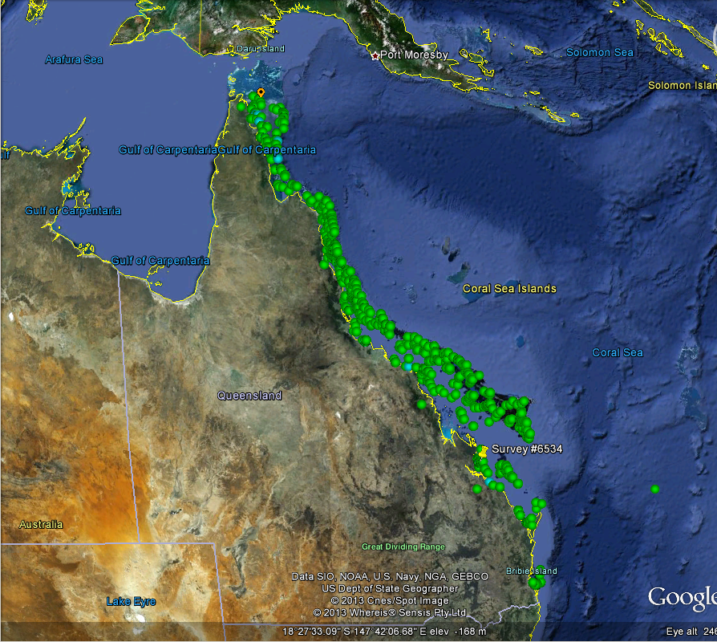
Citizen Science in Action – Eye on the Reef Program
Since the program began in 2009:
43,000+ surveys of Reef Health submitted
19,000+ sightings of protected species and significant events logged
From 1200 Reefs
700+ people trained in survey methods

Slide 21
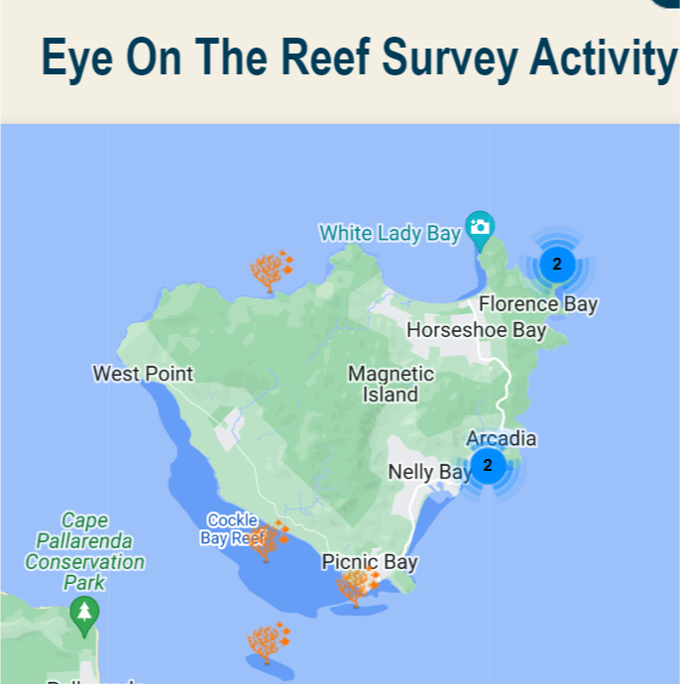
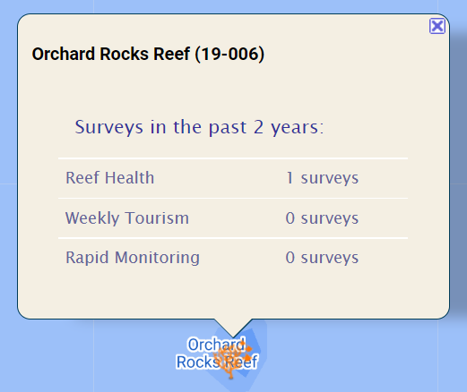
8 Surveys in the last 2 years around the island

Slide 22
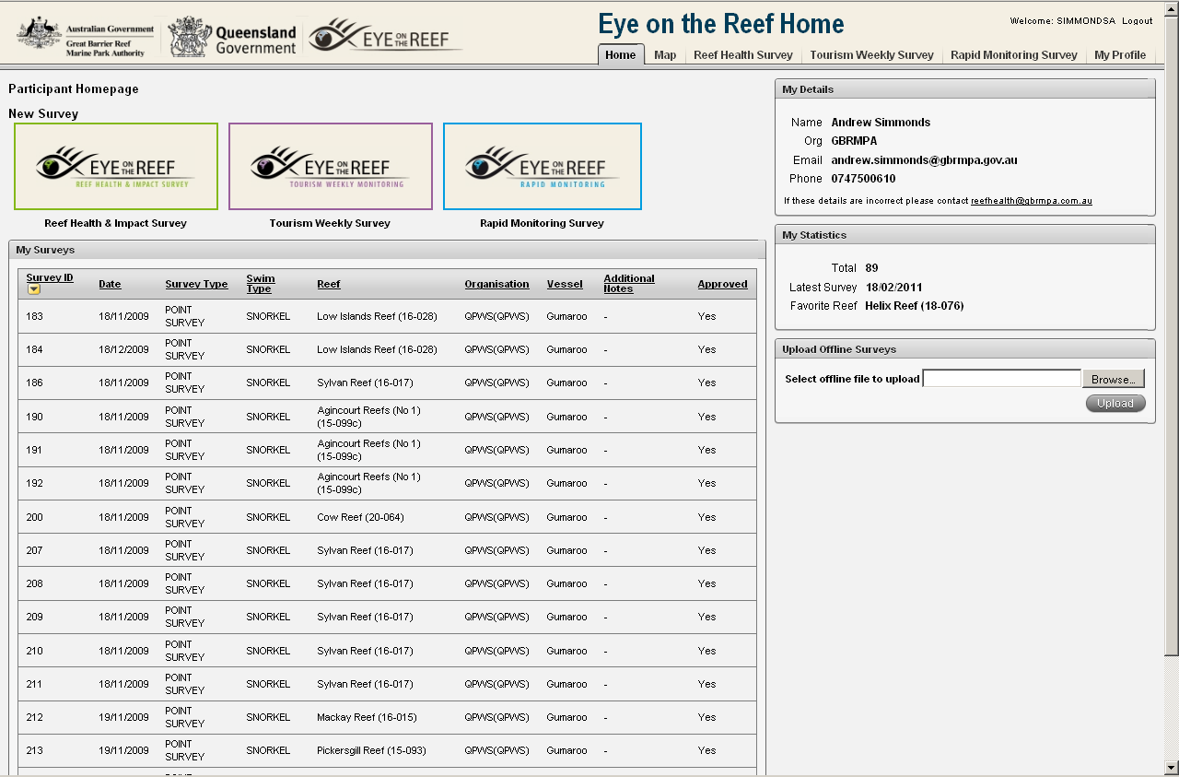
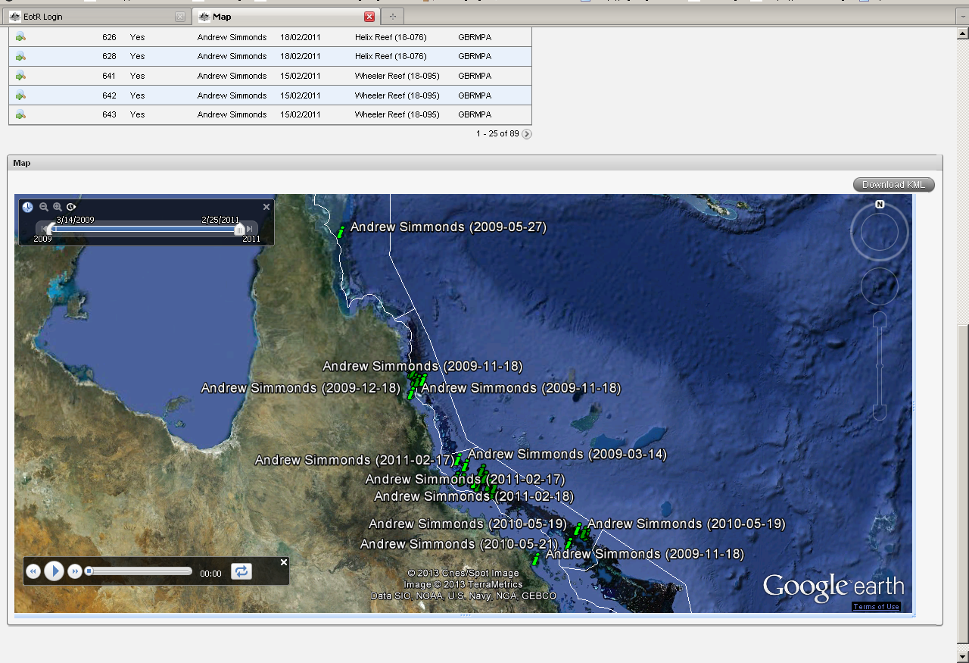
Participant Access
An Eye on the Reef Champion View

Slide 23
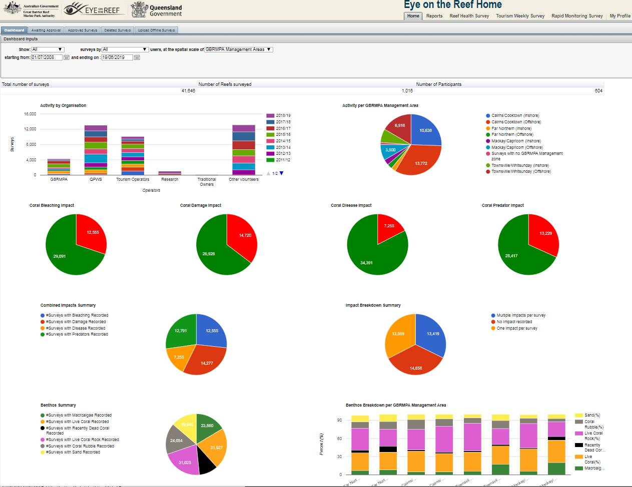
Teacher Dashboard

Slide 24
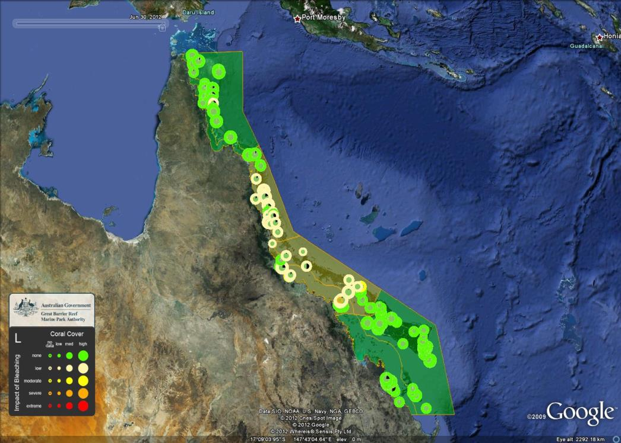
Management View
Results can be presented spatially and temporally using time aware KMLs to illustrate the severity and extent of impacts to inform and target management actions.

Slide 25
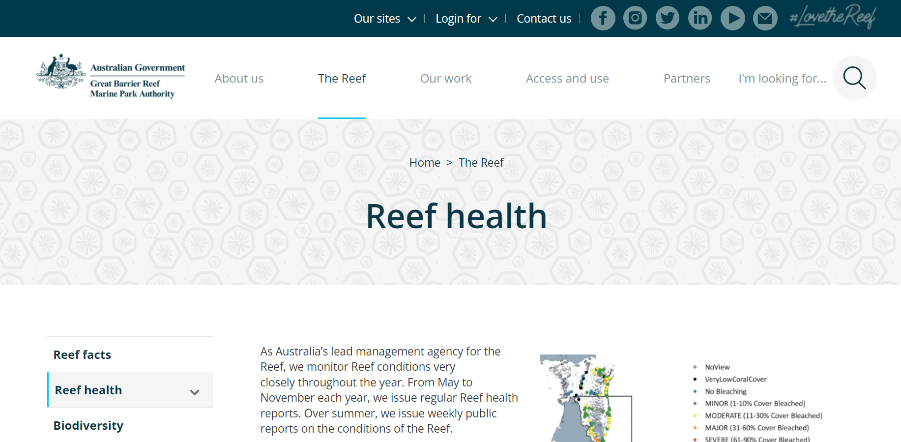
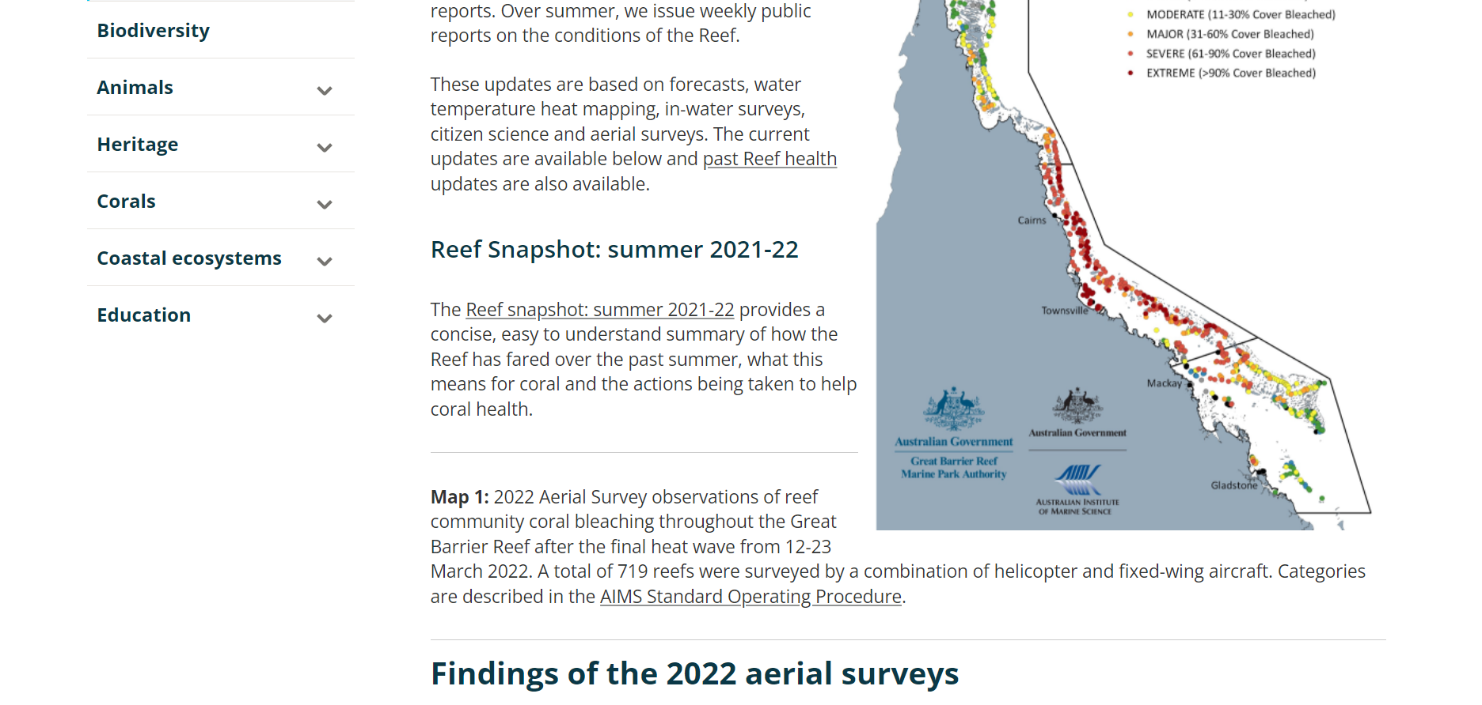
Reef Health Updates
Notes:
Current Status of the Reef and where to stay up to date.

Slide 26
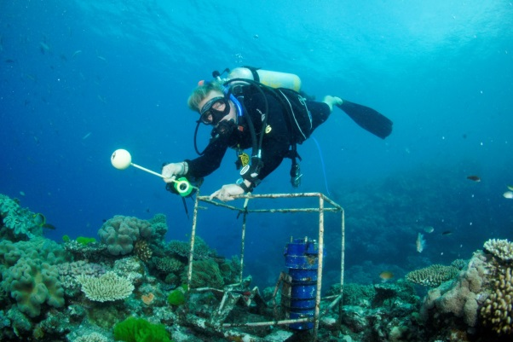
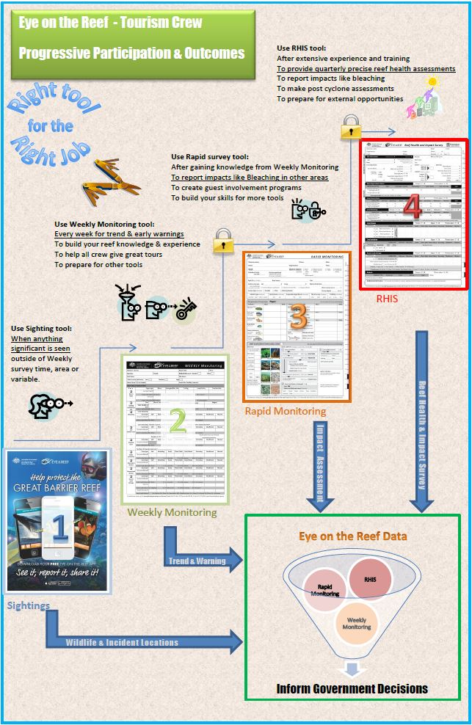
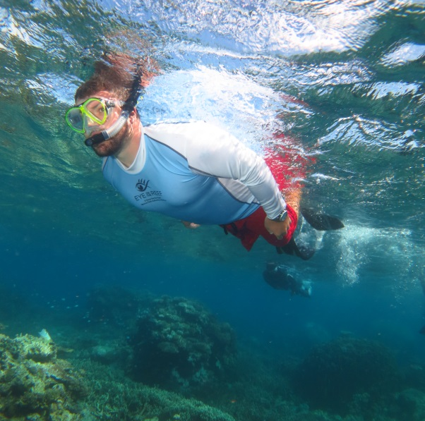
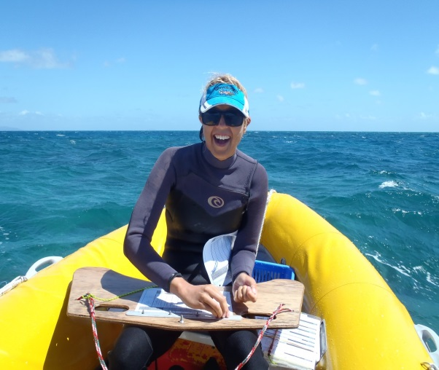
Example Champions
Reef Magic: Moore Reef
Eric Fisher has 7+ years of continuous trend data and is now a PhD candidate studying fish spawning aggregations.
Passions of Paradise: Michaelmas Reef
Russell Hosp has contributed much of the 6+ years of data, particularly on early COTS impact and is now expanding into immersive experiences for guests.
Wavelength: Opal & Tongue Reef
Emma Scott has contributed several years of data from multiple sites and now also works at JCU TropWater and on QPWS surveys for COTS.
Notes:
Crew that stay longer in industry can build their capacity through the different survey methods…. But an over-arching Reef Guide approach is needed….Fiona will speak on that at the end.

Slide 27
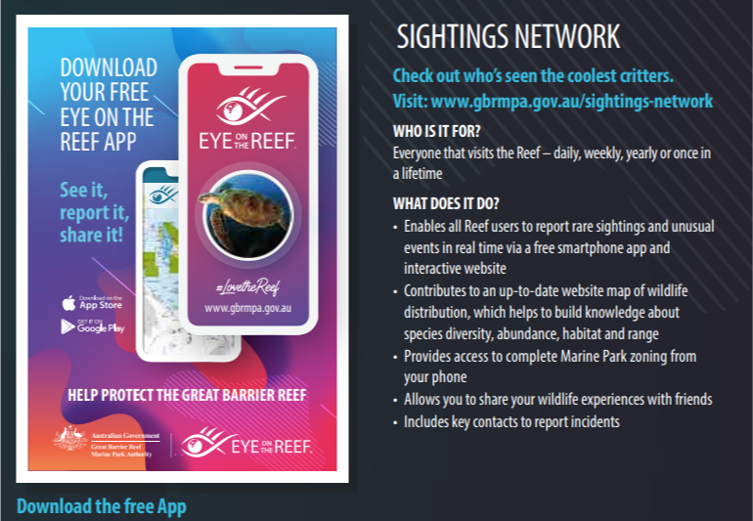

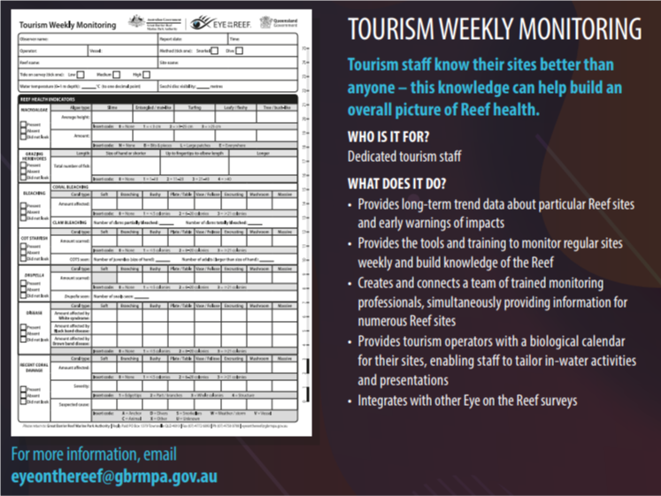

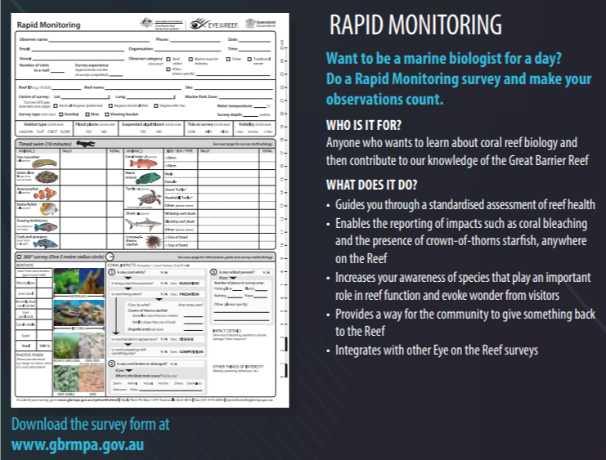
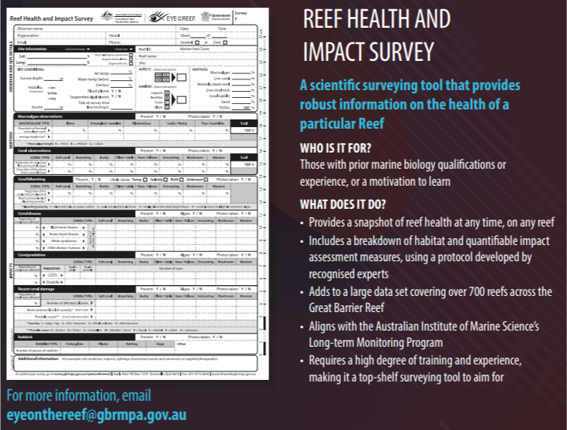
Little to no training required
Adapt tourism weekly to community weekly for the island??
Online and in-water training provided

Slide 28


