Slide 1
AIMS research and data relevant to Monitoring on Magnetic
Libby Evans-Illidge

Slide 2
Acknowledgement
AIMS acknowledges the Traditional Owners of the land on which we meet today, and pay our respects to elders past, present and future.
We honour their continuing culture, knowledge, beliefs and spiritual relationship and connection to country.
We also recognise Aboriginal and Torres Strait Islander peoples as the Traditional Owners of the land and sea country on which the
Australian Institute of Marine Science works, and as Australia’s first scientists.
Through collaboration and two-way knowledge sharing, we can learn from each other.

Slide 3
Overview of this presentation
About AIMS data holdings (relevant to Yunbenun)
  Data catalogue
  Weather stations
  Reefs under survey
ReefCloud – useful open-access platform for monitoring data
Coral cores from Yunbenun
What is helpful to community monitoring here?

Slide 4
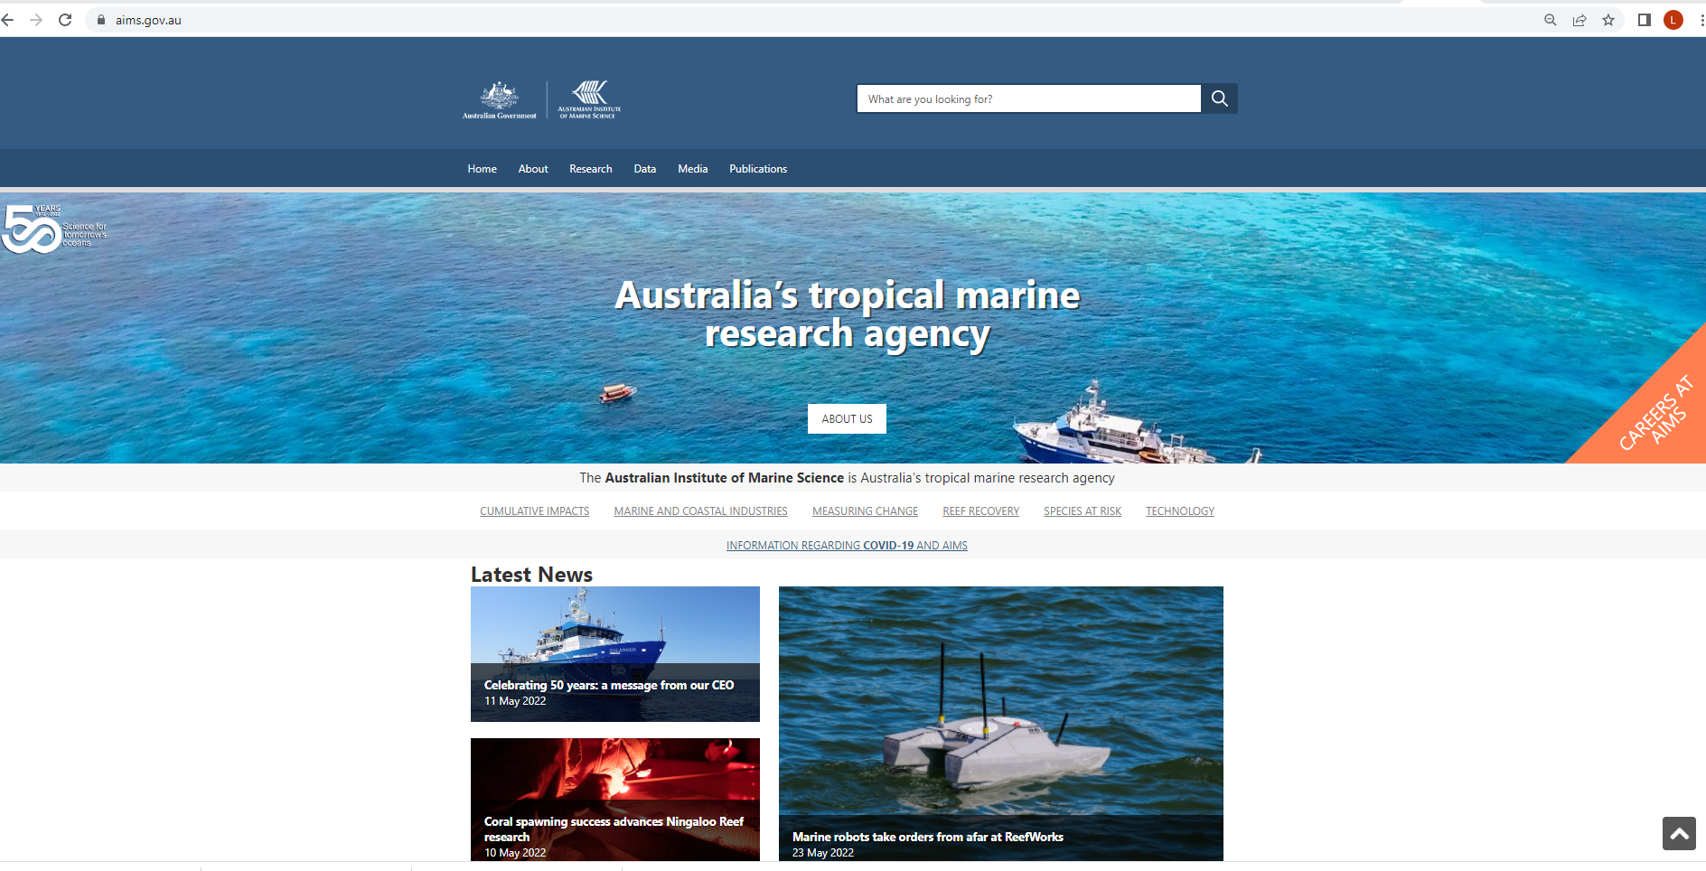
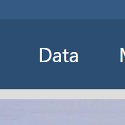
How to find out about data holdings at AIMS
www.aims.gov.au

Slide 5
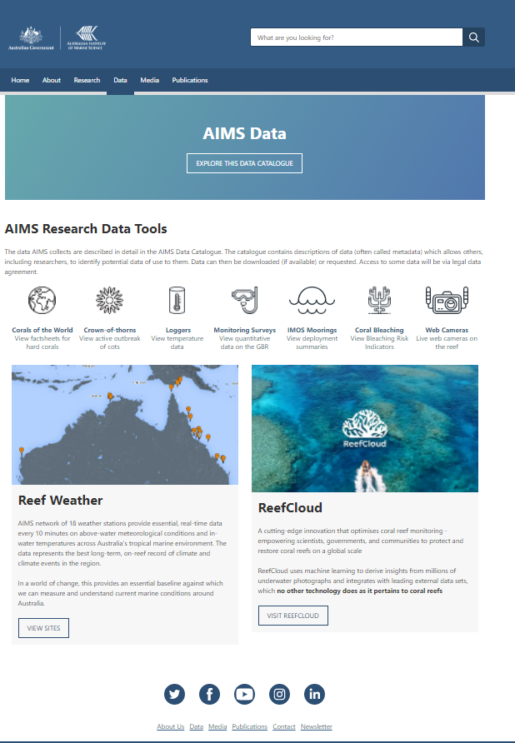
Data catalogue via a map
Reefs under survey
Weather stations
The ReefCloud

Slide 6
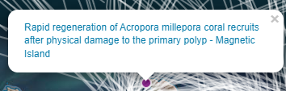
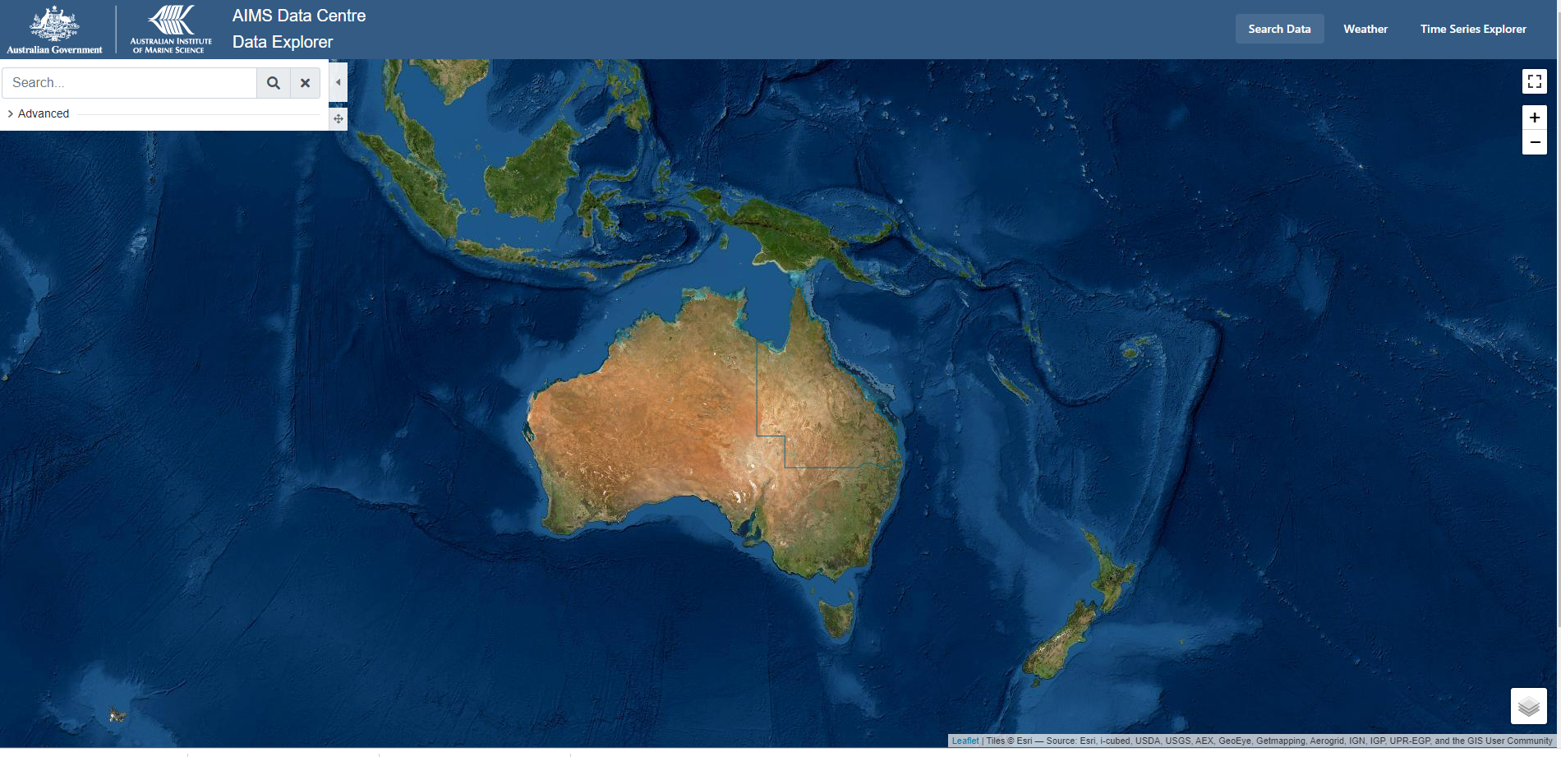
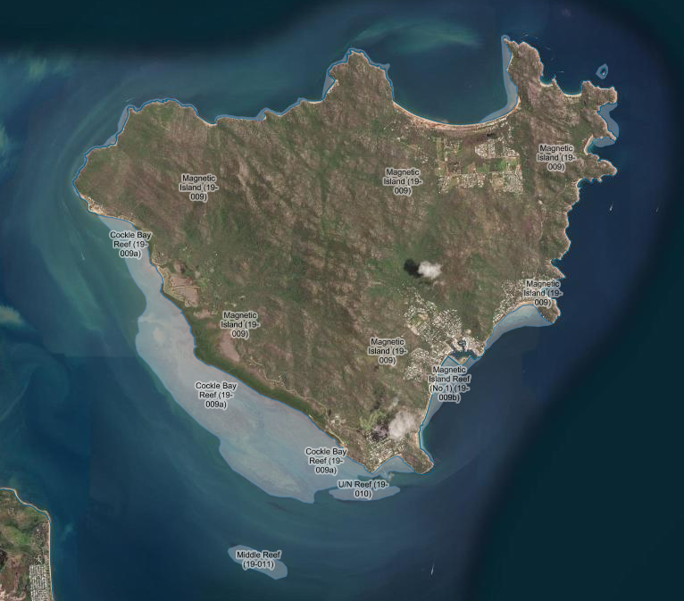
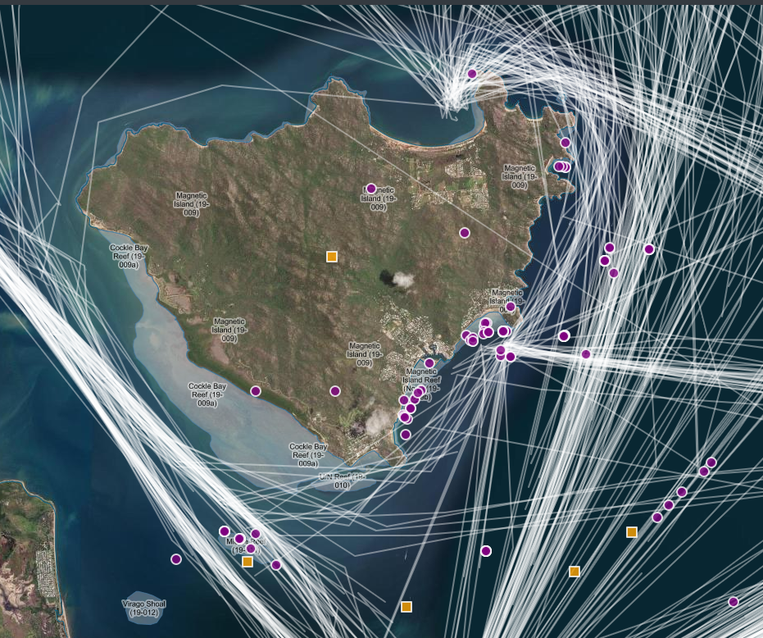
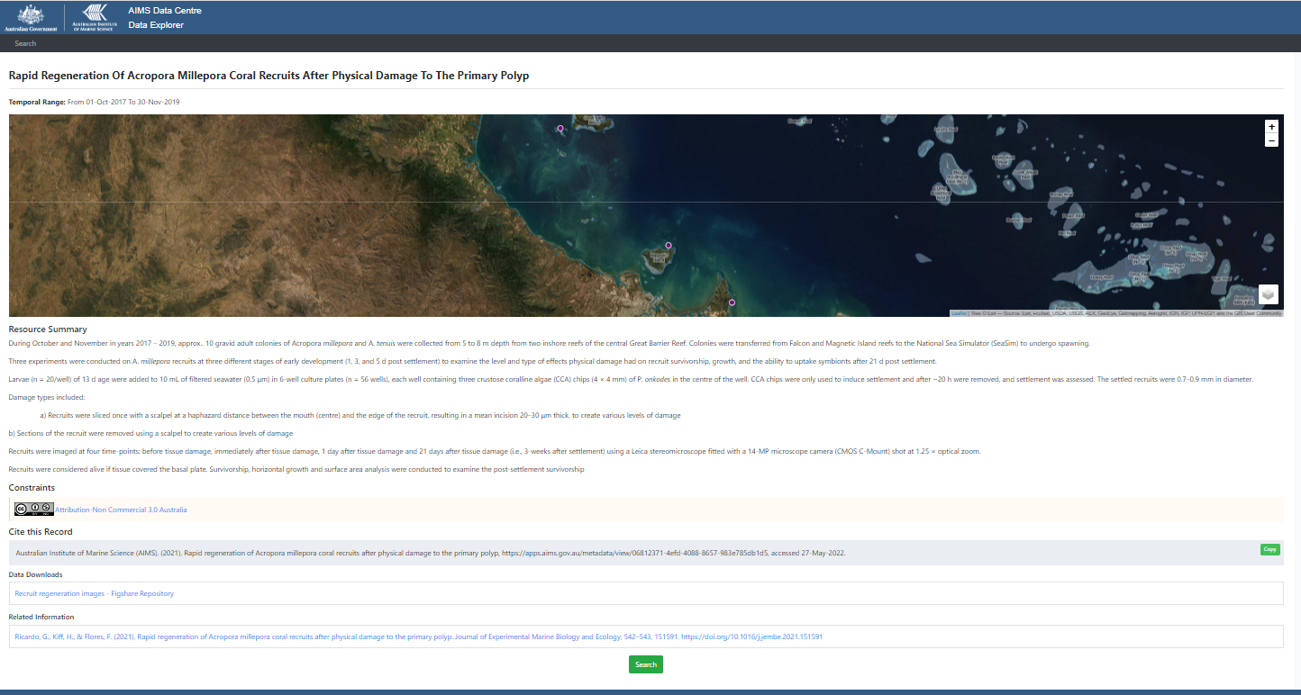
AIMS Data Explorer

Slide 7
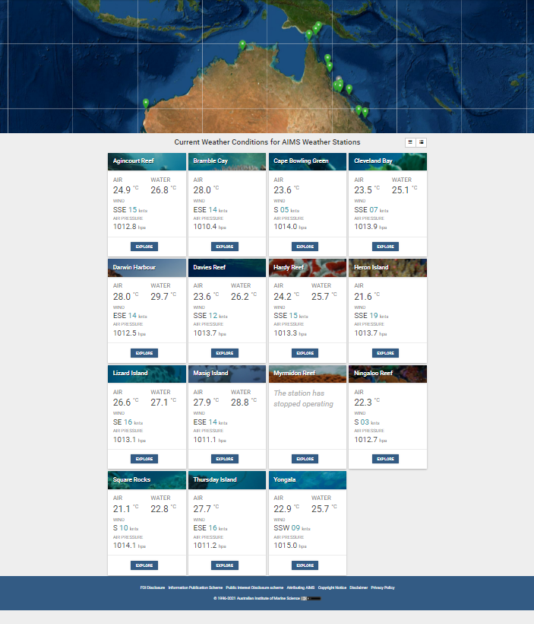
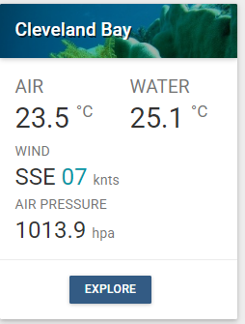
AIMS Weather Stations

Slide 8
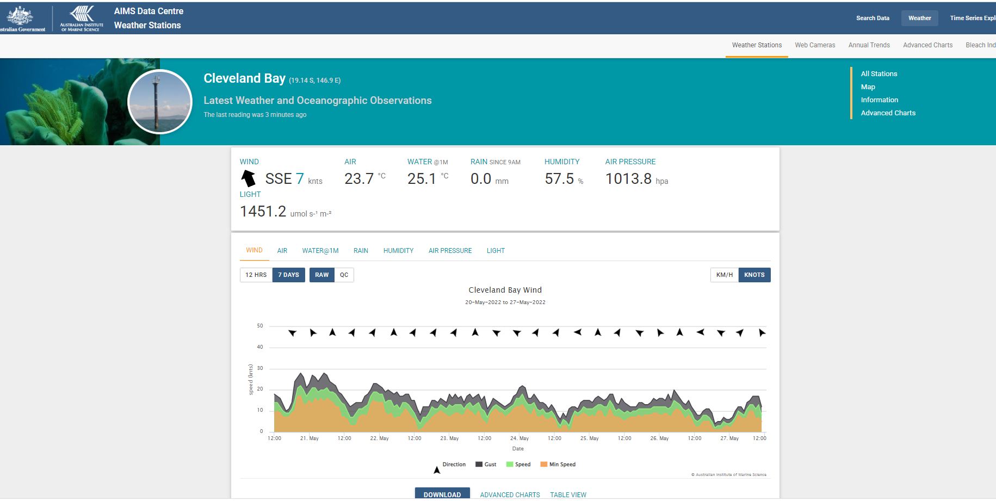
Explore/download data through time from 1990
(temp, wind, rain, humidity, air pressure, light)

Slide 9
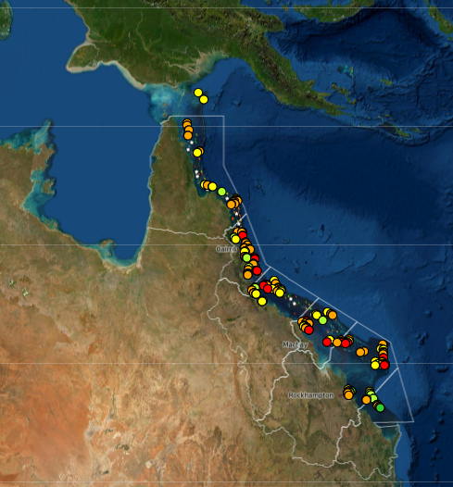
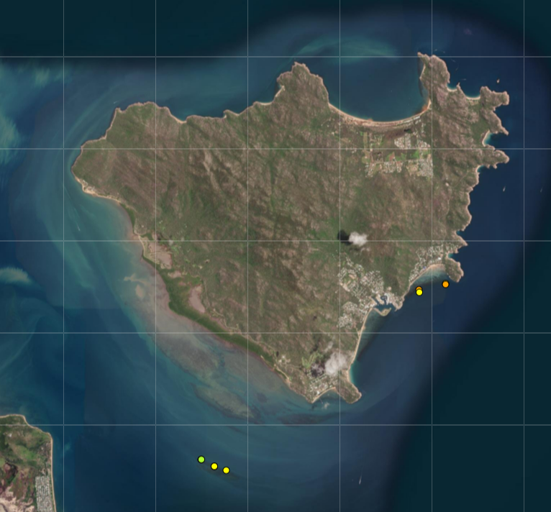

Reefs Under Survey – Inshore Reef Monitoring (GBR Marine Monitoring Program)

Slide 10
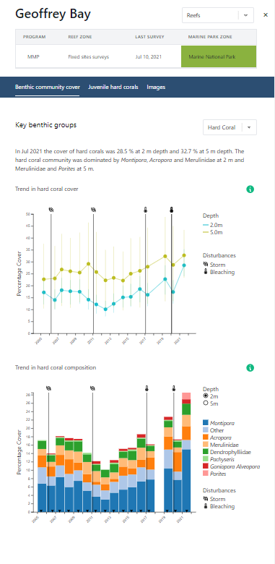
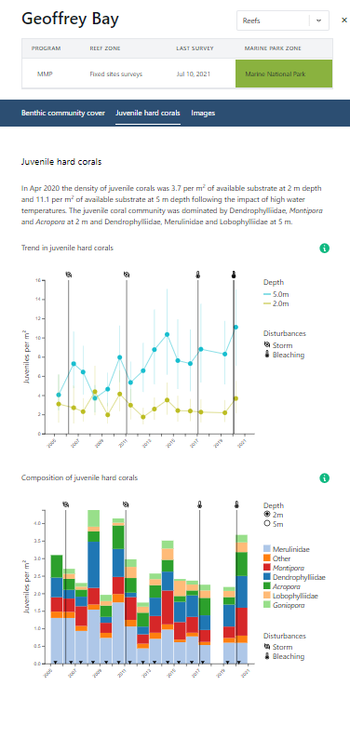
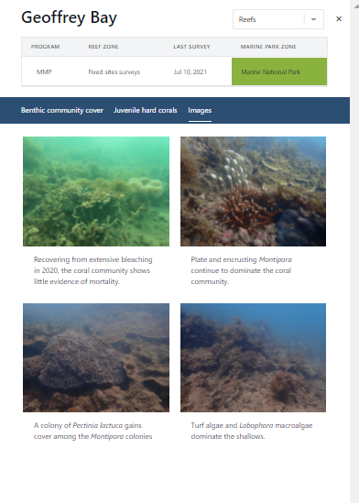

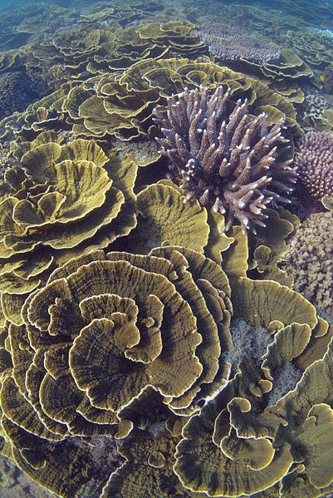
Site Specific Data

Slide 11
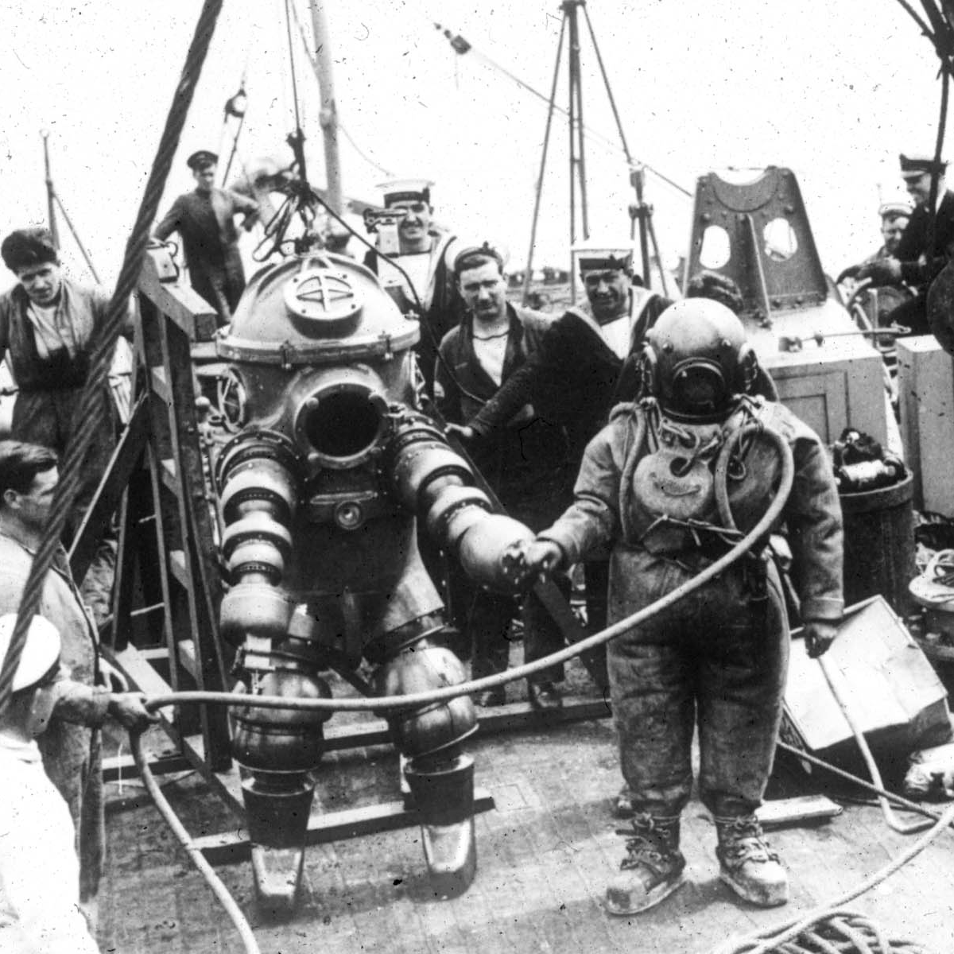
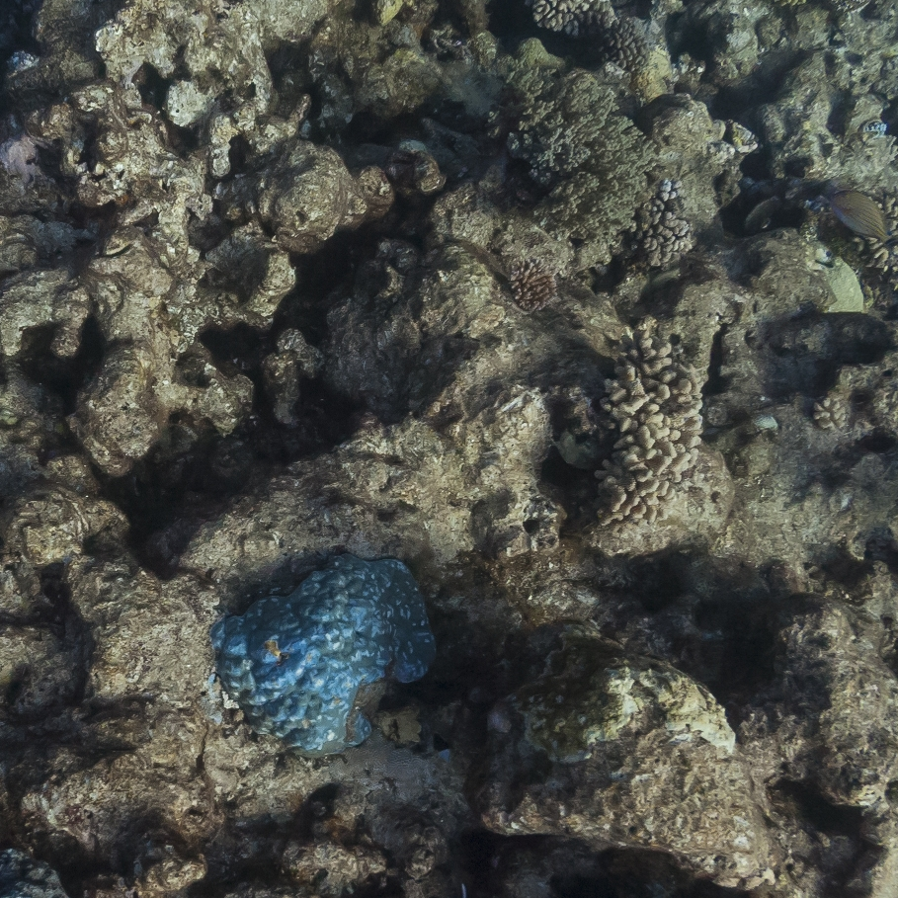
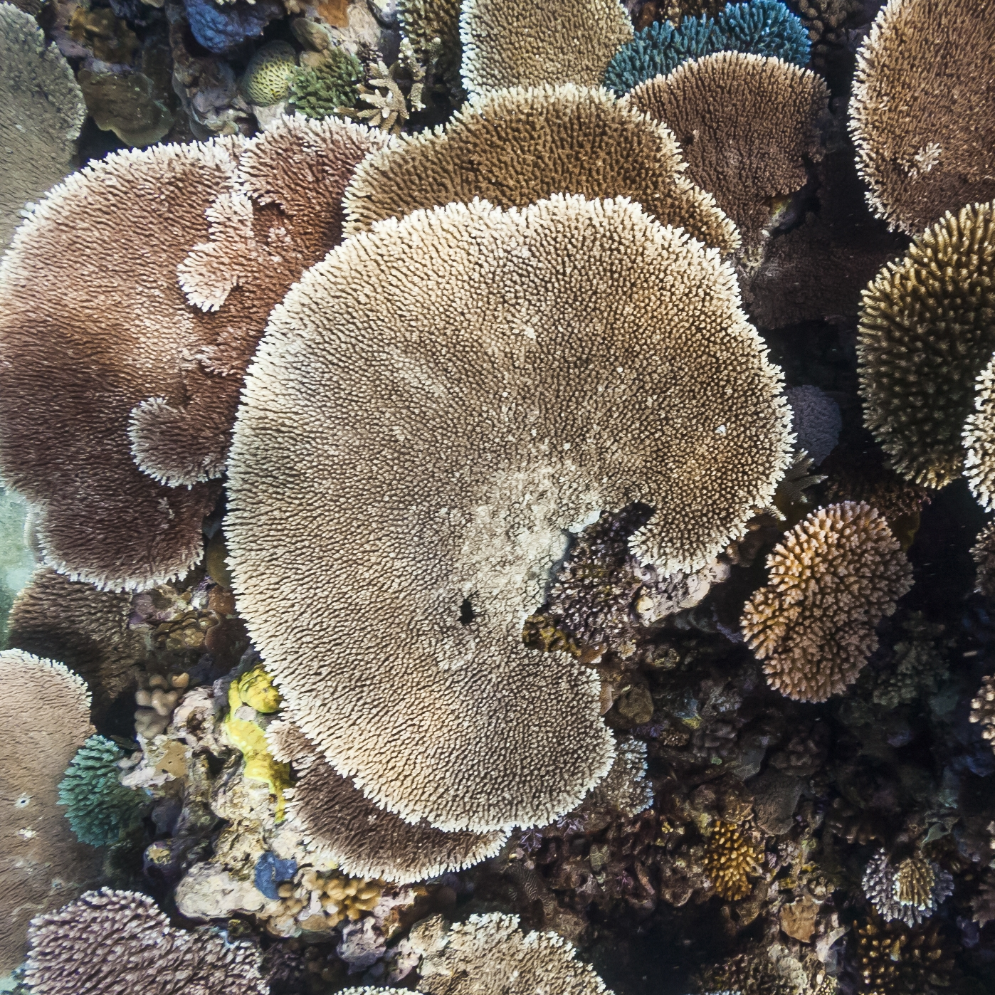
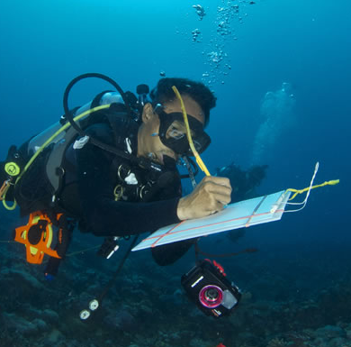
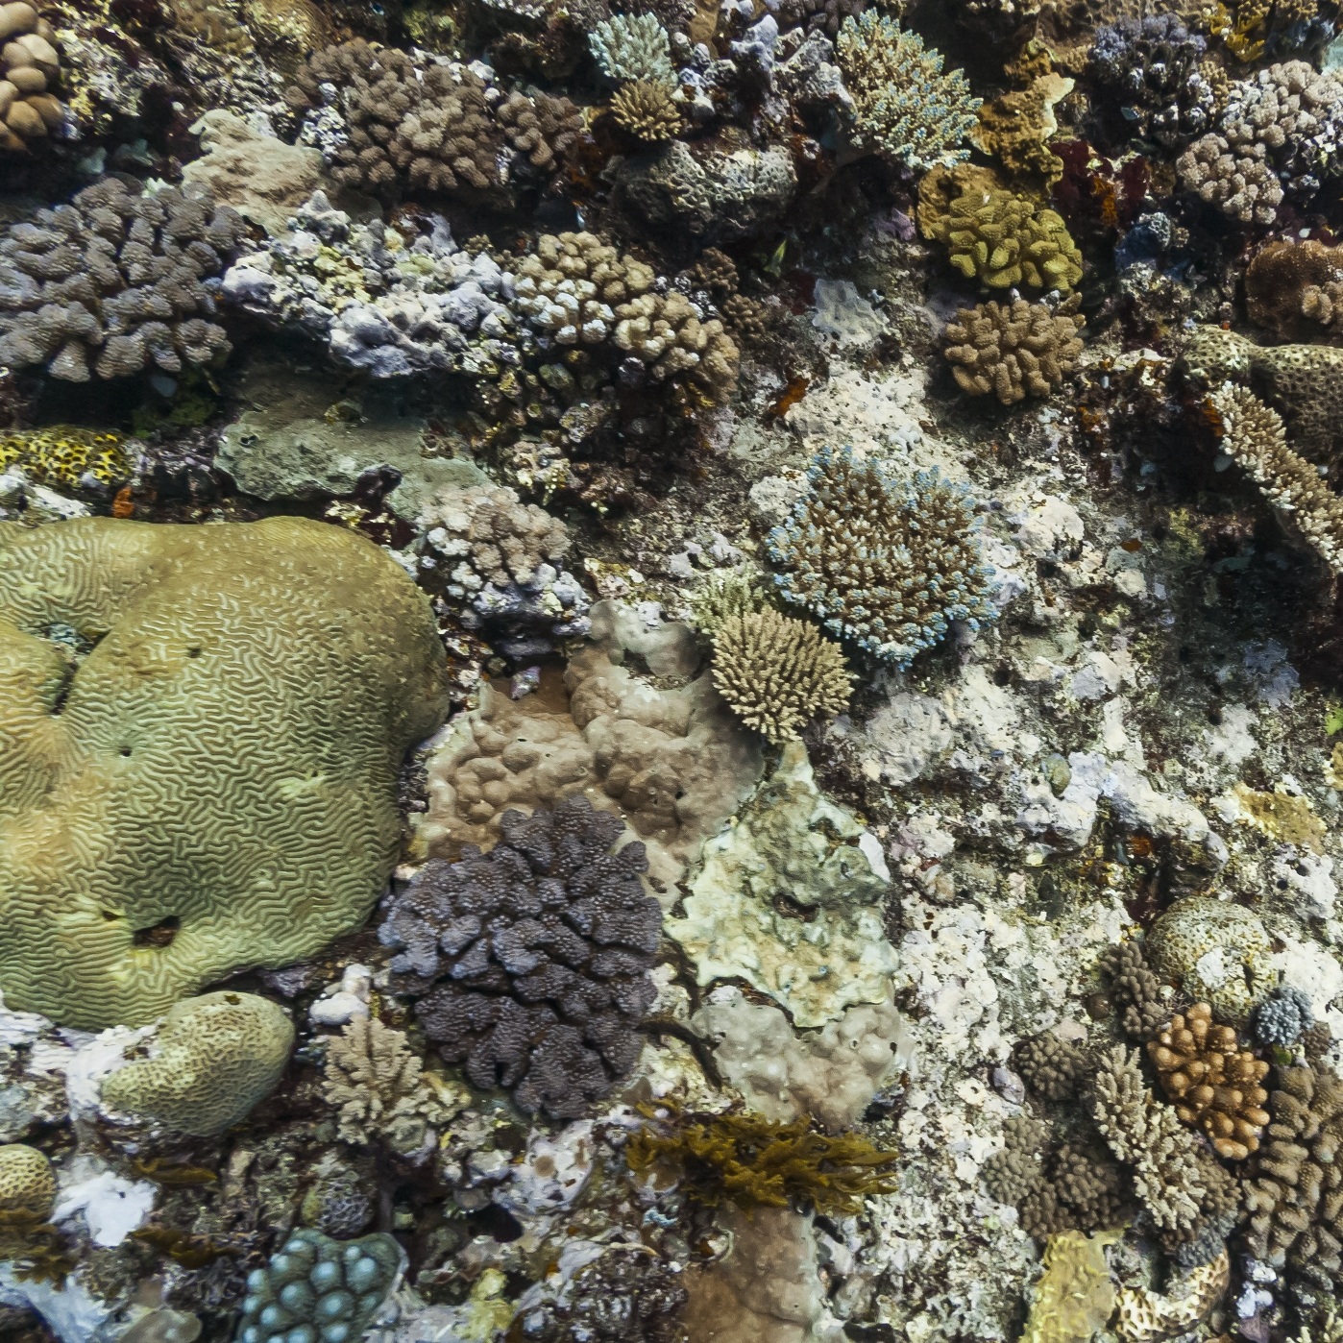
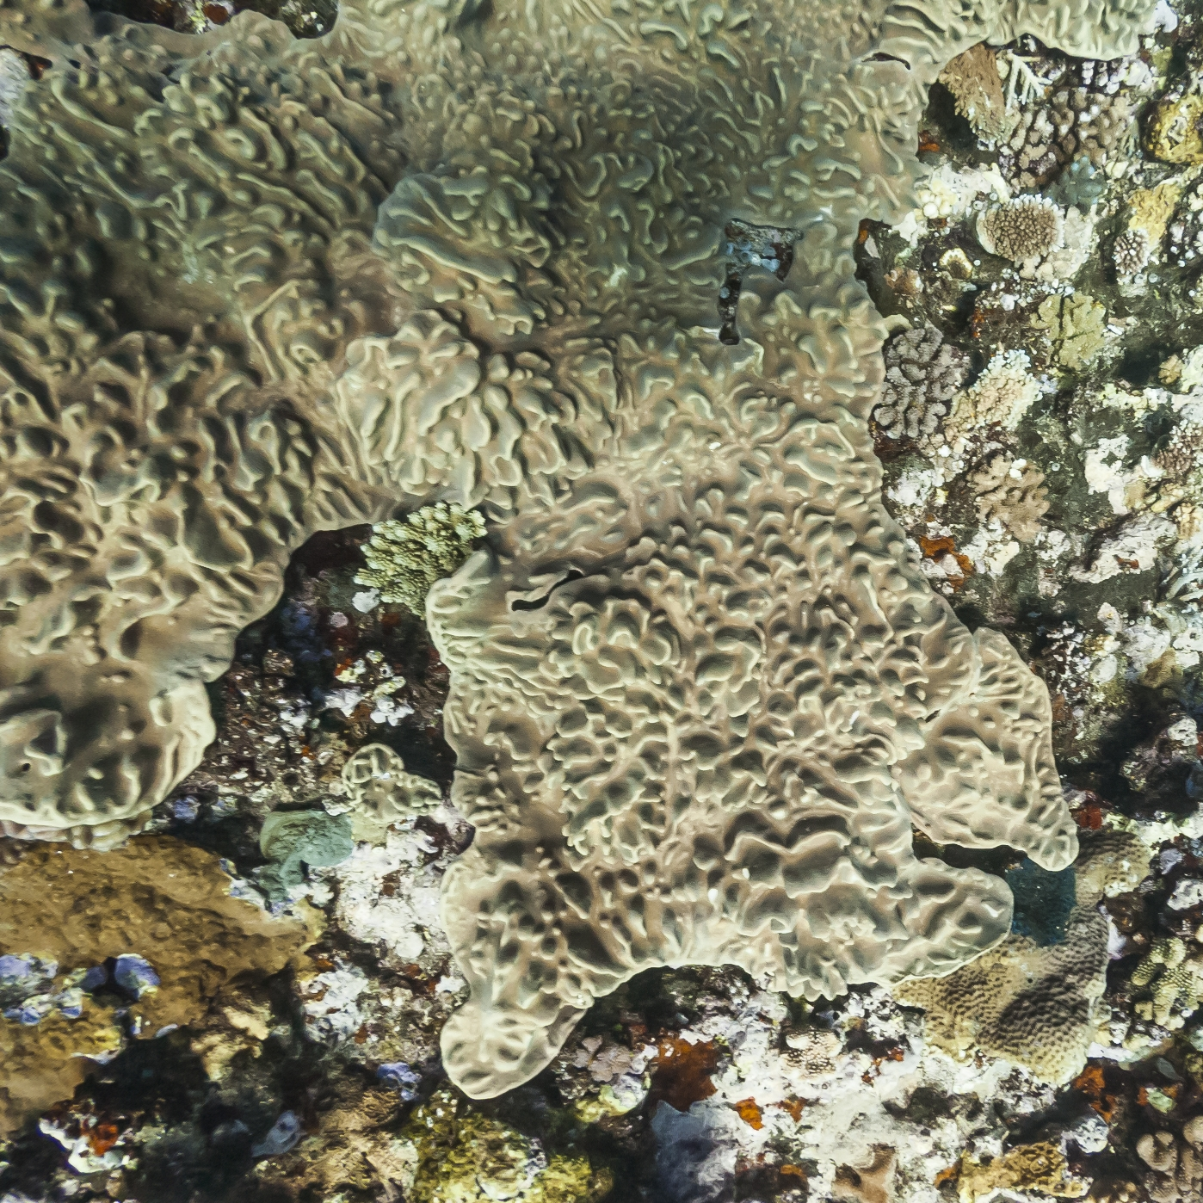
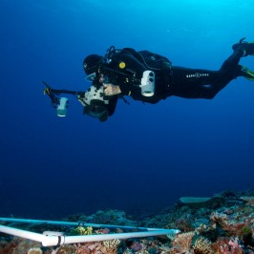
Reef Cloud for modern reef monitoring
Digital
Underwater
Photography
Quick
Easy
Standardised
Permanent
Detailed
60% of monitoring
Notes:
The way we keep an eye on corals has changed a lot over the last 50 years.
At AIMS we used to do standard surveys, where scuba divers get in, swim along a transect and write down what we see but taking us so long underwater and sometimes team member got sick
Digital photos – revolutionsed record and volunteers collect.
Standard data format – pictures – that can be shared with everyone in your team
Permanent record – so instead of remembering what you saw, you can go back and check – we got interested in Sea Cumcumbers and went back through our photos to check them all
Quick and viable method for collecting data – we don’t have to get in the water anymore, can drag a tow-camera behind the boat
Do not required high-specialised training – means anyone can get involved.
Every photo contains a wealth of information – lots of species of coral in that photo alone
So digital photos have been great because now not limited by how long stay underwater. Monitoring teams all across the planet are switching to using photos and 60% of people surveyed recently use photos – take more and more photos and gather more and more information – but gathering more information comes at a cost

Slide 12


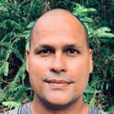
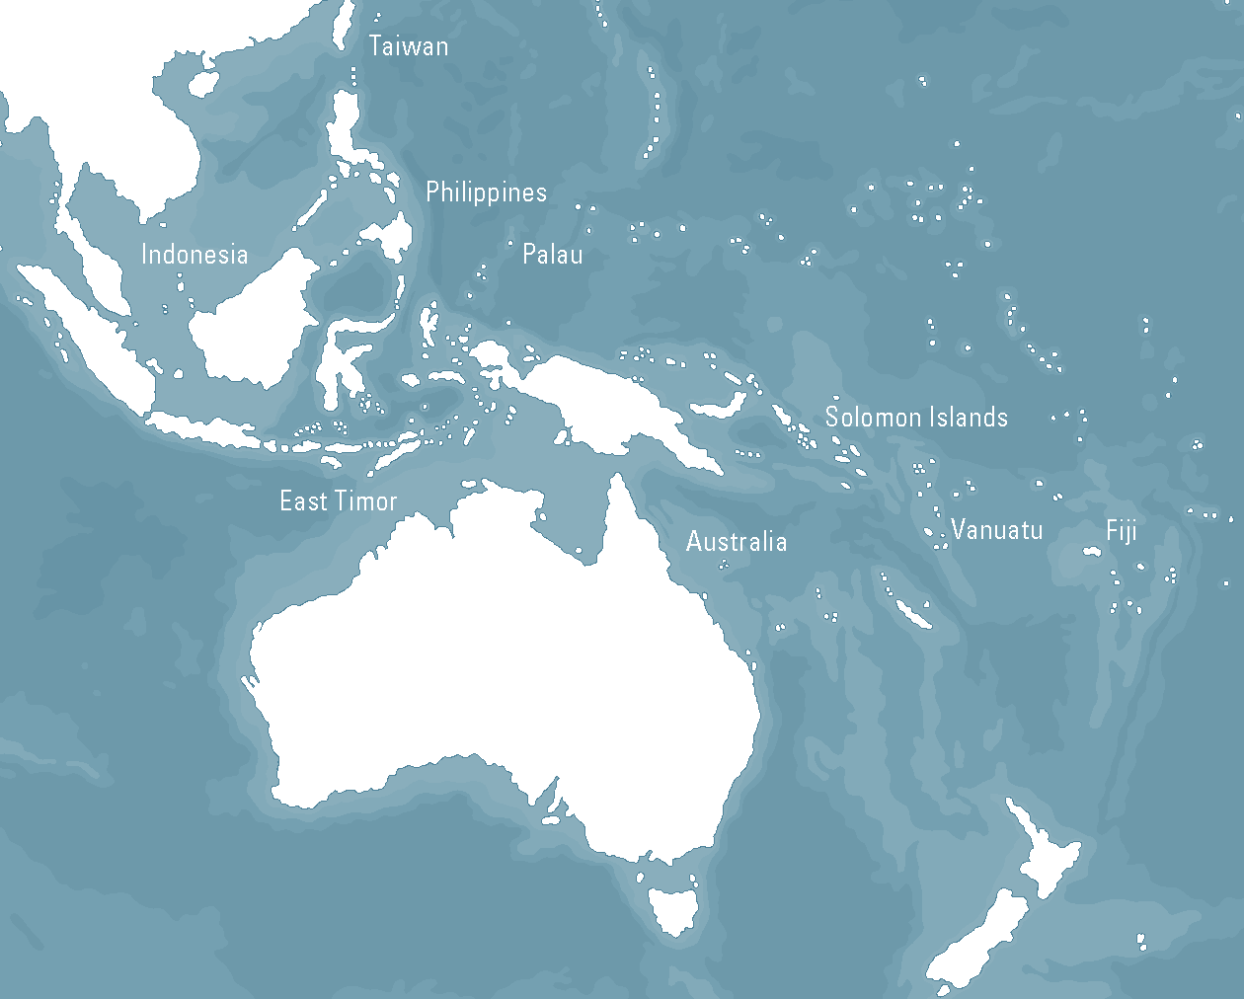
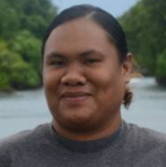
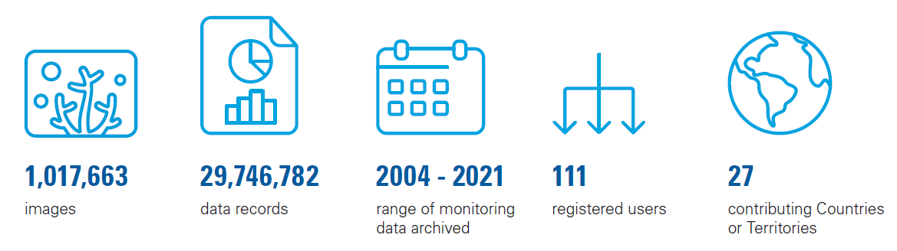


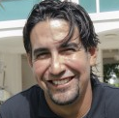
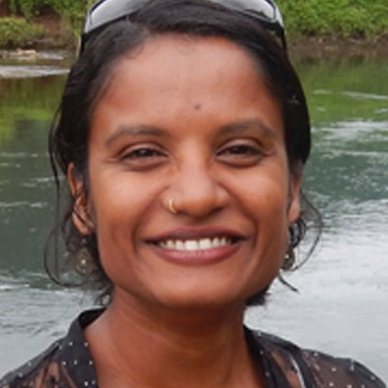

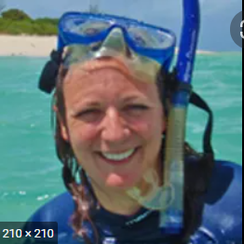
A big collaboration
Central Munda Rangers
PICRC
Bardi
Jawi
TSRA
AIMS
WCS
ReefCheck
C2O
Notes:
Of course we didn’t do this on our own – we wanted ReefCloud to be something that was useful for everyone, so we asked our friends to help us. They’ve been testing it and making sure it works for them too. Some of the groups testing do very similar monitoring work to us
Uly, she’s from Palau International Coral Reef Centre, which is federal government monitoring facility similar to AIMS, but in Palau. They had a few things we changed with the
NGOs like WCS in Fiji are helping us – even working with ecoresorts – Yashika is the science director for Fiji coordinates WCS team of surveyors
We also wanted to make sure this would work, so working with Alec in the Solomons who helps manage a network of community groups who managed over 150 square kilometers of resilient coral reef and lagoonal habitat in Western Province, Solomon Islands – Central Munda Rangers
Under NAMMA have been seeing if ReefCloud can help analyse data collected by Bardi Jawi, and by the Torres Strait Regional Authority (TSRA) land sea management unit
Finally citizen science groups like ReefCheck are trialling some of
And this is just a small proportion of people helping us. BUT still in development

Slide 13
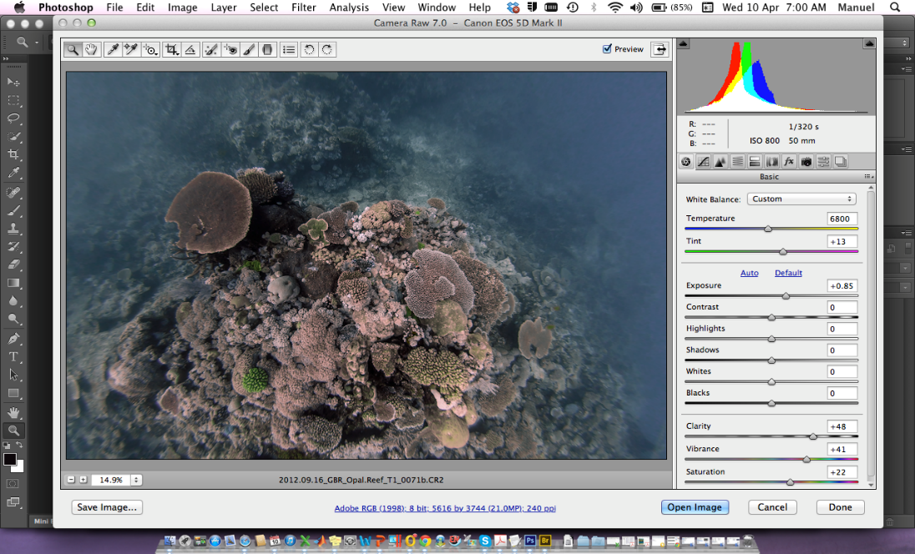
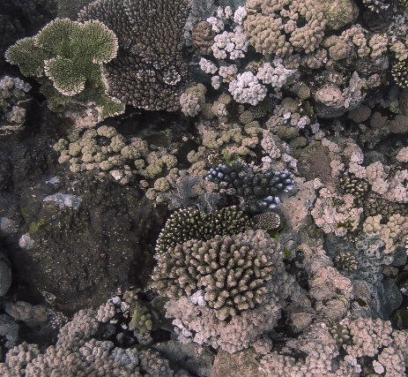

Big data
Machine learning
Cheaper
Faster
Machine
Human
Machine
Human
Just as smart
Acropora coral
Cheaper
Faster
Soft coral
Just as smart
Pocillopora coral
Sponge
Machine
Human
Machine
Human
Notes:
Because its a lot of work to extract information about the health of the reef from a photo.
For our team to go through one photo from the reef and look at everything in that photo would take about 10 mins
But sometimes we’d collect 100s of photos per reef – and we were generating too much information – it was taking us years and years to
Reached a critical bottleneck. Essentially dvances in gathering information tools challenge data processing capacity
Needed a way to make this manual process automated – this is where scientists at AIMS used deep learning neural networks and image recognition technology to train a machine to recognise different coral species, and help go through the photos and pull out information on them.
Machine learning can accurately extract benthic cover information at a rate that is 300-900 times faster than manual methods
The error of machine learning is similar to human error
Cost of machine learning implementation is minimal
High density data and fast turnover of information are key advantages of the using machine learning framework
Then test the machine against a person
Looking at key indicators of reef health – algae and coral, automated analysis vs manual annotation

Slide 14
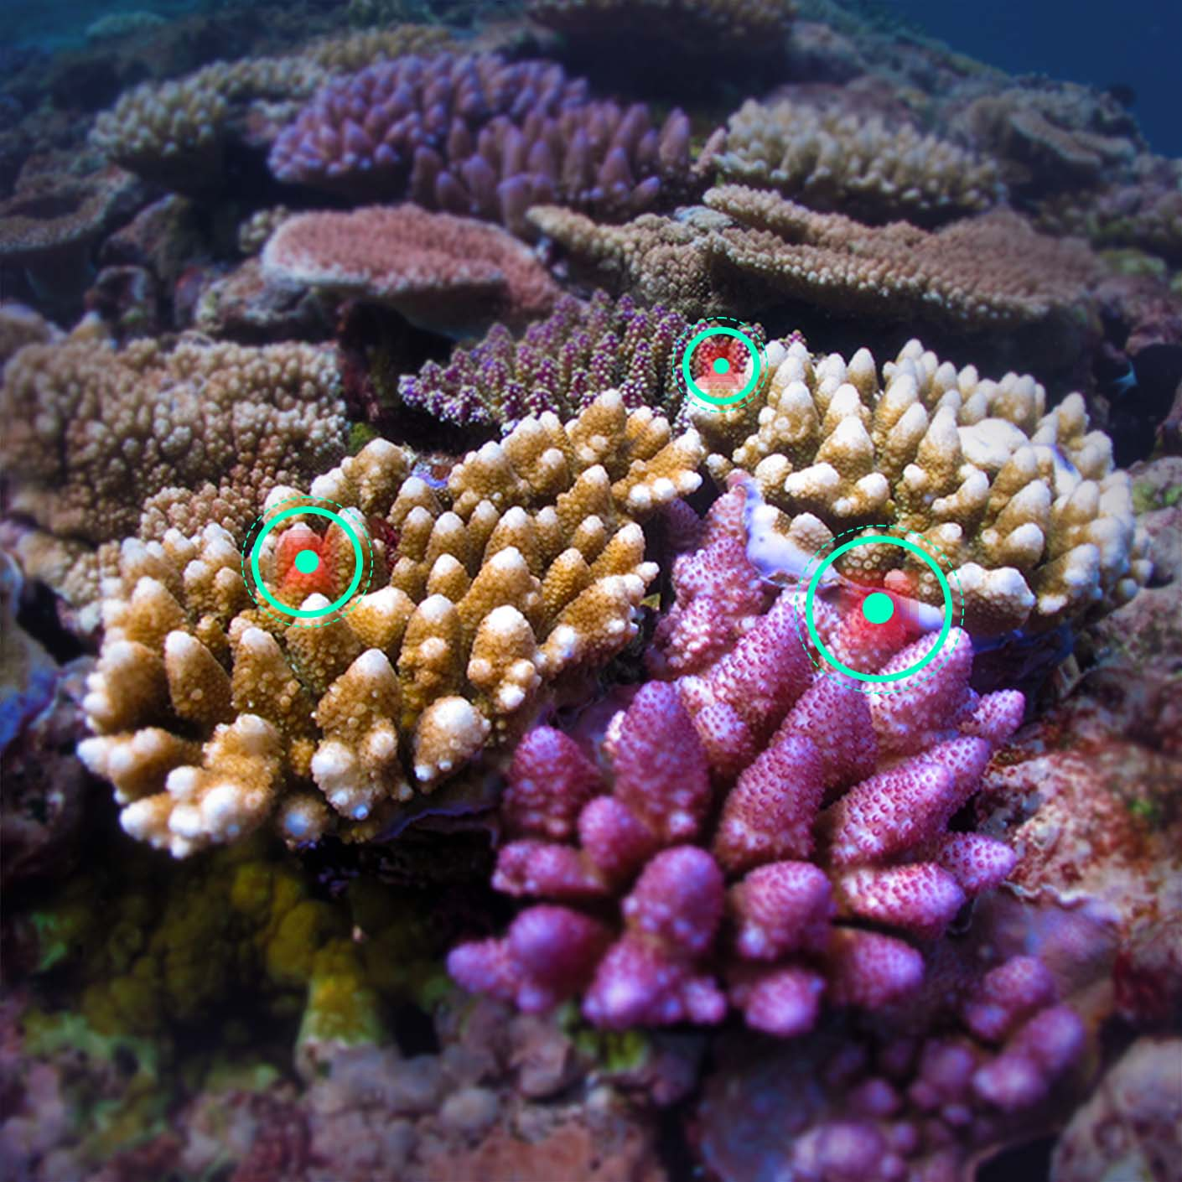




ReefCloud
Manage imagery in the field
Analyse with manual and AI tagging
Automate analysis and reporting
Image and data safety and access controls.
Notes:
Of course, as more and more people using photos this is a problem for everyone, so we wanted to share what we made with everyone, which is how ReefCloud came about: put this technology online for everyone to use.
ReefCloud does a bit more than that, it also acts as a manager –
so a safe place to store and organise all your photos
Has the machine learning component to help analyse all your photos
And finally also helps produce graphs and summaries of all your photo data

Slide 15
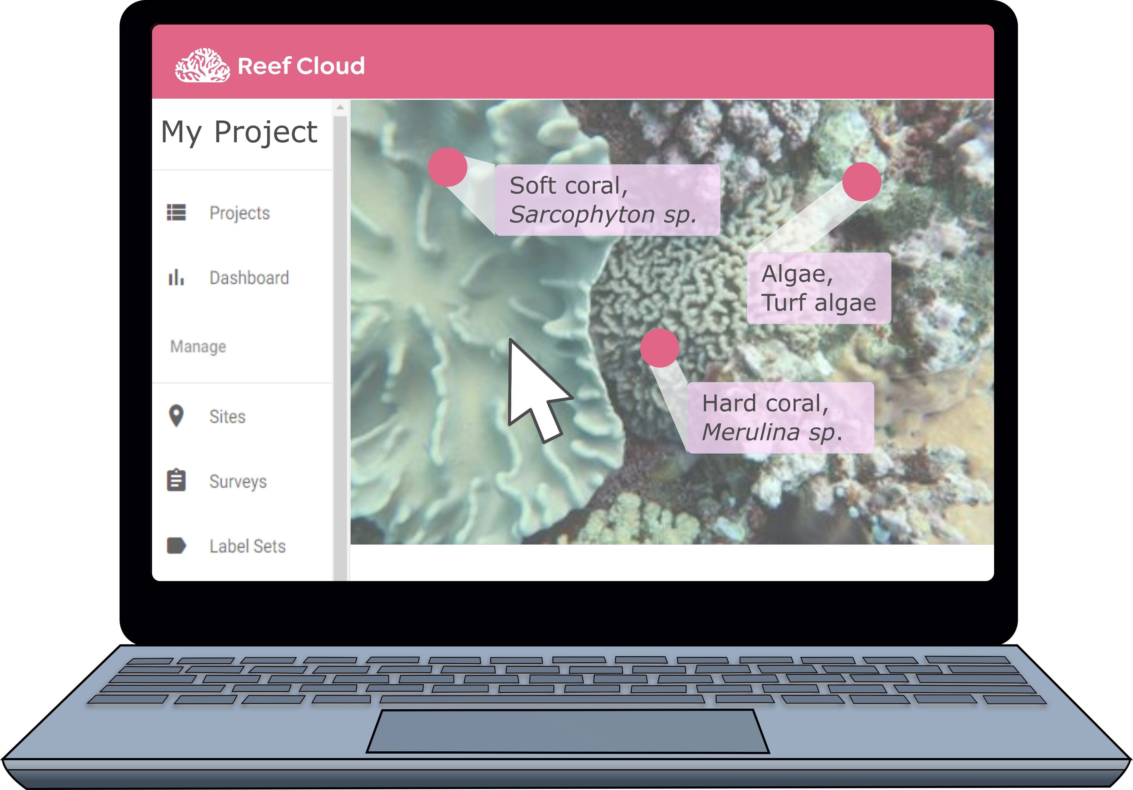
How does it work?
Four easy steps
Step 1: Get Started
Create an account
Set up a project
Add users to your team
www.reefcloud.ai
Notes:
What if you wanted to try using ReefCloud?
Yes, four easy steps for using ReefCloud.
Step 1 is getting started.
Simply registering online for an account – completely free to use.
Set up a project, following the prompts – big red “help” button in top right with instructions. Your project is private place you can store and organise your photo data, and train a machine to help you analyse your photos in the way that you want.
Add users to your team – these are the only people who can have access to your data, work together to train your own individual machine. Change permissions so they can just view, or edit.

Slide 16
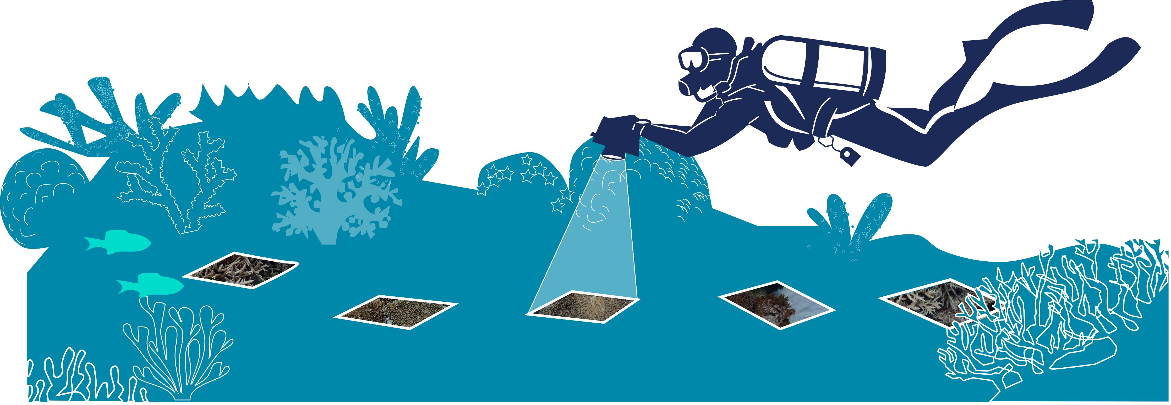

STEP 2
Collect photos
Add surveys to your sites
Upload images
Review your image collection
Notes:
Not going to tell people how to conduct field surveys – lots of different ways.
Talking to our partners – ReefCheck do 4 x 20m line intercept, Allen Coral Atlas swim 500 m taking photos, Torres Strait used dropcams
AIMS we swim 4 50m transects take a close up photo every 30 cm.
Site selection is going to depend on what you want to study – looking for recovery? Long term sites return to? One off bleaching survey.
Important to know where you are…
GPS – or locate on a map and collect GPS data later.
Suggestions to get better results from the machine learning…
Camera has underwater mode setting, better for light – good with cameras can manually adjust ISO
Move slowly to avoid blurry images
Camera downward facing – if on a wall might need to roll on your side so still facing downward
Consistent distance from floor – lots of ways of doing this, could use quadrat of known size, tied a fishing weight to camera so always – either way its good to have an idea of width
Distinguish – maybe on different cameras, maybe use image time stamp later, take a photo of your hand or I like to use an underwater slate.

Slide 17
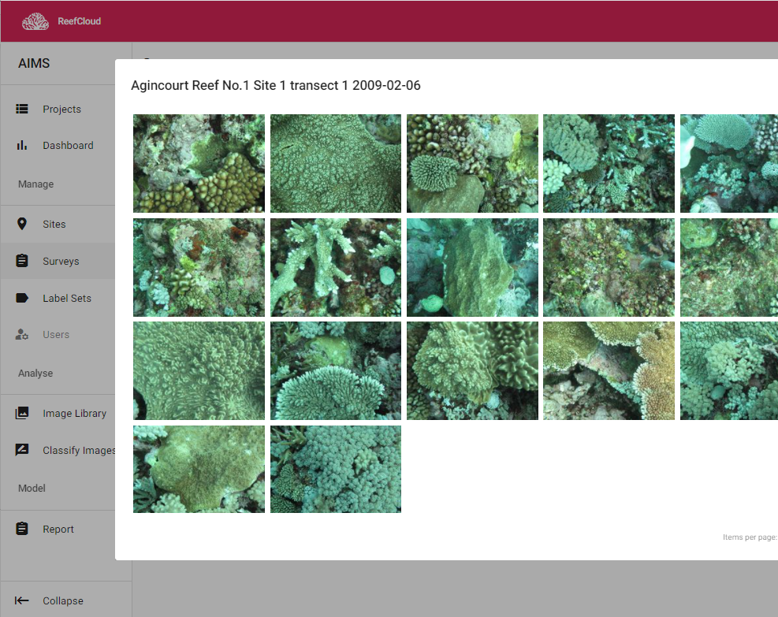
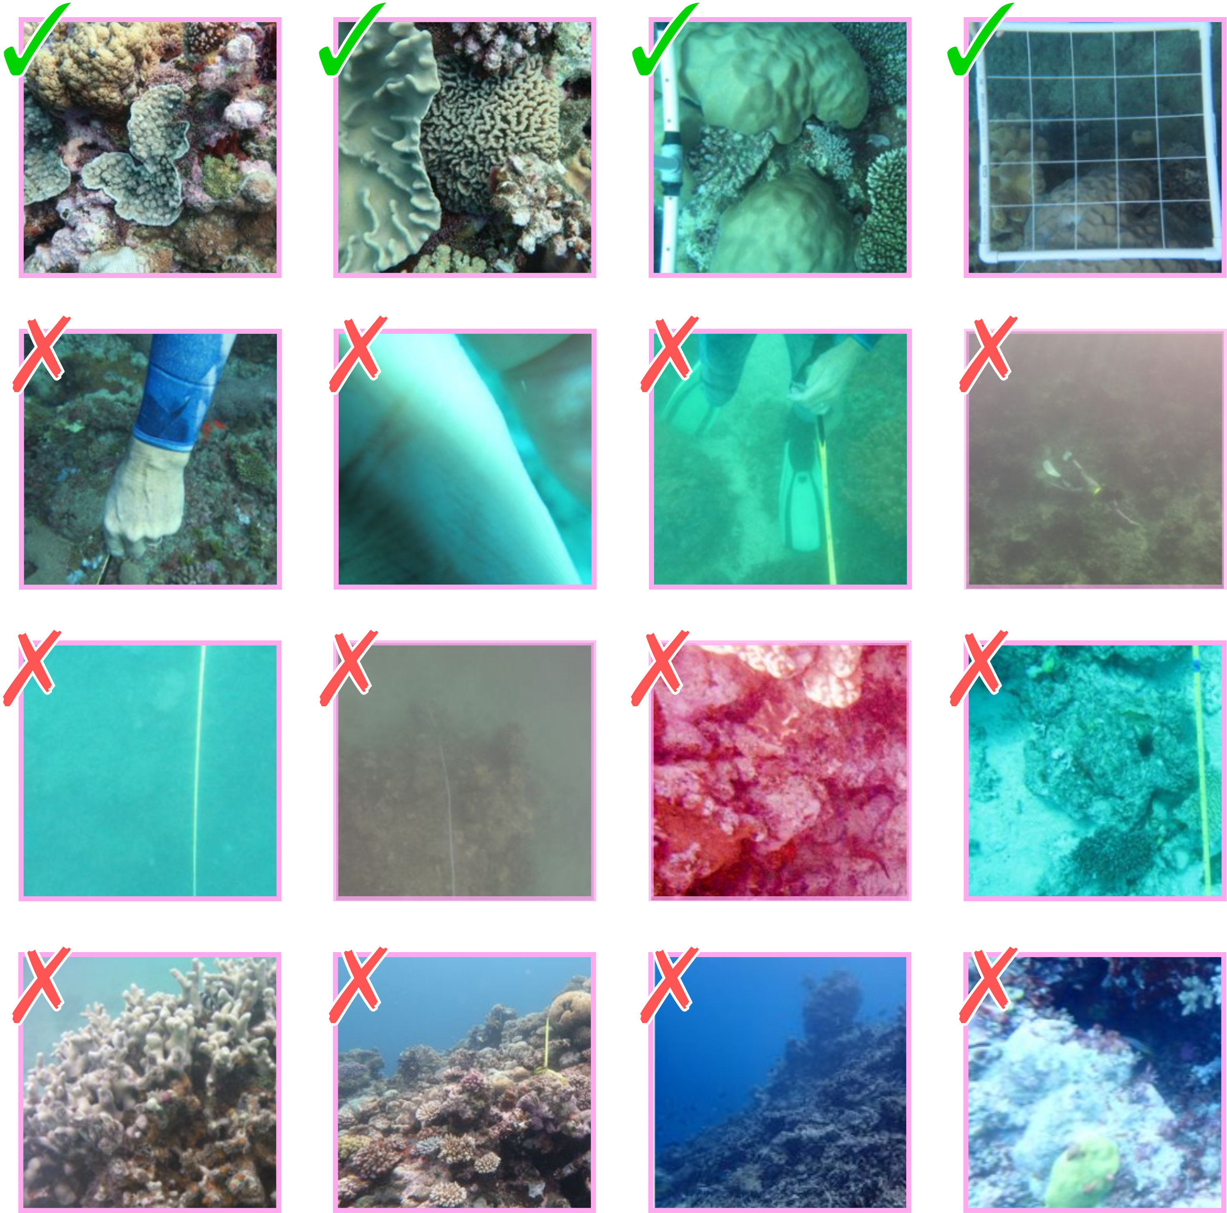
Upload your photos and review

Slide 18
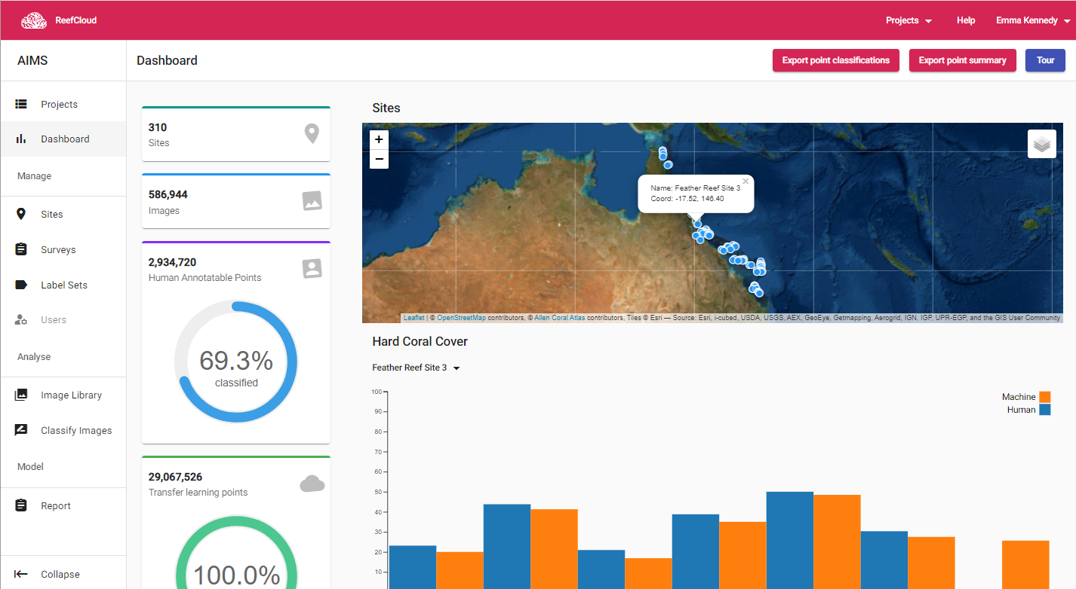
Upload all your photos
View your sites on the map
See your data
Train your machine
Notes:
Part of setting up your project will be
Will need info like Project Name
Sites – one by one or fill a spreadsheet
Labelset – how do you want your data analysed?
Number of points per photo
Privacy

Slide 19
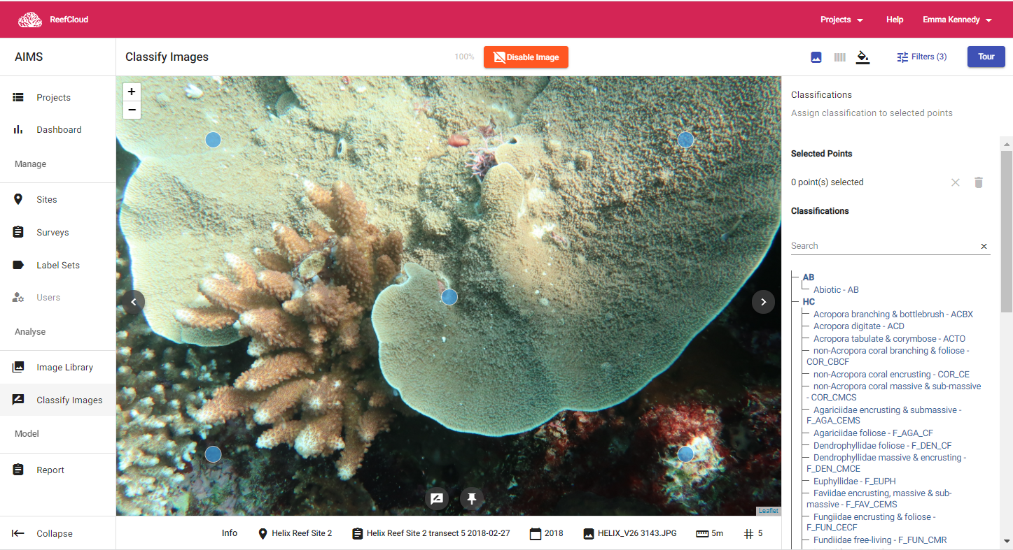
STEP 3
Annotation points
Assign label
Train your Machine
Analyse images
Train AI algorithm
Validate Results
10-20% of points = enough

Slide 20
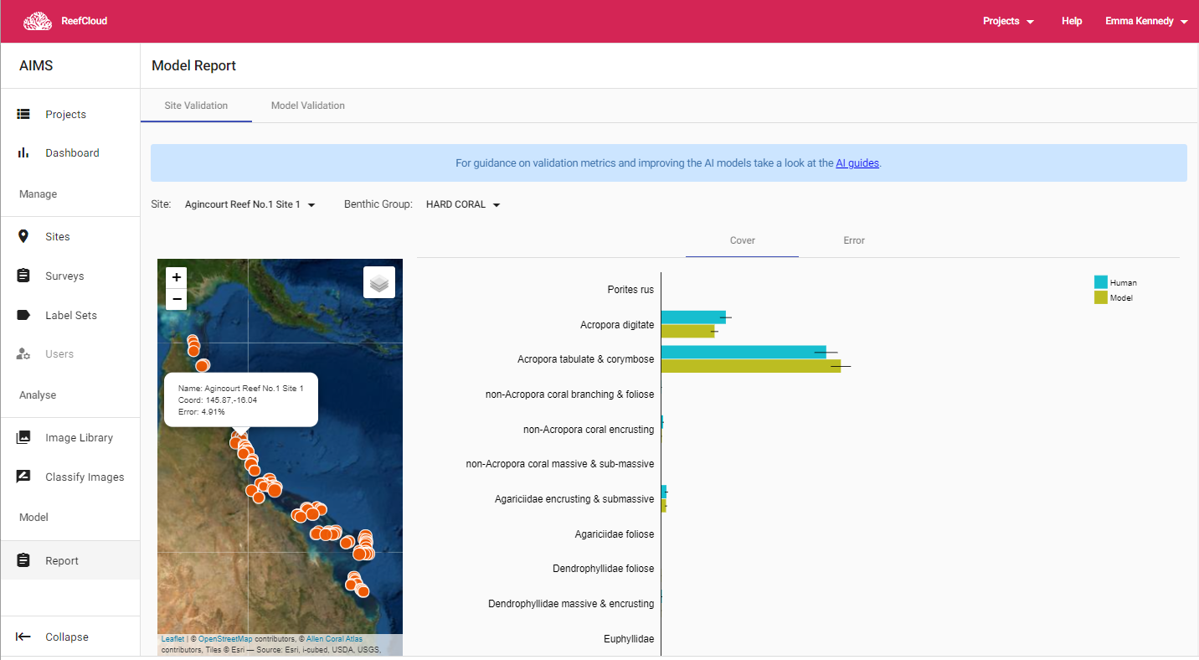
Validate Results
Size of circle reflects agreement at that site
Human estimate vs Machine estimate for each label
Big difference indicates machine needs more training!
Notes:
Key part of this is being able to check how your machine is performing as you go…

Slide 21
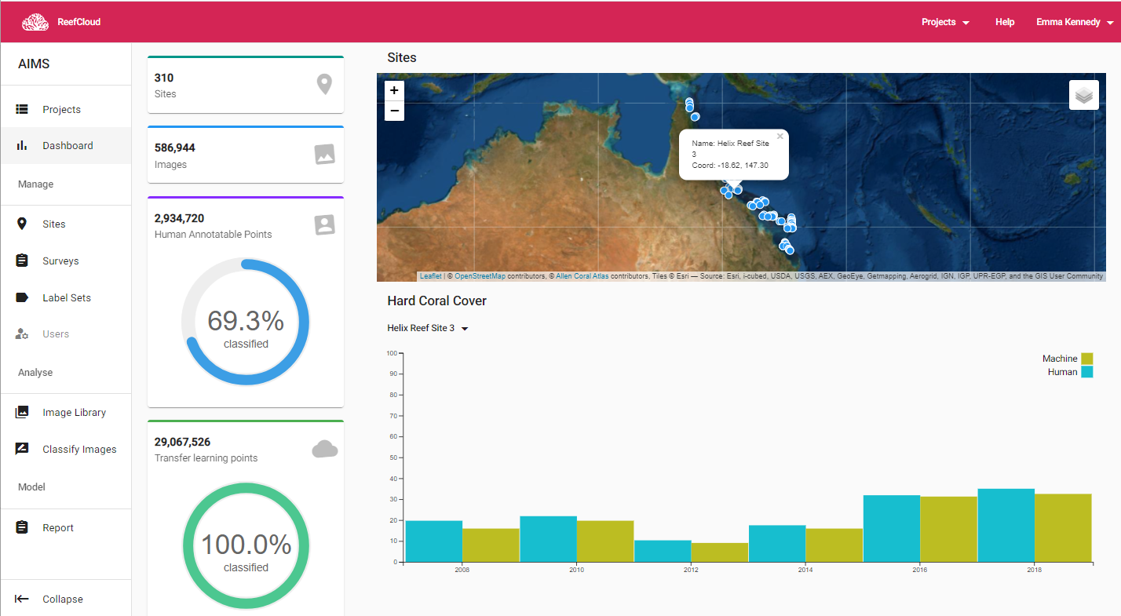

Step 4: get results
View and download your own results
Download full dataset as a .csv
Explore summary data for each site

Slide 22
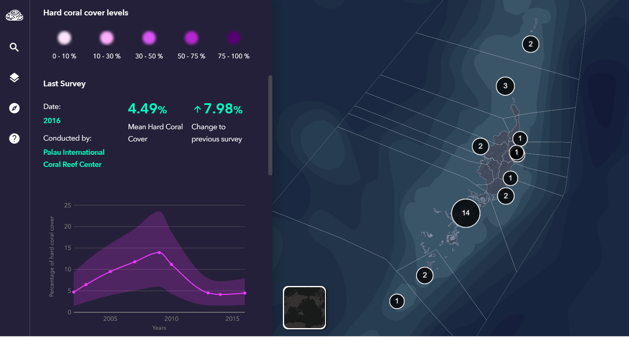
Shows the location of everyone’s data
Shows trends in reef health in context of environmental drivers

Slide 23
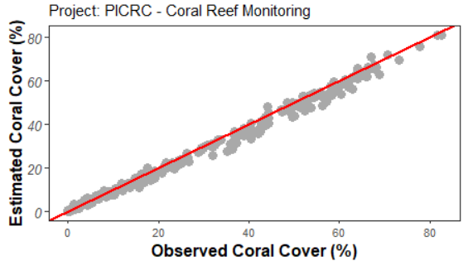
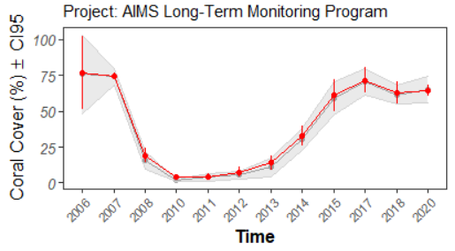
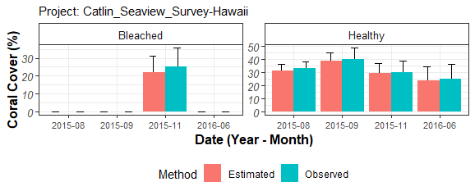
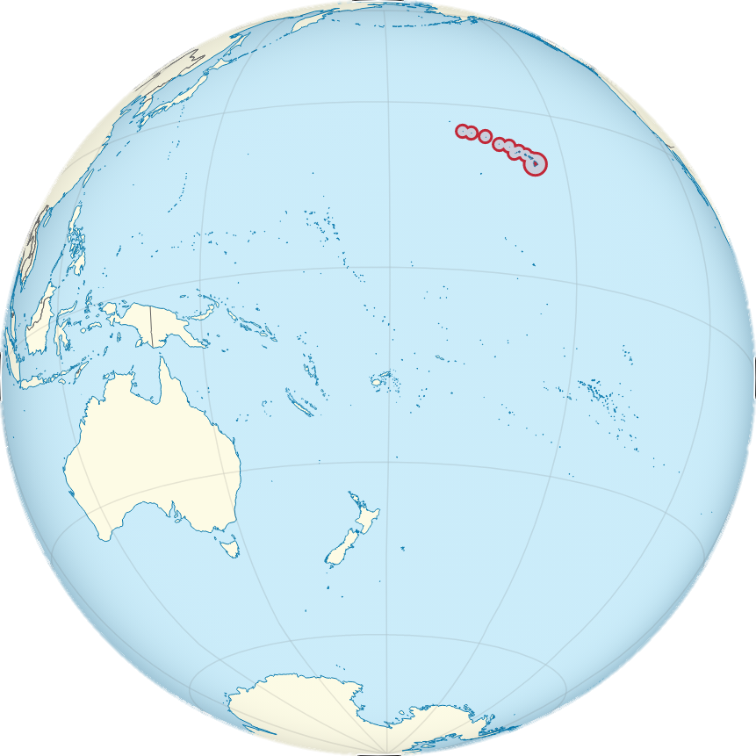
Does it work?
Accurate
Precise
Diverse
Notes:
Does it work? Answer is yes.
Still testing it and using it.
Excellent results with the machine learning.
Accuracy really high in terms of assessment of key metrics like coral cover.
Precise – even when seeing big changes over time
Diverse – so works on diverse datasets, e.g. train it to look at Coral Bleaching
Also works well in different geograohies.
Working with scientists in Palau, community rangers in the Solomons, NGOs in Fiji, citizen scientists in Brisbane, mainly to make usability.
Going to be launched soon in February in Palau

Slide 24






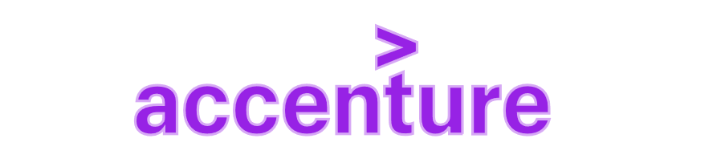







ReefCloud Partnerships
AIMS TEAM
Erin Peterson (QUT)
Kerrie Mengersen (QUT)
Jo Johnson (C2O Pacific)
Hana Amir (MMRI)
Nizam Ibrahim (MMRI)
Melanie Angerer (Accenture)
Dan Baker (Fjord)
Chloe Kim (Fjord)
Manuel Gonzalez-Rivero
m.gonzalezrivero@aims.gov.au
@Manu_GR
Mat Wyatt (AIMS)
Mark Rehbein (AIMS)
David Crossman (AIMS)
Nader Boutros (AIMS)
Eric Lawrey (AIMS)
Murray Logan (AIMS)
Peran Bray (AIMS)
Kate Osborne (AIMS)
David Souter (AIMS)
Marji Puotinen (AIMS)
Ronen Galaiduk (AIMS)
Emma Kennedy (AIMS)
Sangeeta Mangubhai (WCS)
Stacy Jupiter (WCS)
Yashika Nand (WCS)
Stuart Kininmonth (USP)
Helen Sykes (MEC)
Tedi Rengiil (PICRC)
Yim Golbuu (PICRC)
Uly Olsudong (PICRC)
Christina Karanassos (PICRC)
Julie Vercelloni (QUT)
Amy Stringer (QUT)
David Warne (QUT)

Slide 25
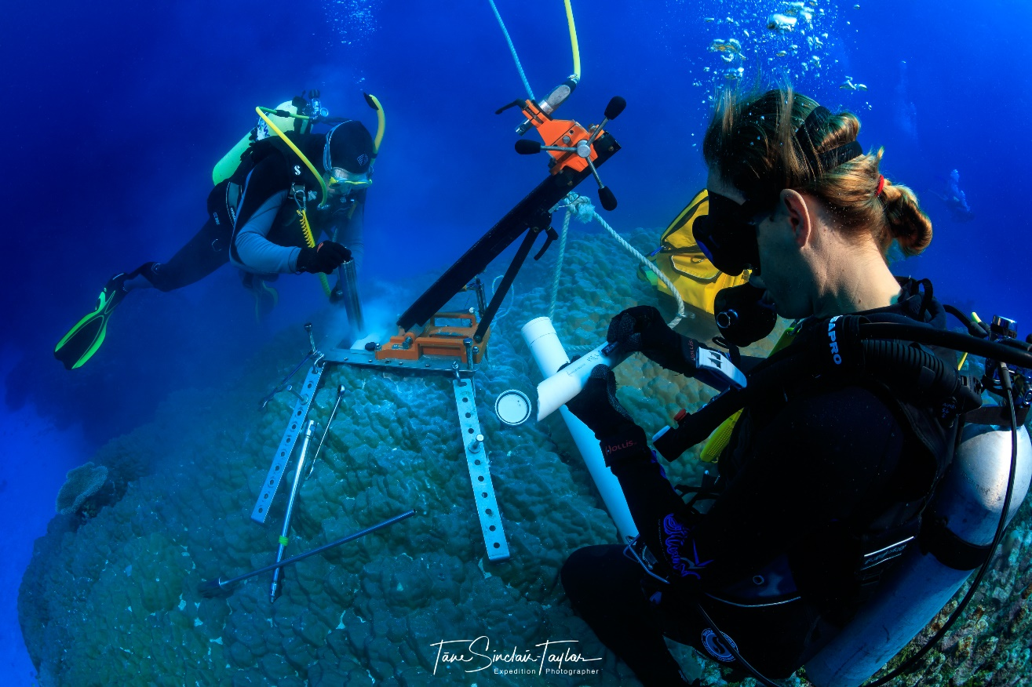
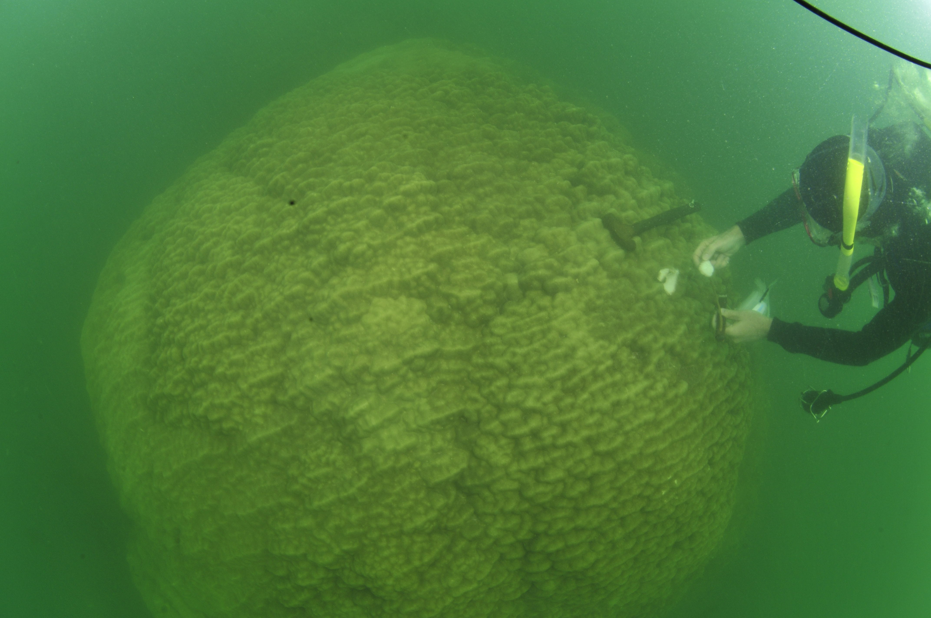

weather and environmental records in coral skeletons

Slide 26




Annual time series: growth, rainfall and colony age
High Density Bands – Summer
Low Density Bands – Winter
1998
1991

Slide 27




Core collections:
Central Great Barrier Reef
Collections in 1980’s, 2004-05
N=144 cores
Inshore
Pandora: 21 colonies
Nelly Bay: 15 colonies
Geoffrey Bay: 20 colonies
Havannah Island: 5 colonies
Mid-shelf
Rib Reef: 21 colonies
Britomart Reef: 8 colonies
Offshore
Myrmidon: 22 colonies
E. Matson AIMS

Slide 28



Rainfall variability: 1648 -2011
Burdekin River
Core UV Luminescence
Annual river runoff
Observed
Coral UV
reconstruction
Notes:
Other analyses
- Growth anomalies linked to bleaching, disease, ocean acidification

Slide 29





Nelly Bay Fossil Coral Records
¹⁴C dating:
NEL03D_07B: 6223-6098 years BP
NEL01D: 6038 – 5918 years BP
Lough et al. 2014 Paleoceanography DOI: 10.1002/2014PA002630

Slide 30
How can this help Monitoring on Magnetic?
Review AIMS data holdings – grab the info that can inform monitoring at Yunbenun
Use the weather station data to help interpret monitoring trends
Consider the ReefCloud as an AI platform
Use the coral core data to put your

Slide 31
Thanks!
Libby Evans-Illidge
e.evansillidge@aims.gov.au
0407930865

