Slide 1
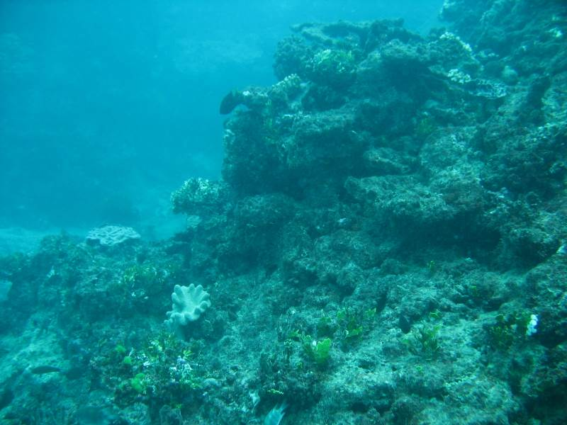
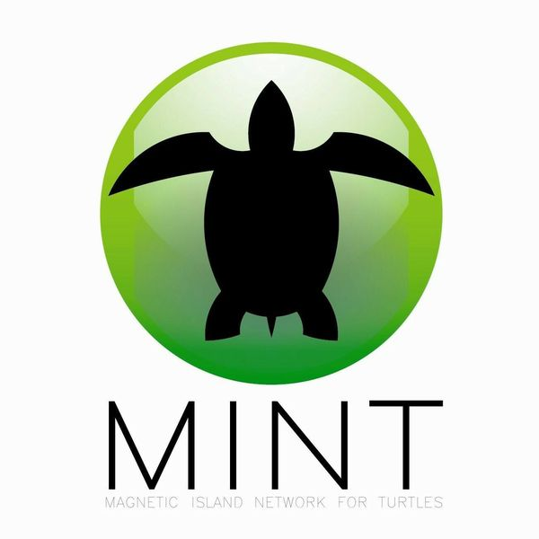
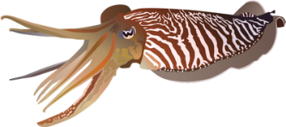
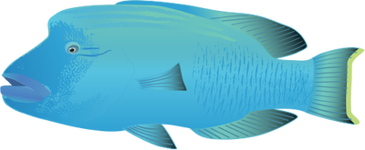
Become involved with turtle monitoring with Magnetic Island Network for Turtles (MINT)

Slide 2
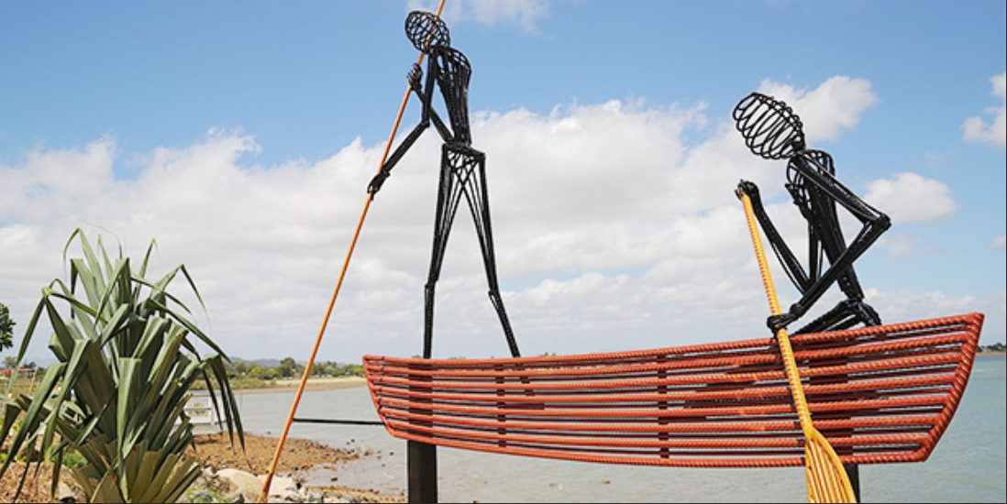
Acknowledgement of Country
We would like to acknowledge the Wulgurukaba people as the Traditional Owners of the Land and Sea Country which we are on today, as well as all of the Aboriginal and Torres Strait Islander peoples who have connection to the Great Barrier Reef.
Notes:
Acknowledgement of Country.
Explain format of the session.
Note: Acknowledgment of Country can be abbreviated to:
We would like to acknowledge the Aboriginal and Torres Strait Island peoples as the Traditional Owners of the Land and Sea Country which we are connecting from today.
We recognise their continuing connection to land, water and community, and pay our respects to their Elders past, present and emerging.

Slide 3
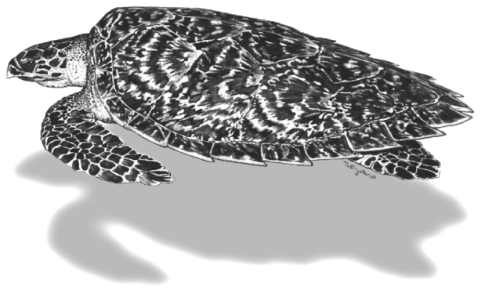
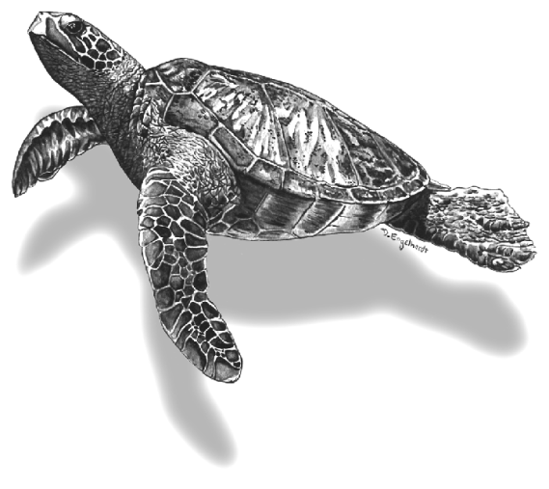
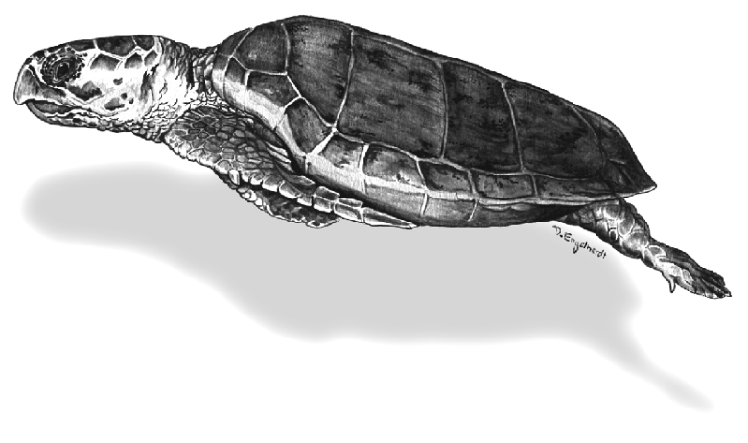
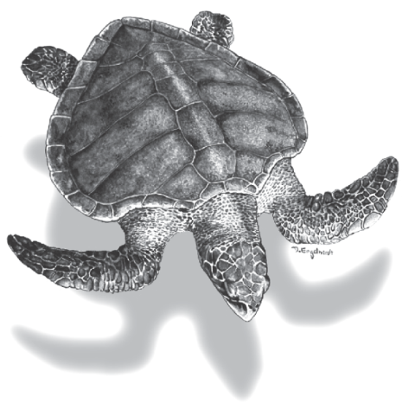
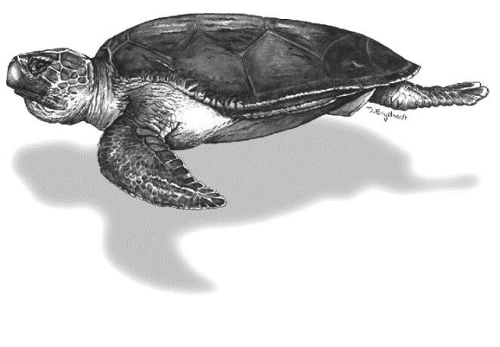
Hawksbill (0.81 m)
Leatherback (1.78 m)
Flatback (0.94 m)
Loggerhead (0.96 m)
Green (1.07 m)
Olive Ridley (0.57 m)
Magnetic Island Network for Turtles
Notes:
These are the six that come into Australian waters

Slide 4
Turtle Conservation Status
Species | *Worldwide | **Australia
Flatback | Data Deficient | Vulnerable
Green | Endangered | Vulnerable
Hawksbill | Critically Endangered | Vulnerable
Leatherback | Critically Endangered | Vulnerable
Loggerhead | Endangered | Endangered
Olive Ridley | Vulnerable | Endangered
Kemps Ridley | Critically Endangered | -
*IUCN: The World Conservation Union (Red List)
**EPBC Act: Australian Environment Protection and Biodiversity Conservation Act
Magnetic Island Network for Turtles

Slide 5
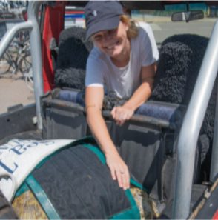
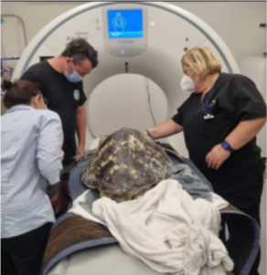
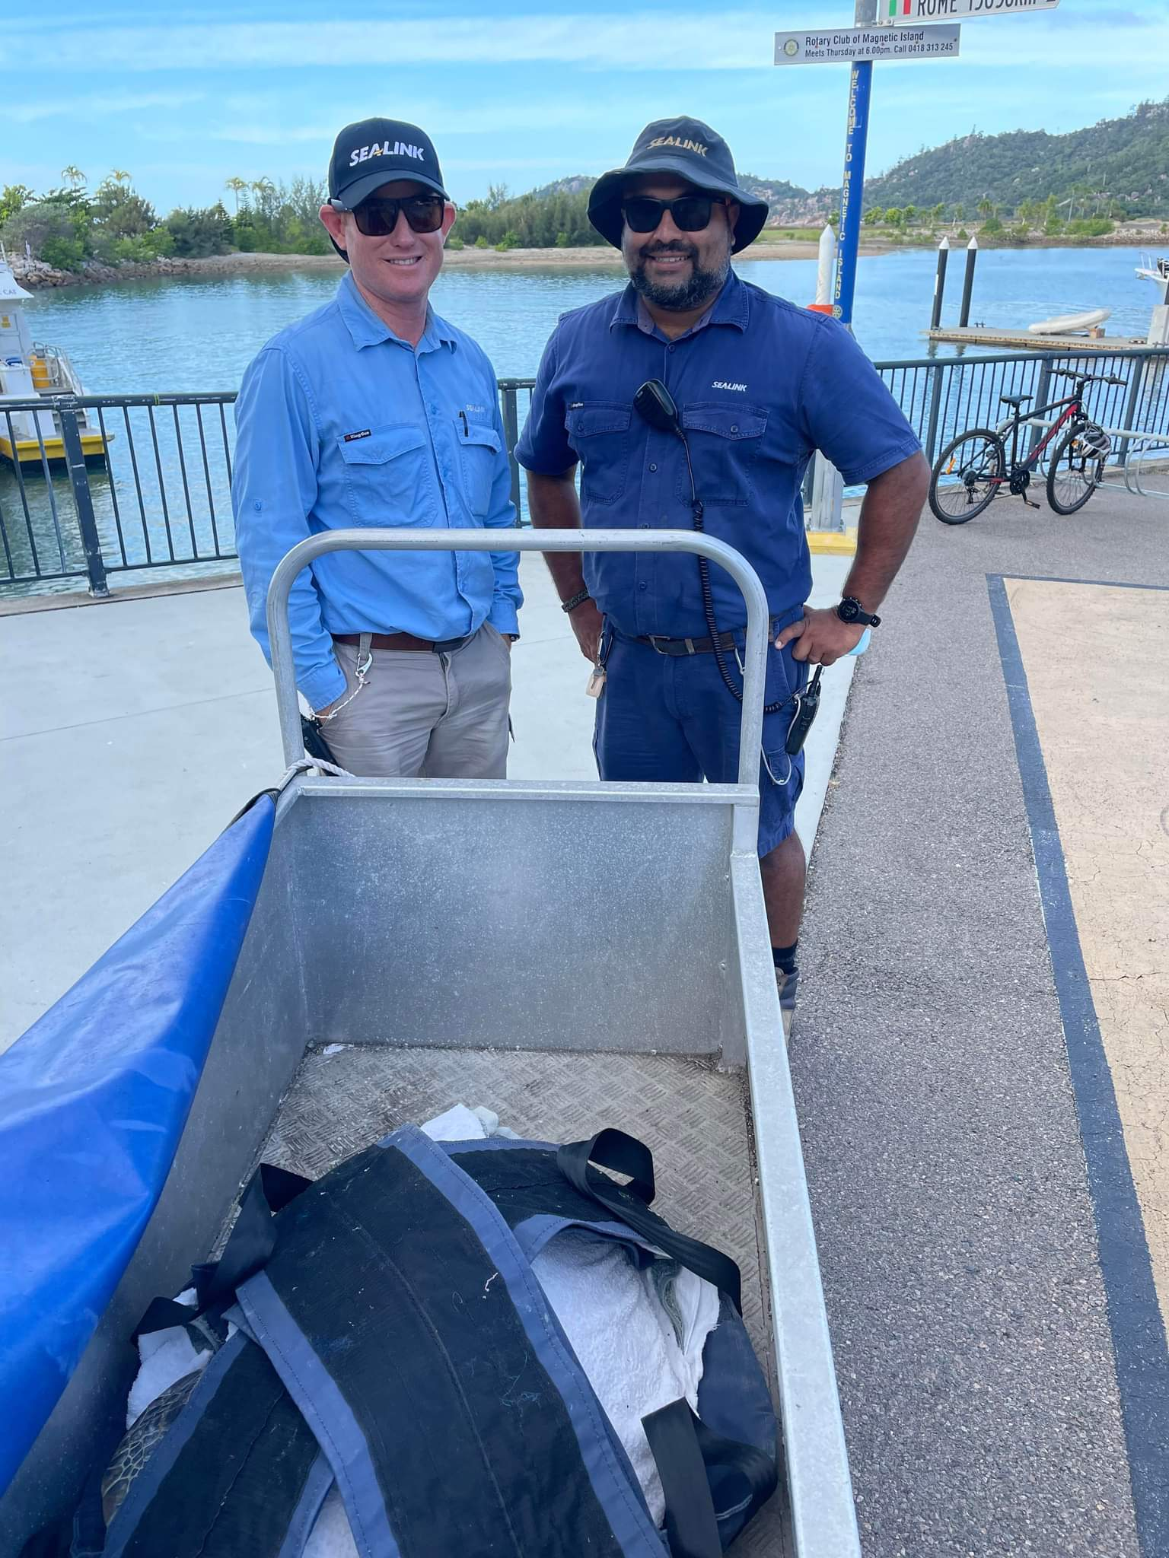
MINT roles and responsibilities
Responding to stranded marine life
Turtle rehabilitation
Turtle nest monitoring (with QPWS)
Sightings
Education
Magnetic Island Network for Turtles

Slide 6
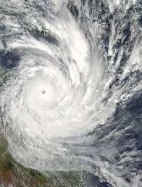
Responding to stranded marine turtles
Year | No. of turtle strandings in Townsville
2010 | 68
2011 | 216
2012 | 260
2013 | 101
2014 | 68
2015 | 51
2016 | 29
2017 | 42
2018 | 27
TC Yasi
Magnetic Island Network for Turtles

Slide 7
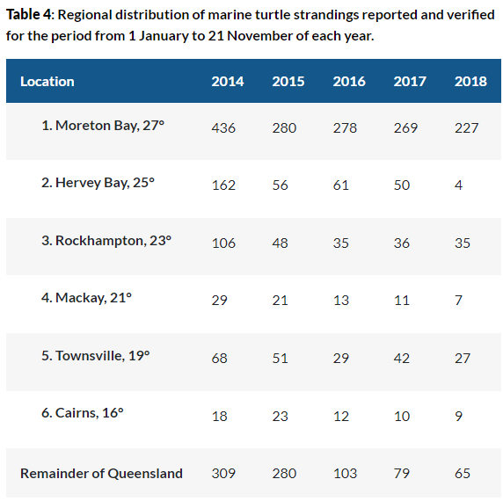
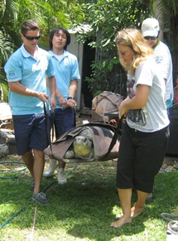
Responding to stranded marine turtles
Magnetic Island Network for Turtles

Slide 8
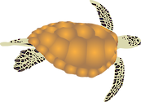
Responding to stranded marine turtles
Marine Strandings Hotline1300 130 372
Magnetic Island Network for Turtles

Slide 9
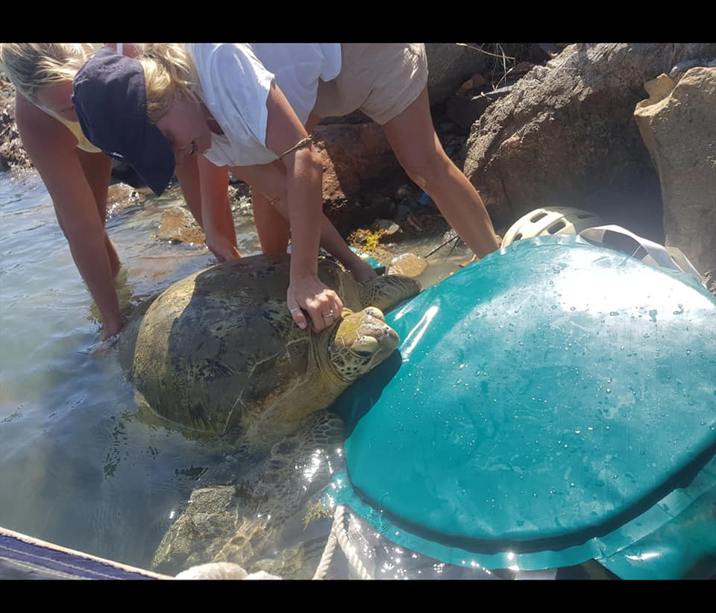
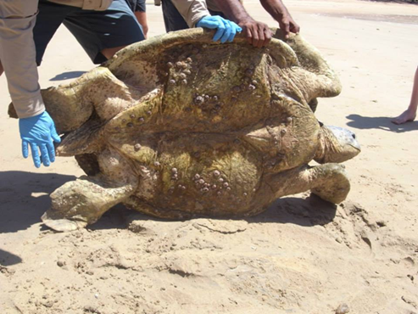
Responding to stranded marine turtles
Become a strandings response volunteer—complete our free online training package which enables local community volunteers to respond to marine wildlife strandings.
The training package includes eight modules that can be done at the user’s own pace. It is comprised of interactive presentations that include videos, audio, graphics and reading, across a series of learning modules.

Slide 10
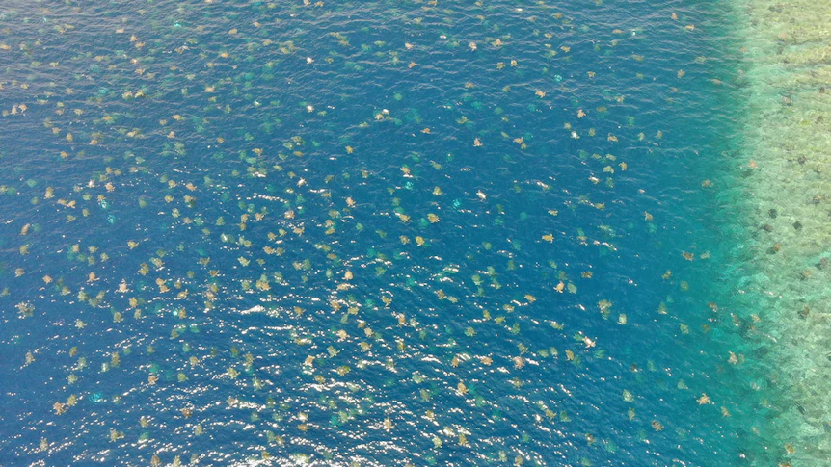
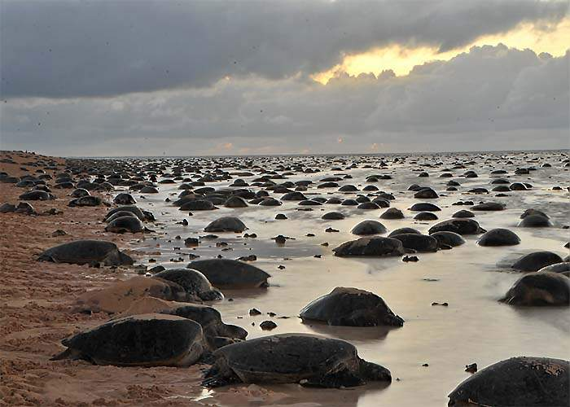
Turtle nesting

Slide 11
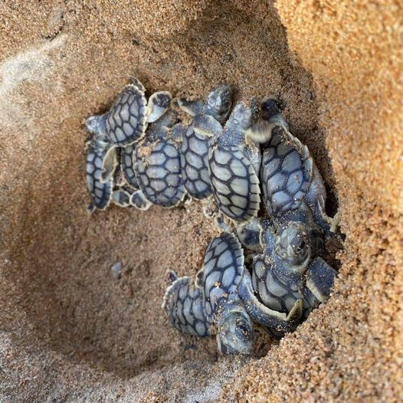
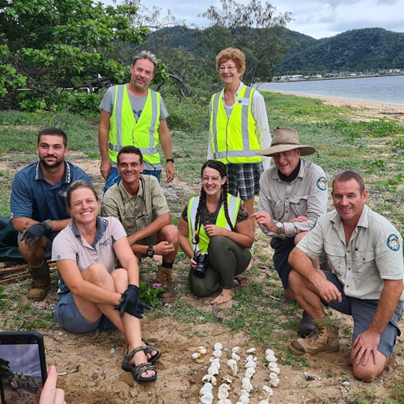
Turtle nesting

Slide 12
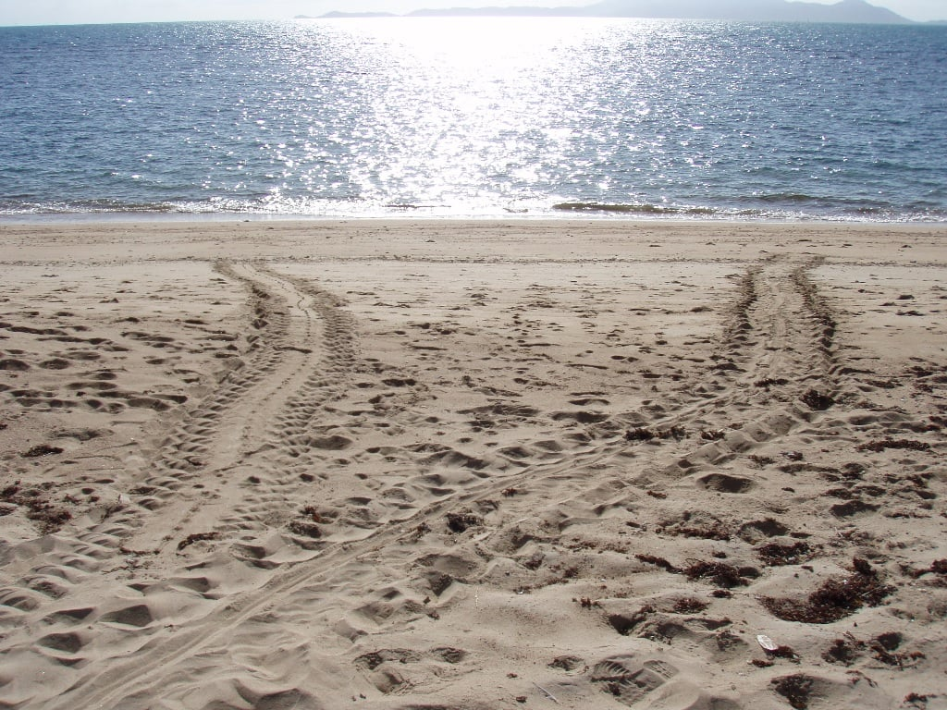
Turtle nesting
Which track is the up and which is the down and why?

Slide 13
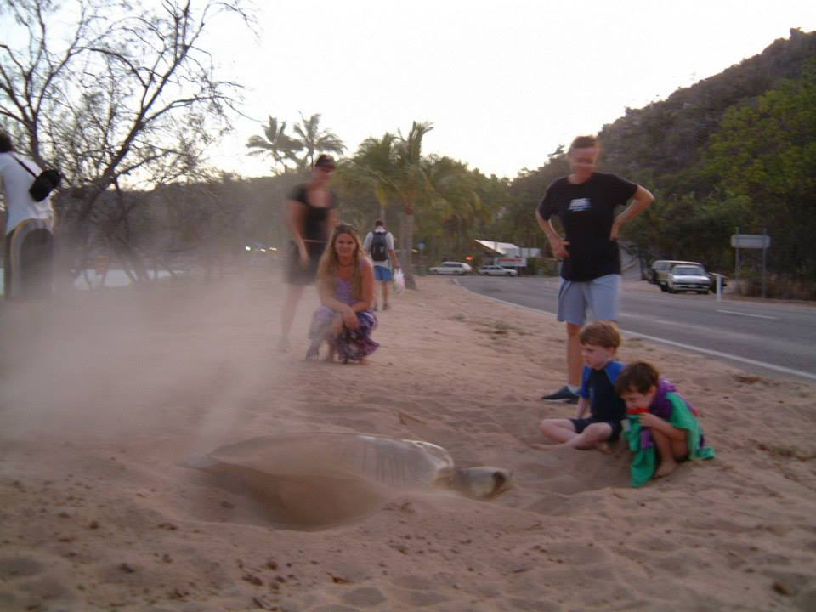
Turtle nesting
Marine Strandings Hotline
1300 130 372
MINT Facebook page
MIFCO

Slide 14
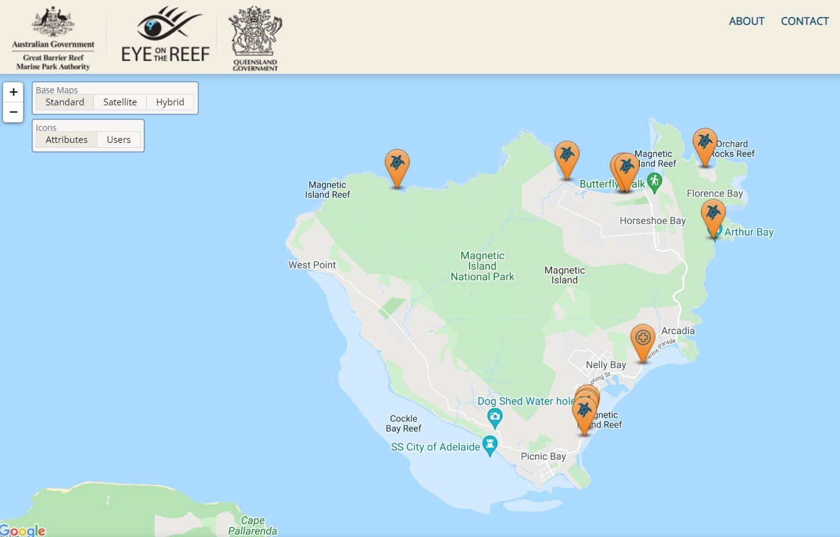
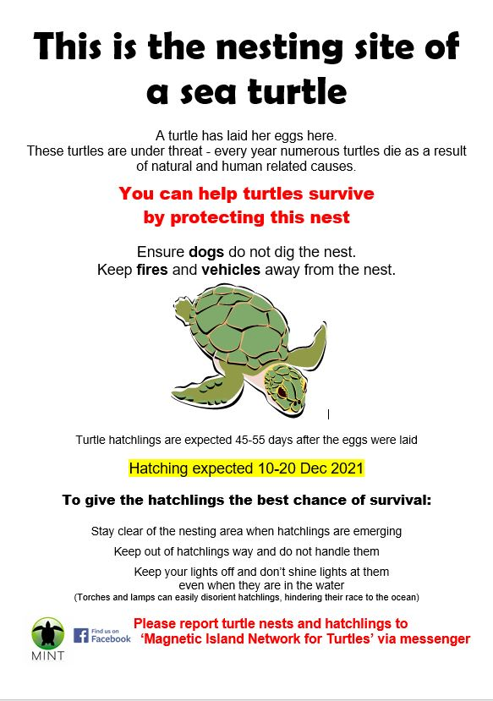
Turtle nesting

Slide 15
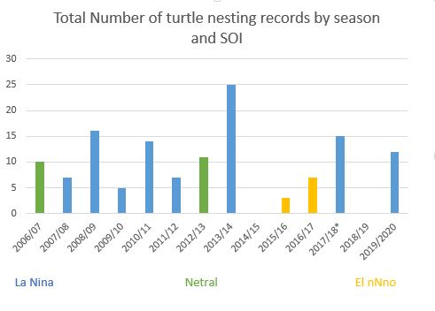
Turtle nesting
2021/22
50 nests
Including 35 Green turtles!

Slide 16
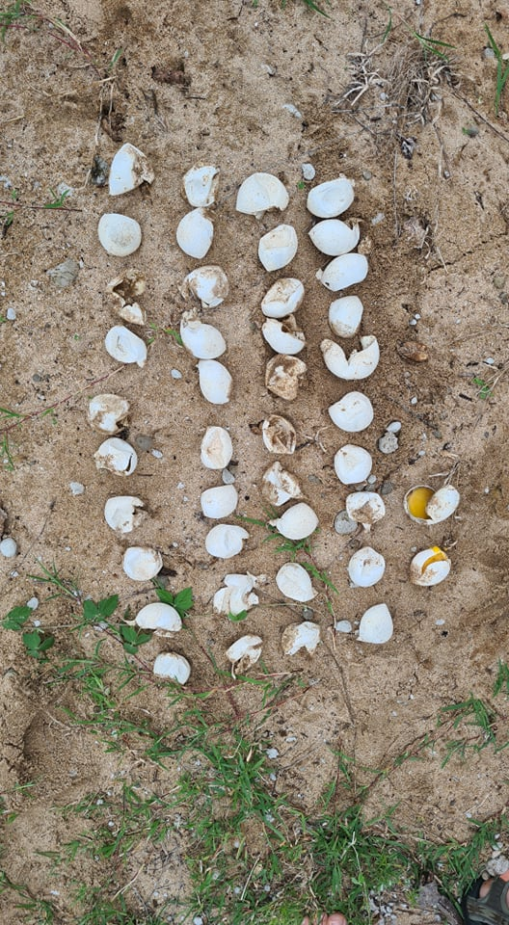
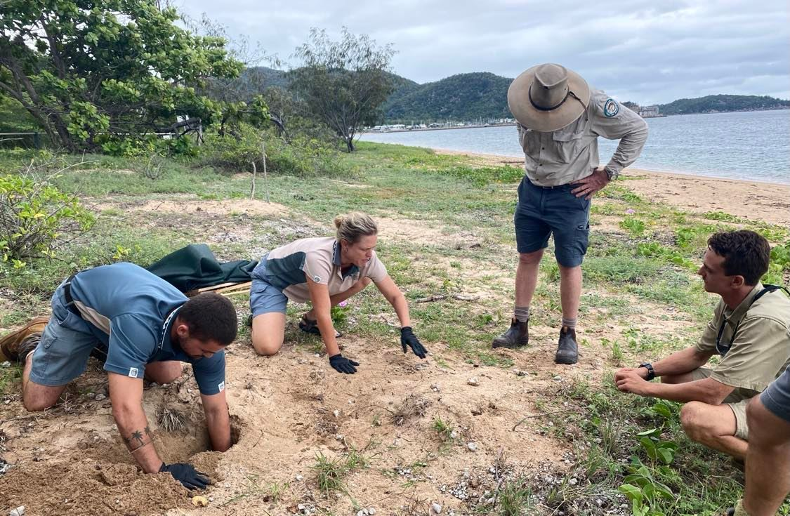
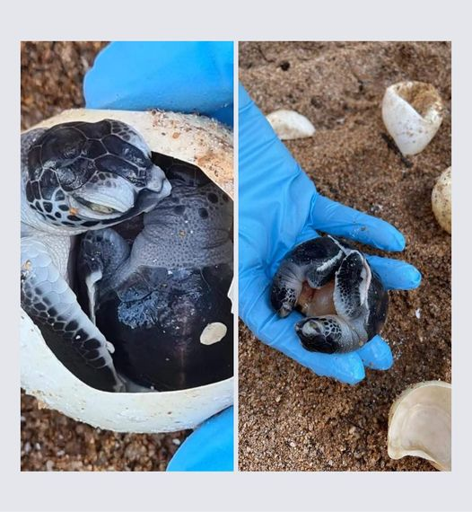
Turtle nesting

Slide 17
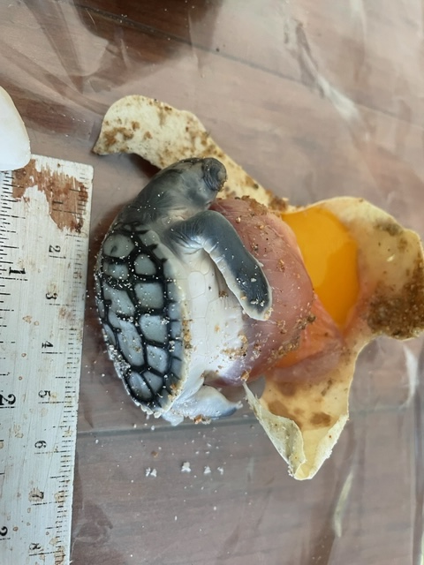
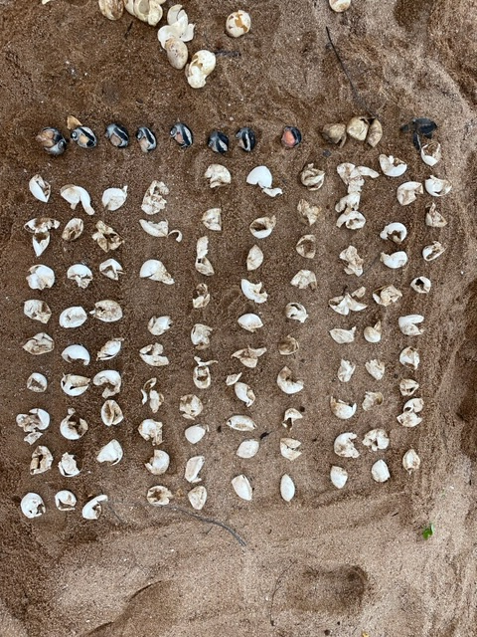
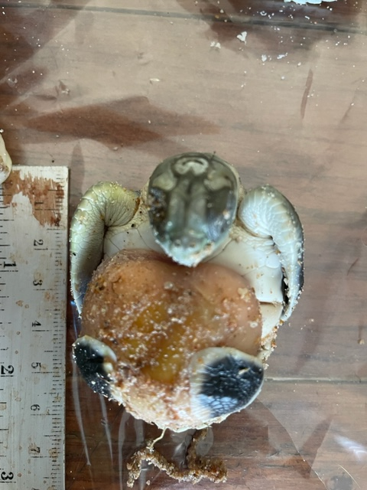
Turtle nesting

Slide 18
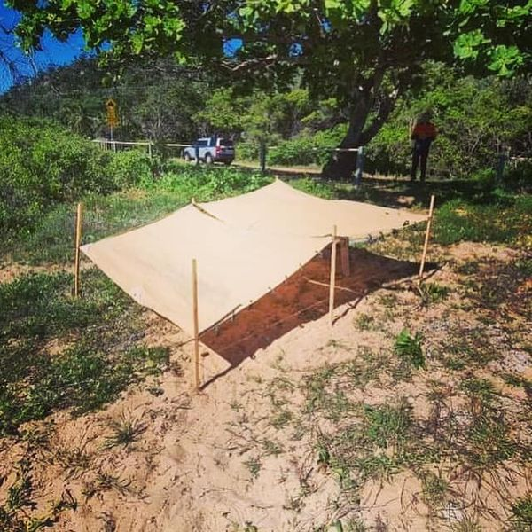
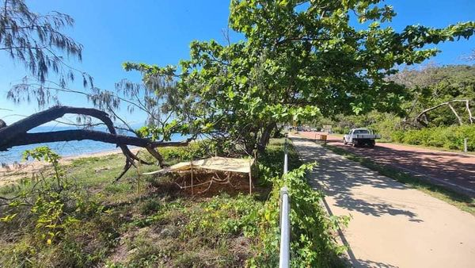
Turtle nesting

Slide 19
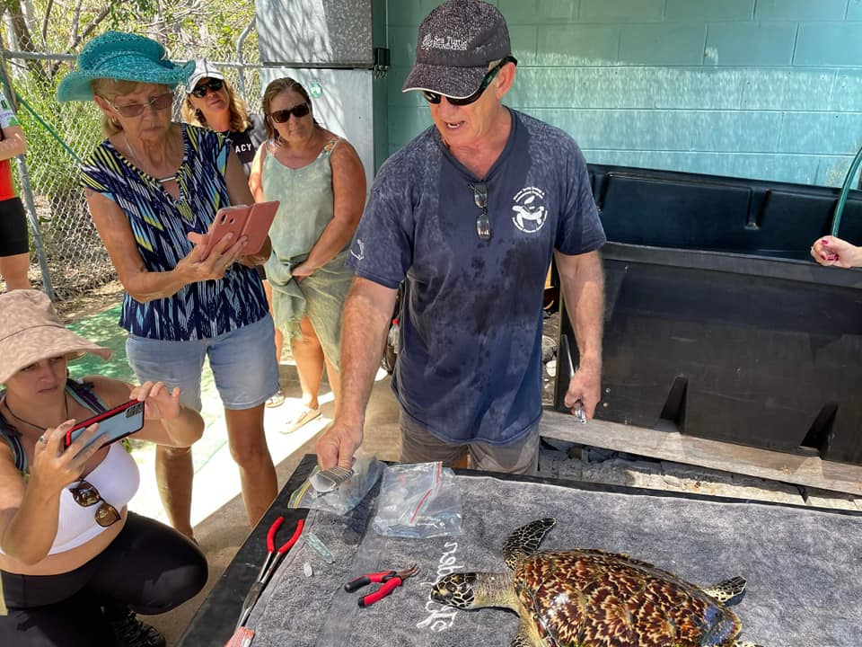
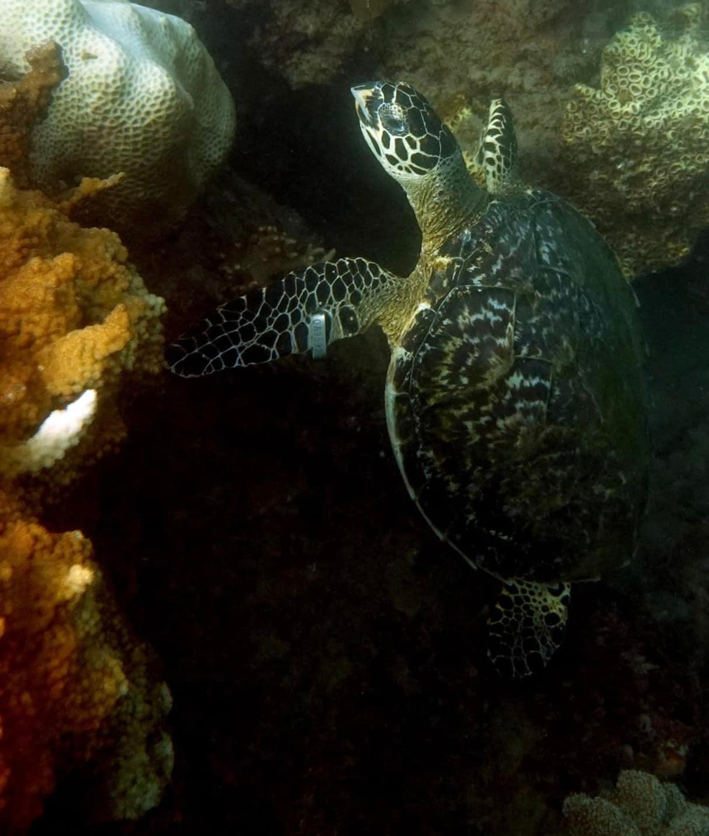
Becoming involved with our turtles
Sightings of turtles and turtle tracks through Eye on the Reef app.
Turtle rescue and Marine wildlife strandings
Turtle rehabilitation
Turtle nest monitoring September to February
Register your interest at tomorrows session

