Slide 1

Fish stories
What do we know about the fish on Yunbenun’s coral reefs?
Dr. Daniela Ceccarelli
Fish Ecologist

Slide 2
Acknowledgement
We acknowledge the Wulgurukaba people as the Traditional Owners of the land on which we meet today, and pay our respects to elders past, present and future.
We honour their continuing culture, knowledge, beliefs and spiritual relationship and connection to country.
We also recognise Aboriginal and Torres Strait Islander peoples as the Traditional Owners of the land and sea country on which the
Australian Institute of Marine Science works, and as Australia’s first scientists.
Through collaboration and two-way knowledge sharing, we can learn from each other.

Slide 3
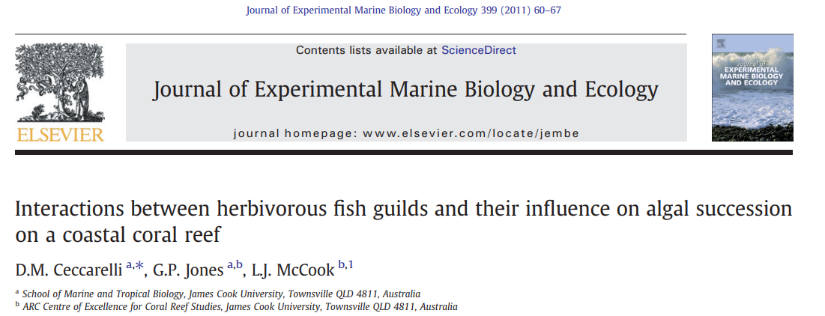
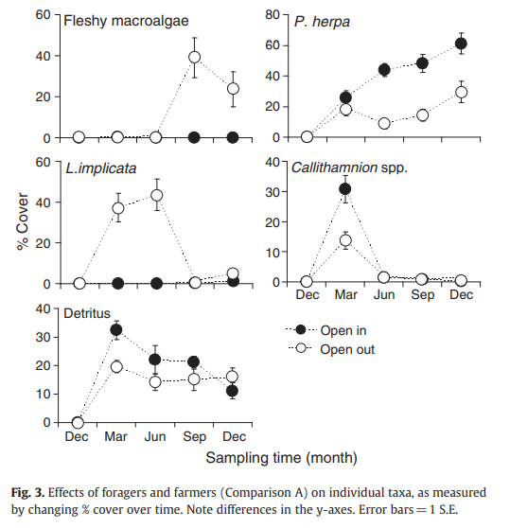
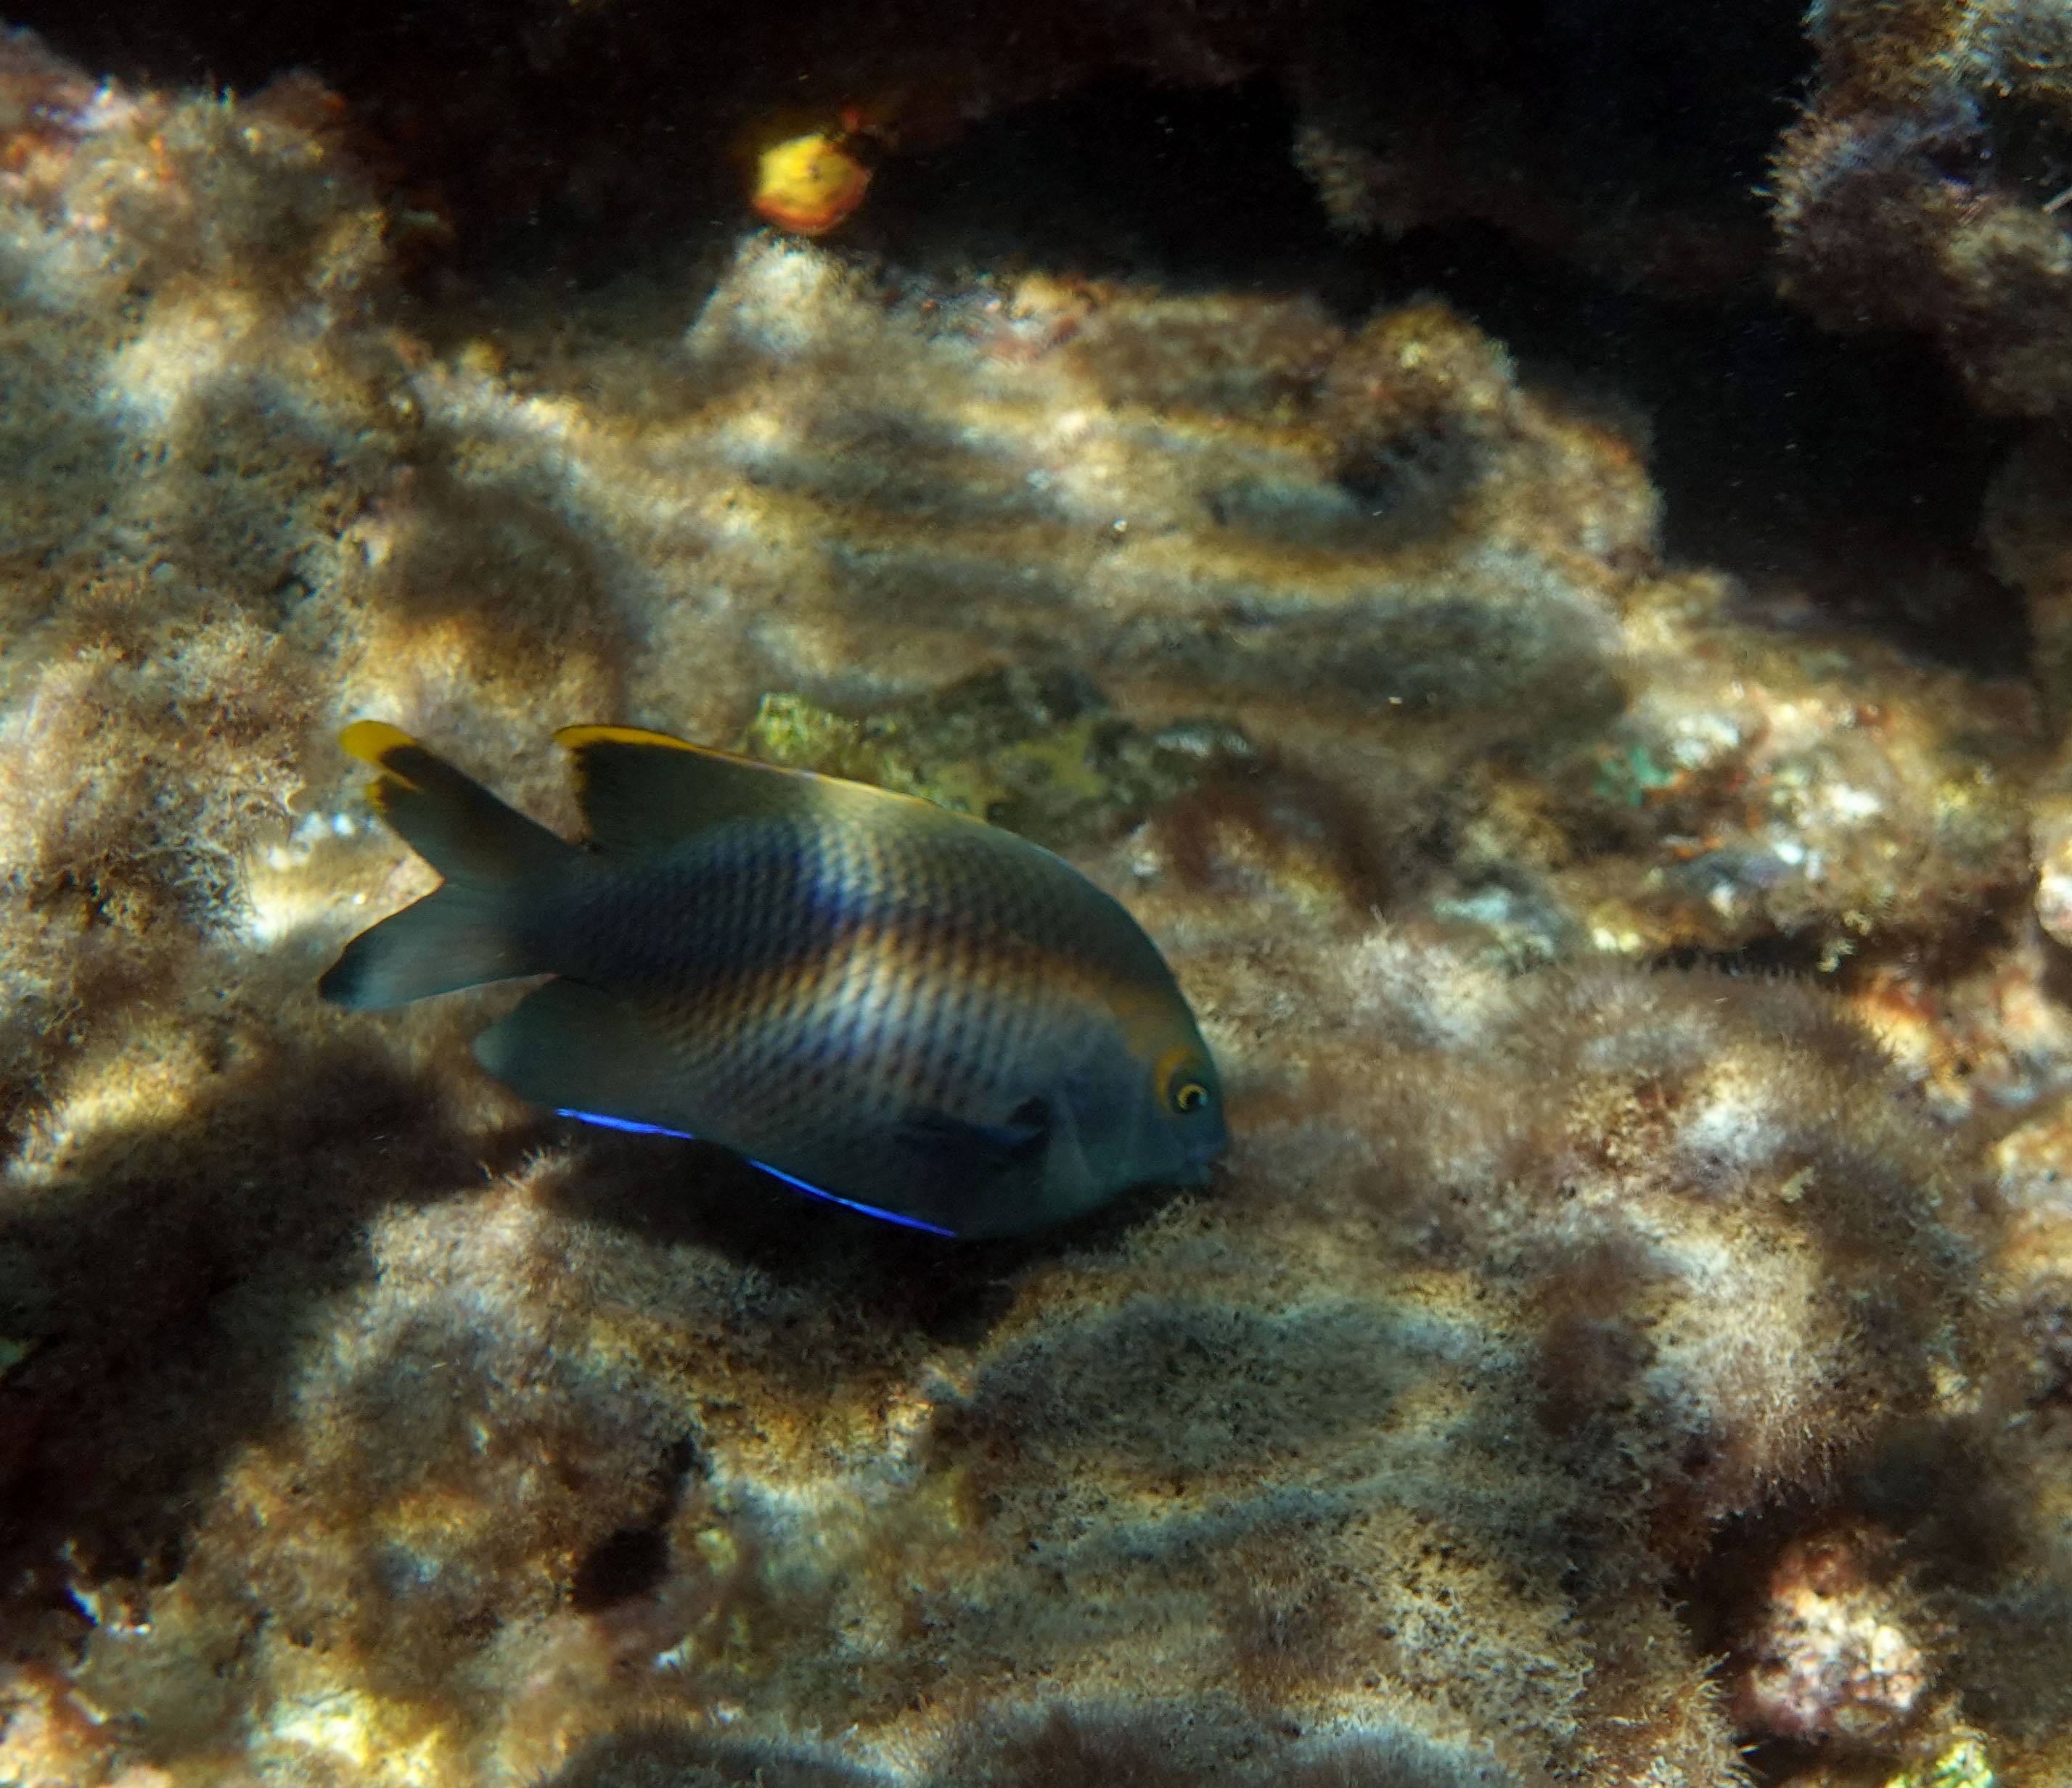
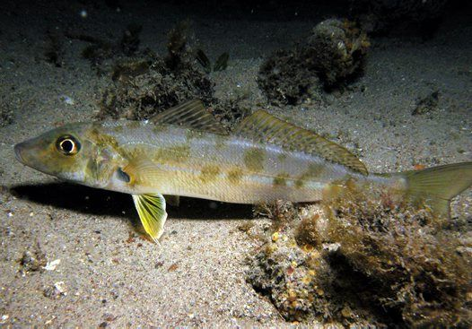
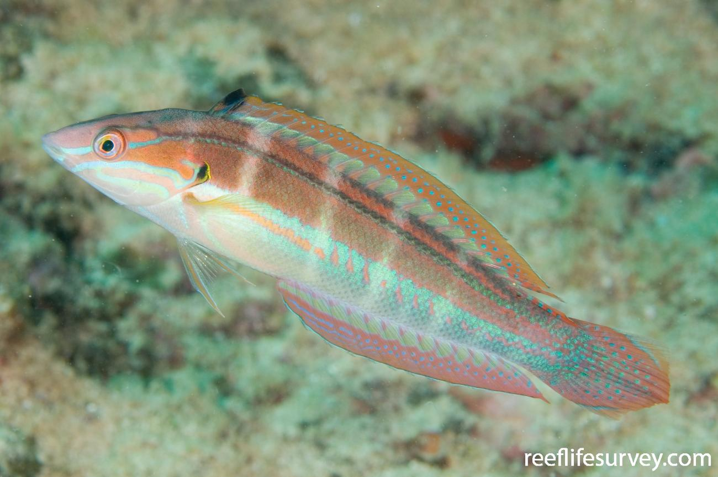
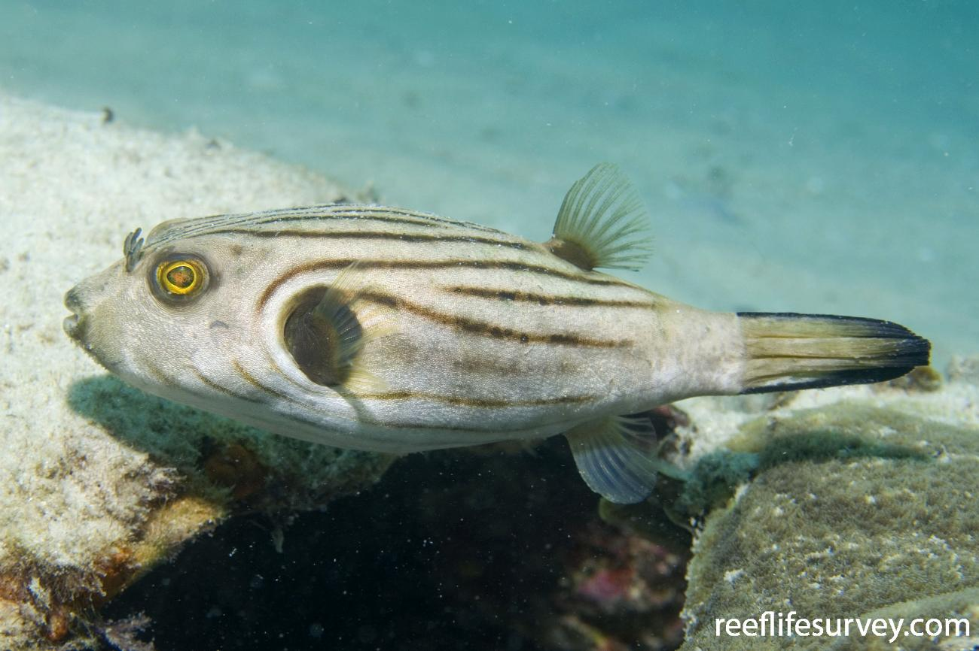
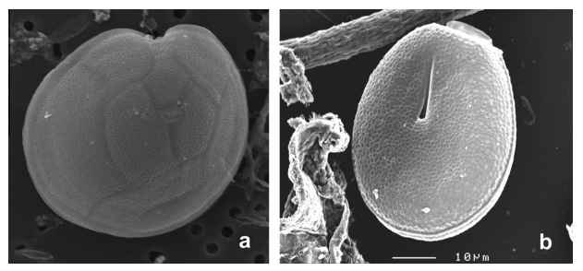
Fish science on Yunbenun
James Cook University / ARC CoE Reef fish surveys at 8 sites on the eastern side of the island to measure the effects of zoning on fish communities, 2004-2019.
James Cook University Tagging of blacktip reef sharks in Cockle Bay, 2008-2011.
University of Queensland Ciguatera study, 2006-2007.
James Cook University Experimental and observational research to test the effects of farming damselfish on corals and algae, 1998-2004.
Environ-Ecological Engineering Institute Diets of fishes inhabiting the seagrass beds of Cockle Bay.

Slide 4
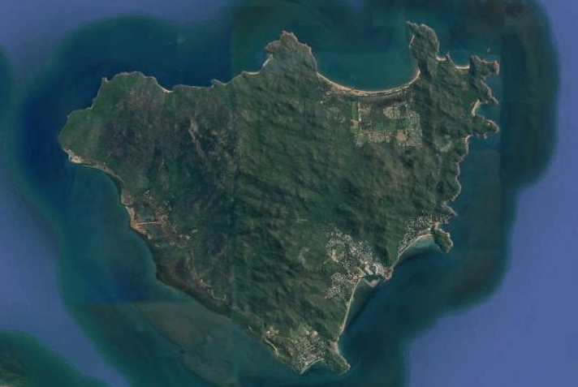
Study sites
Fish studies on Yunbenun
Florence Bay
Arthur Bay
Combined sites from all known studies
Geoffrey Bay
Nelly Bay
Cockle Bay

Slide 5
The JCU Inshore Reef Zoning Monitoring Program
What effect is GBRMPA zoning having on target species and the reef?
Annual/biennial monitoring
since 1998/1999
112 long-term monitoring sites
60 on fished (blue & yellow) reefs
32 on ‘old’ 1987 green reefs
20 on ‘new’ 2004 green reefs
Research on
Fish community
Benthic community
Fishing line
JCU Inshore Monitoring Program
Fish communities on the inshore fringing reefs of the Great Barrier Reef

Slide 6
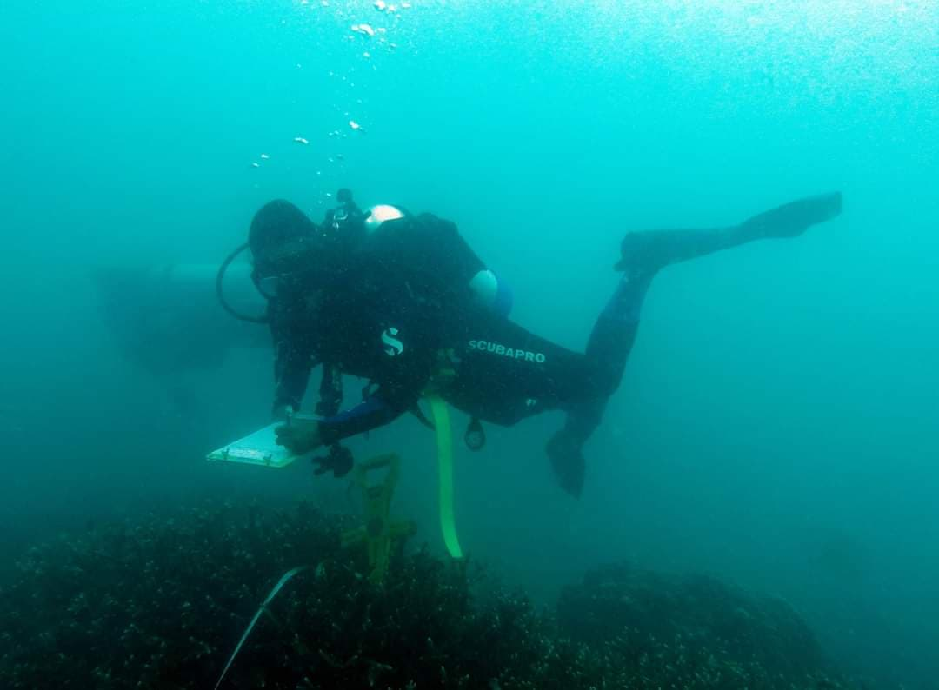
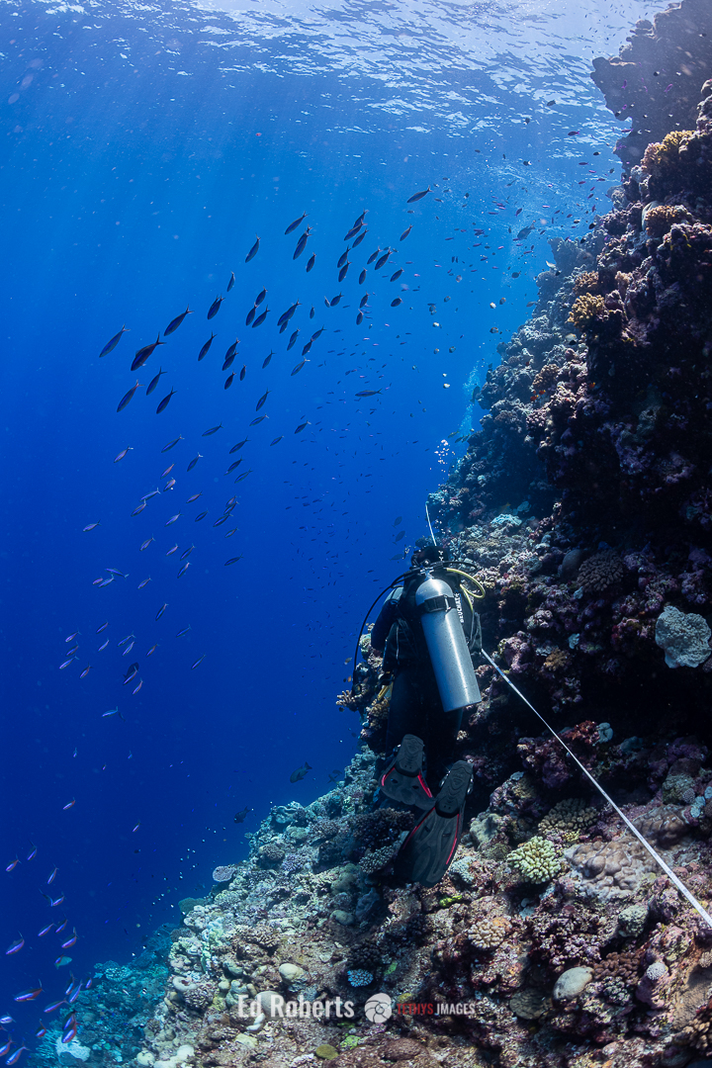
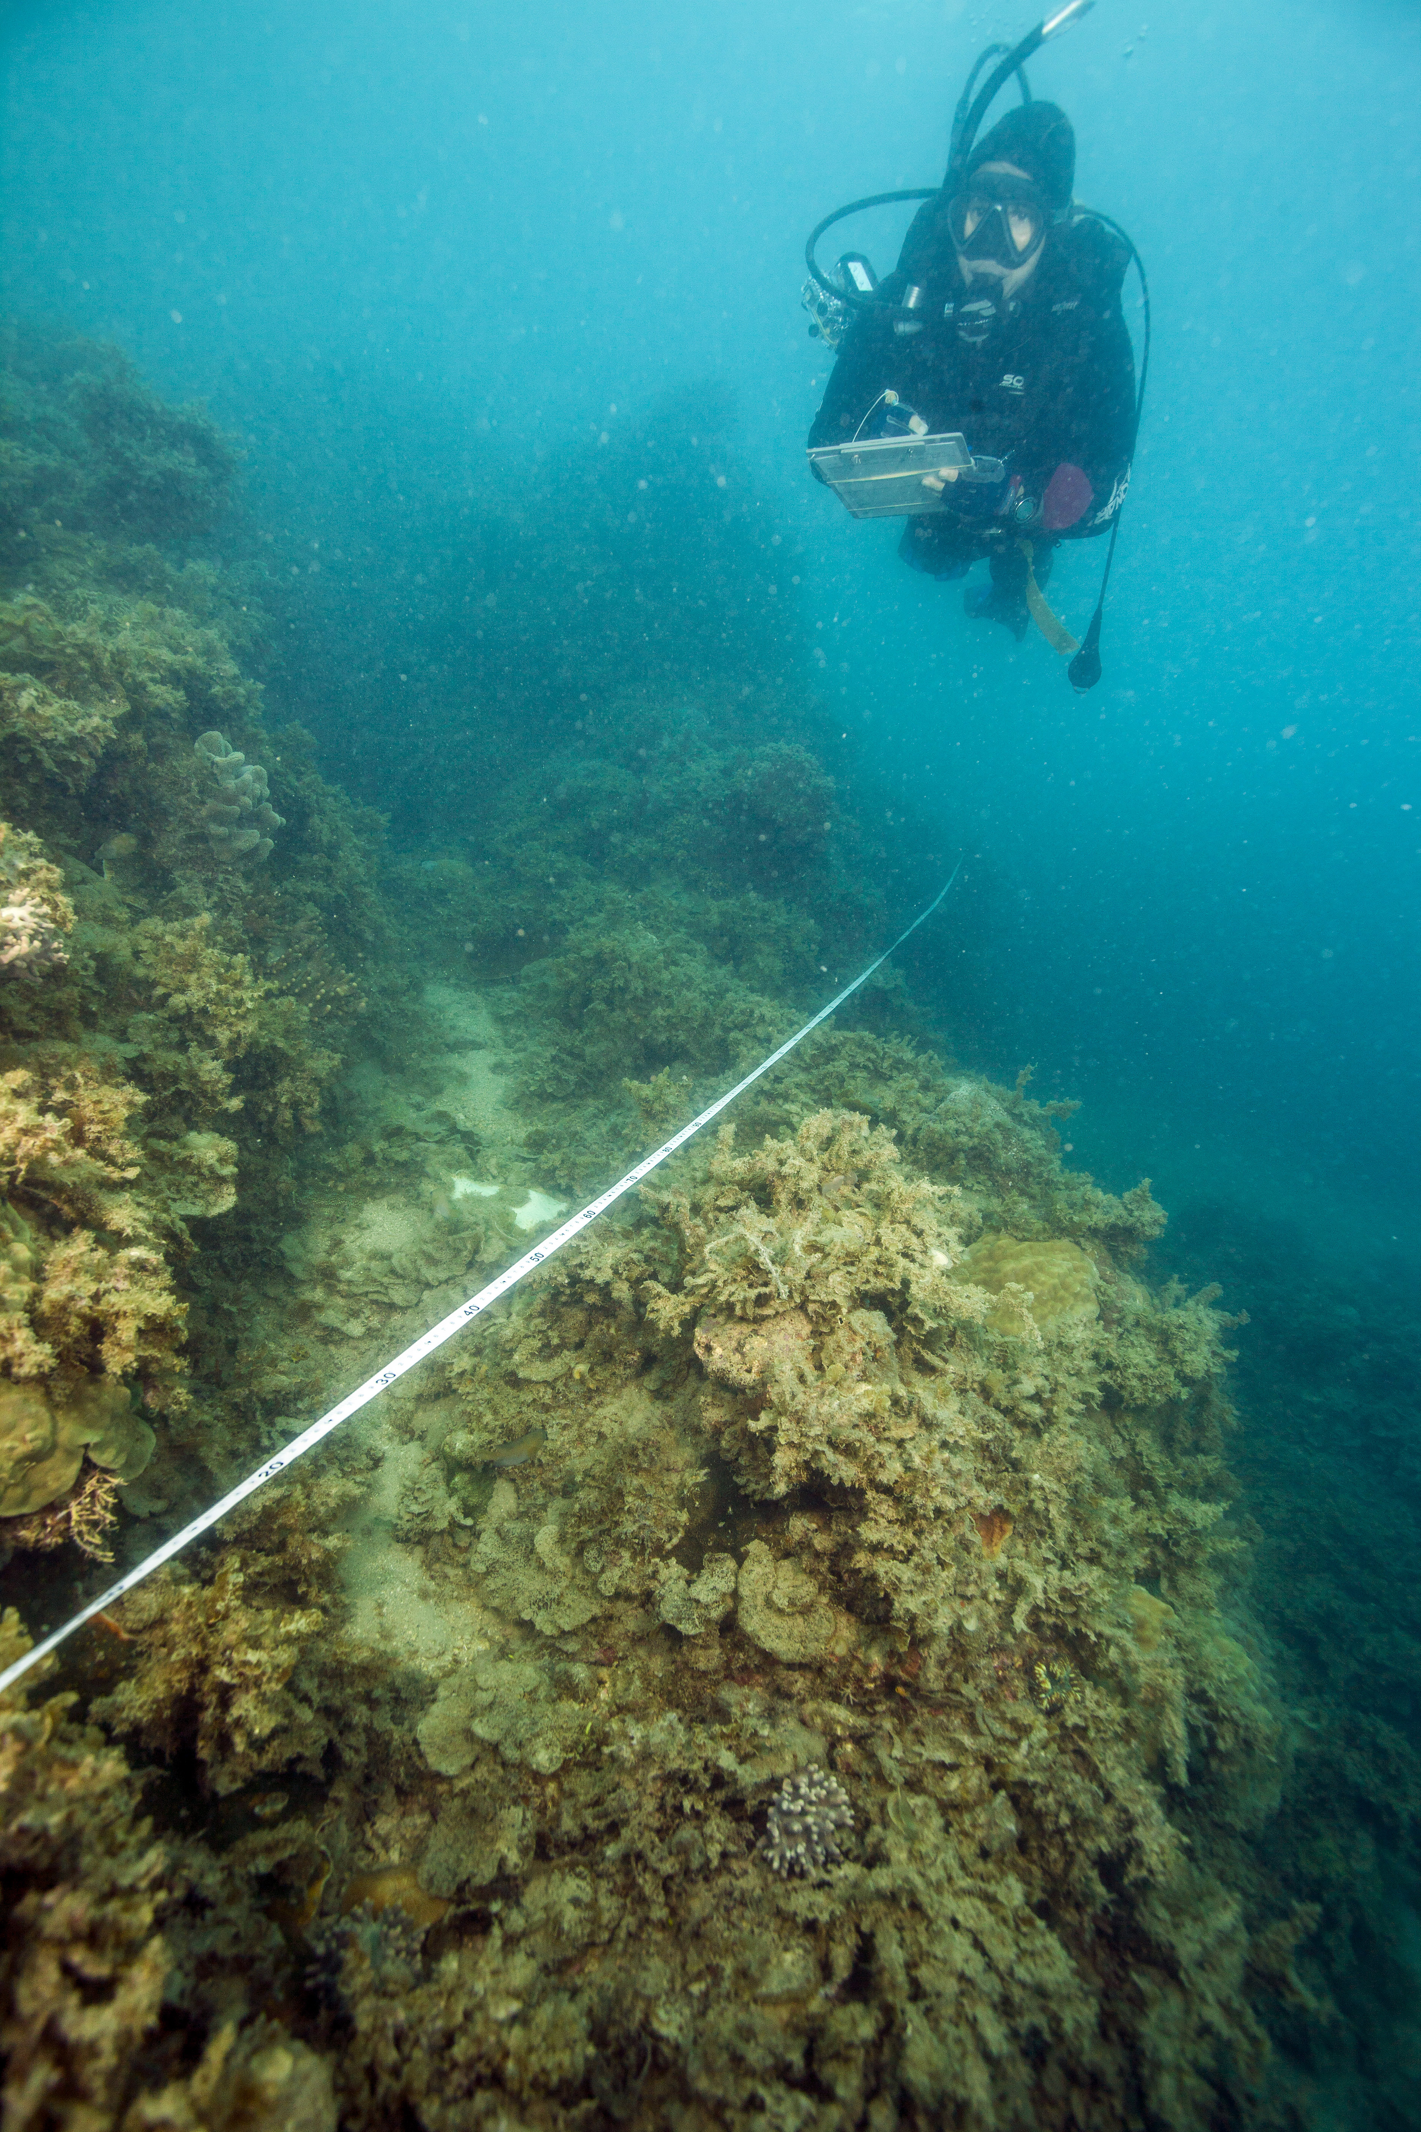
Sites and Methods
How do you study fish on the reef?
JCU Inshore Monitoring Program
Fish communities on the inshore fringing reefs of the Great Barrier Reef

Slide 7
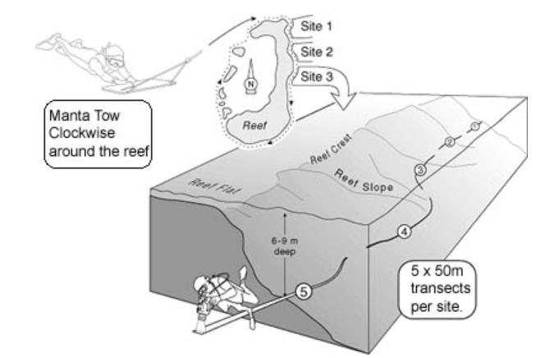
Sites and Methods
How do you study fish on the reef?
JCU Inshore Monitoring Program
Fish communities on the inshore fringing reefs of the Great Barrier Reef
Source: Reef monitoring sampling methods | AIMS

Slide 8
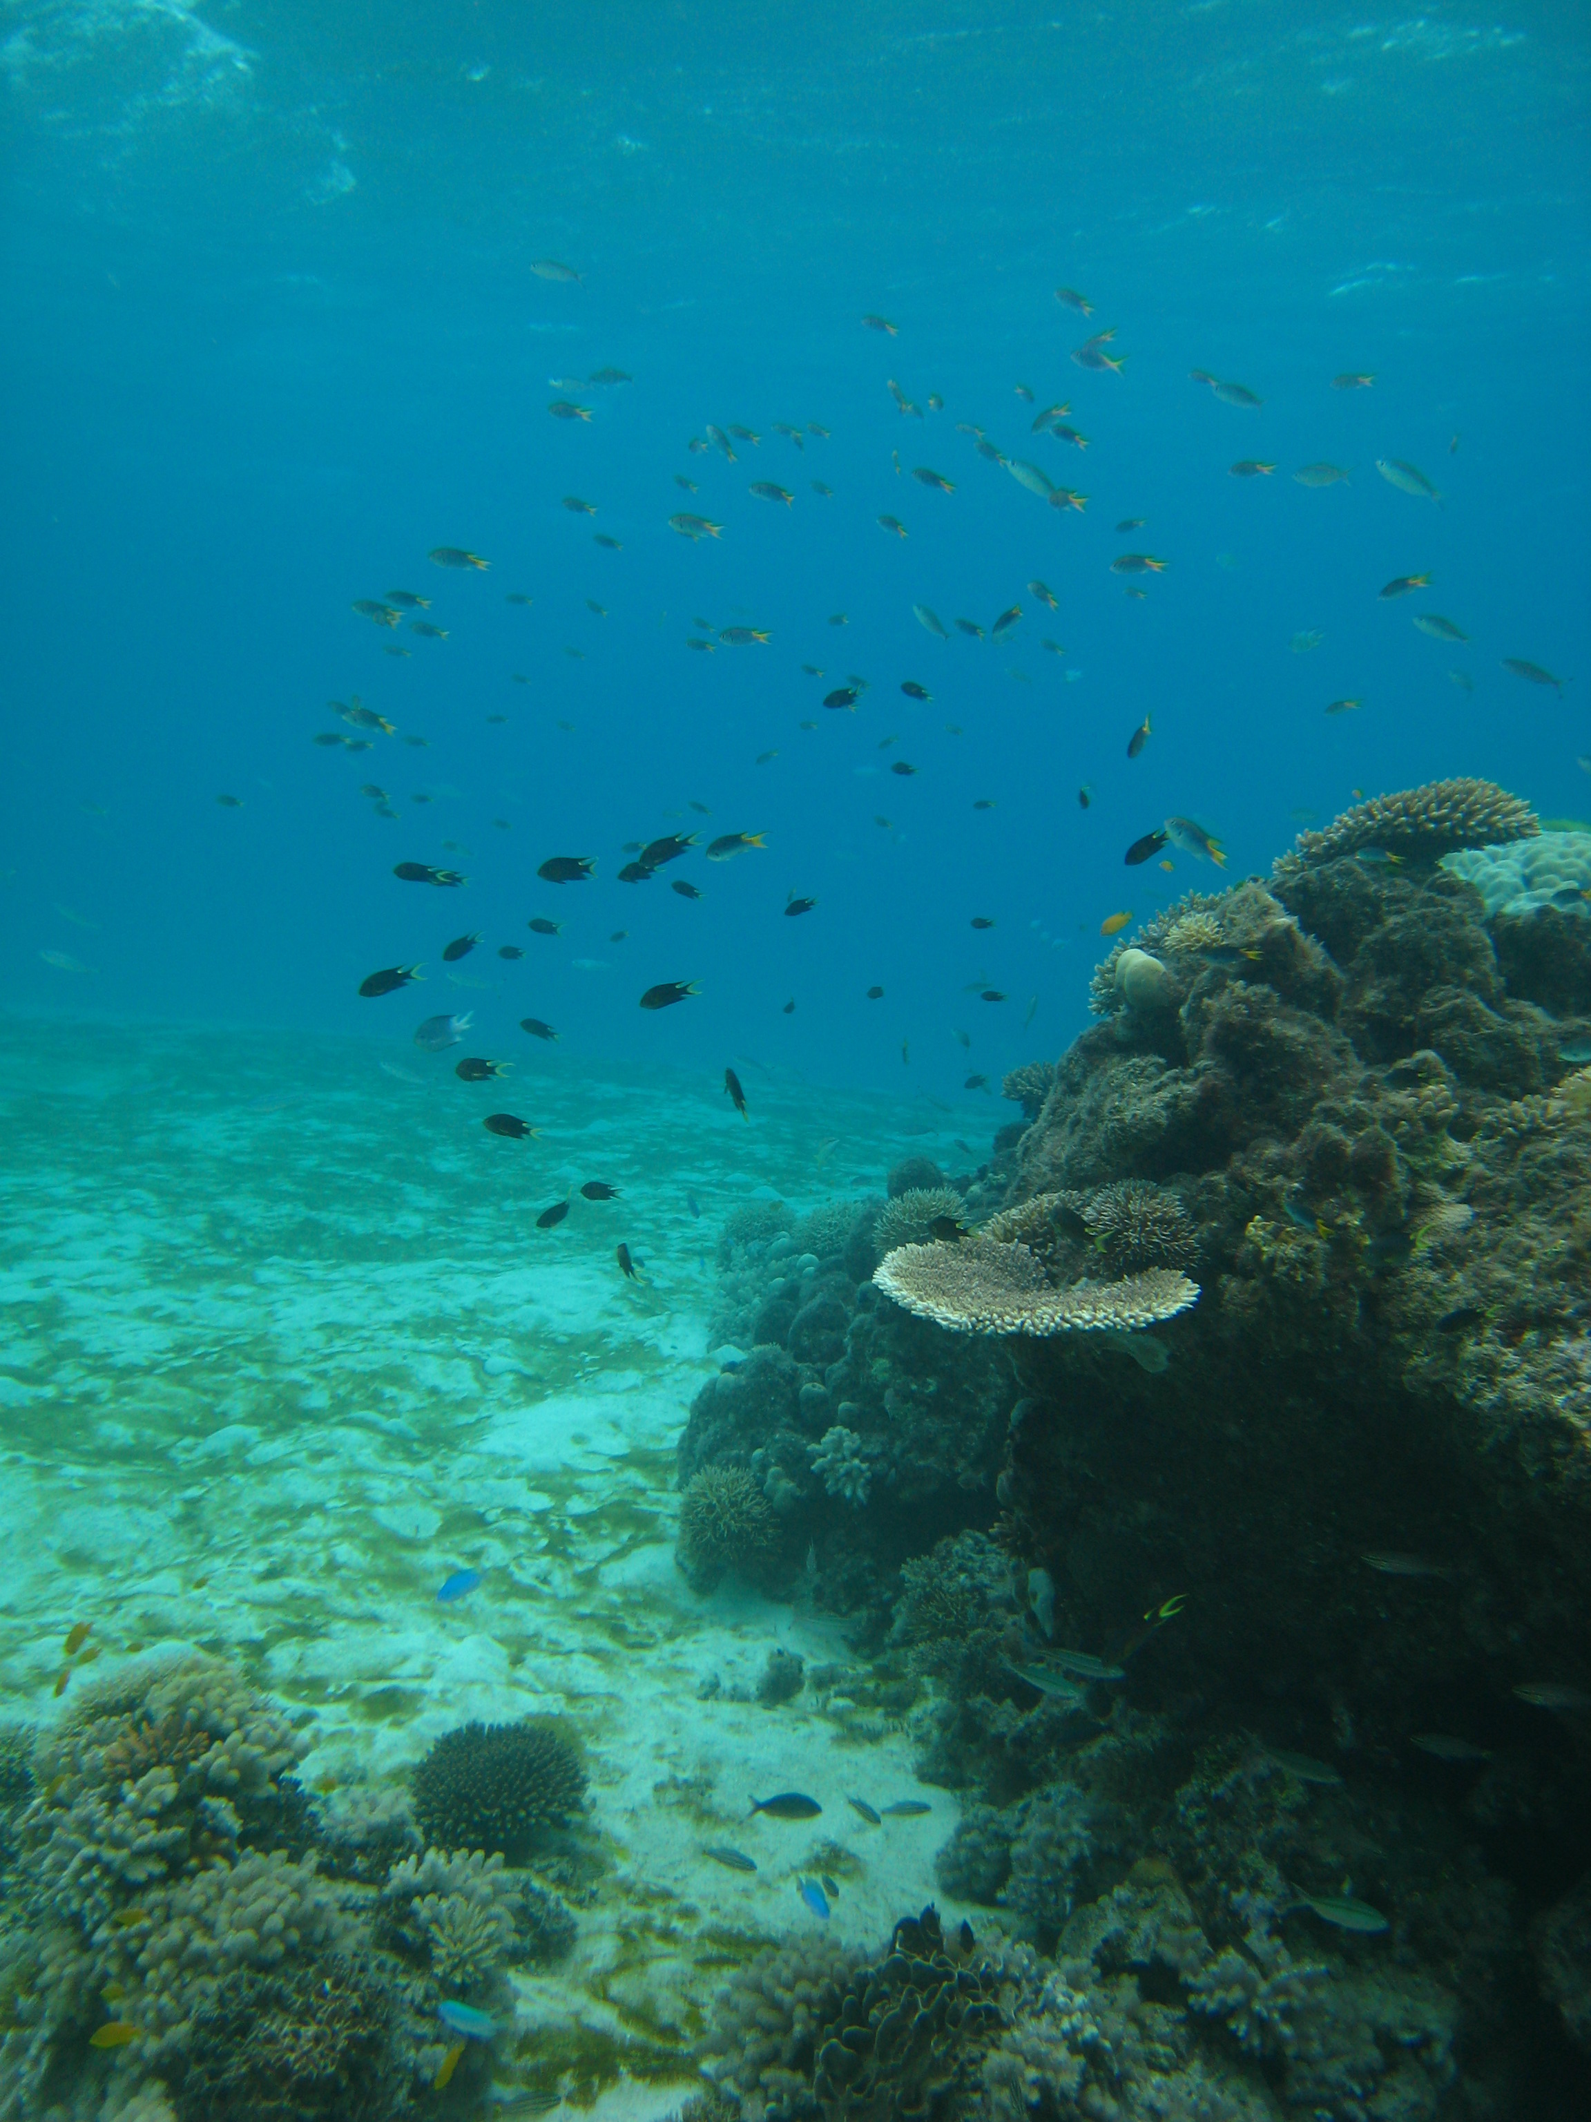
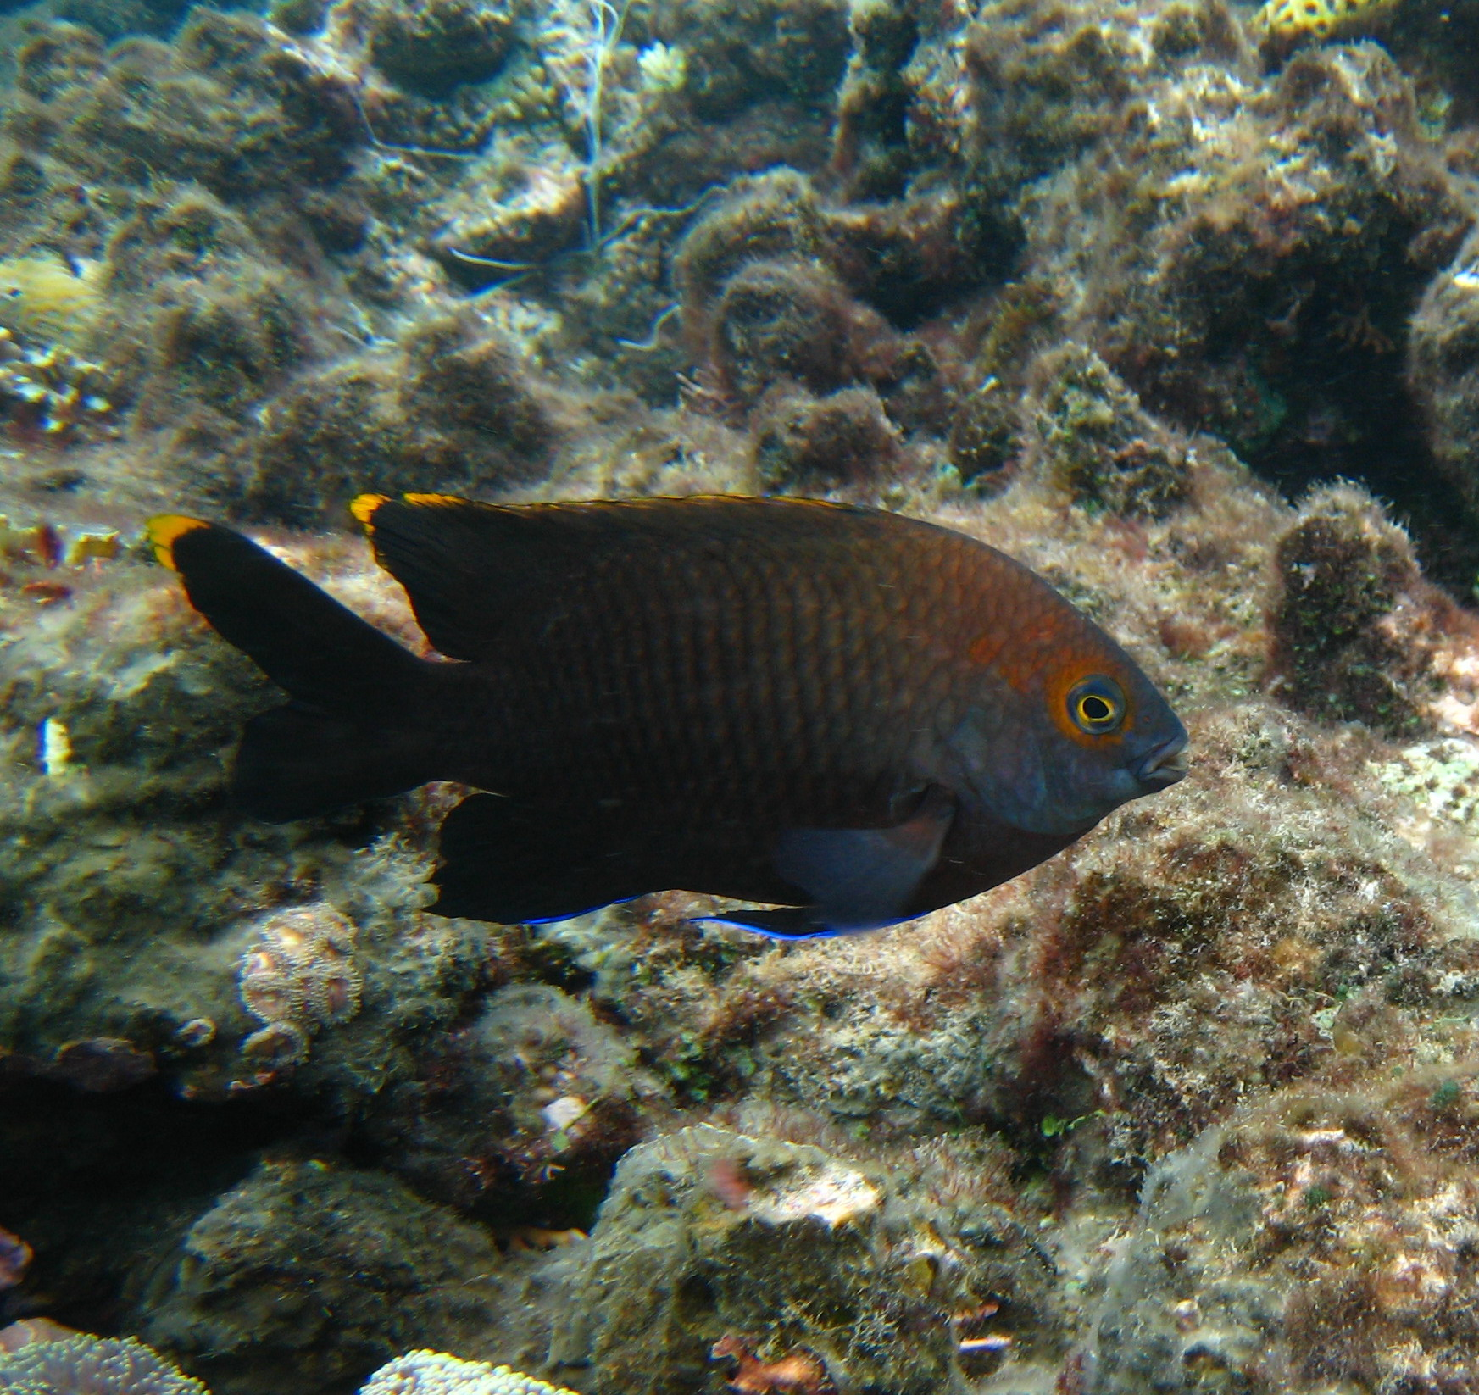
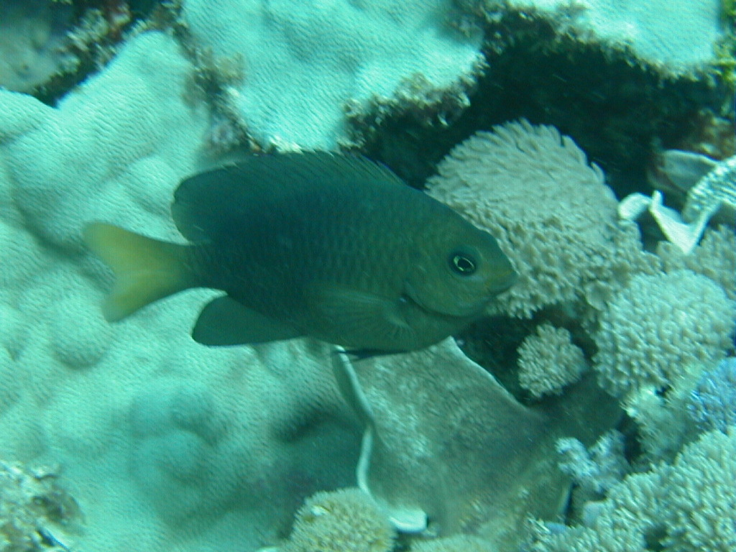
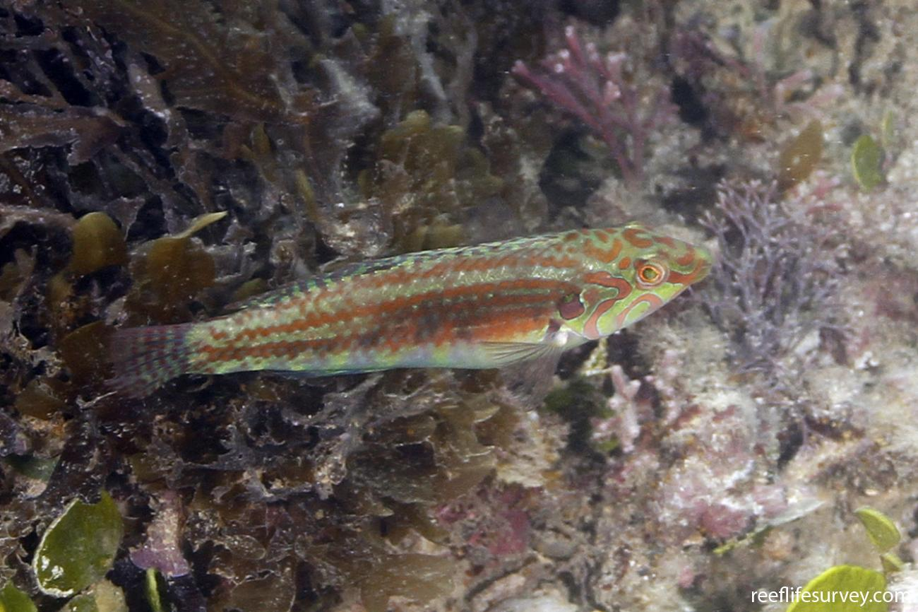
What are the most common types of fish?

Slide 9
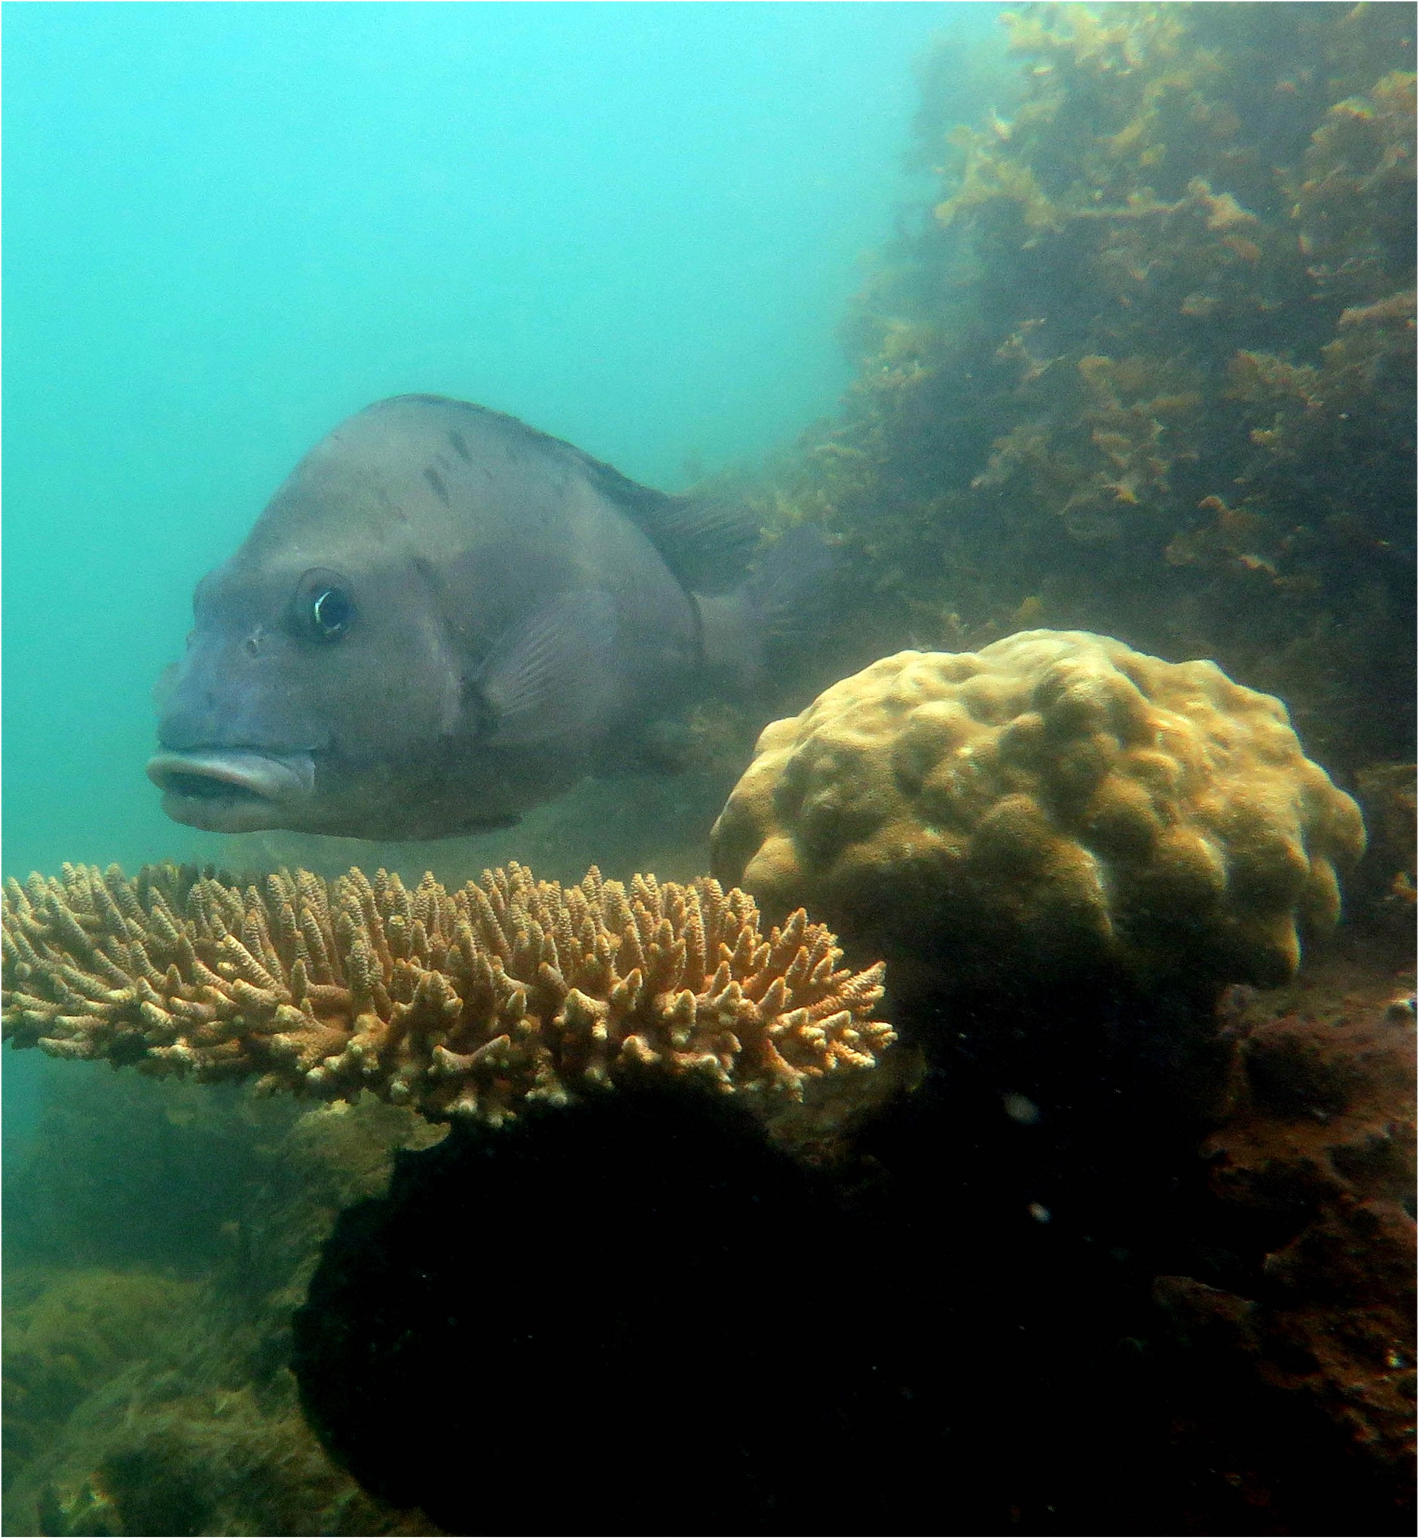
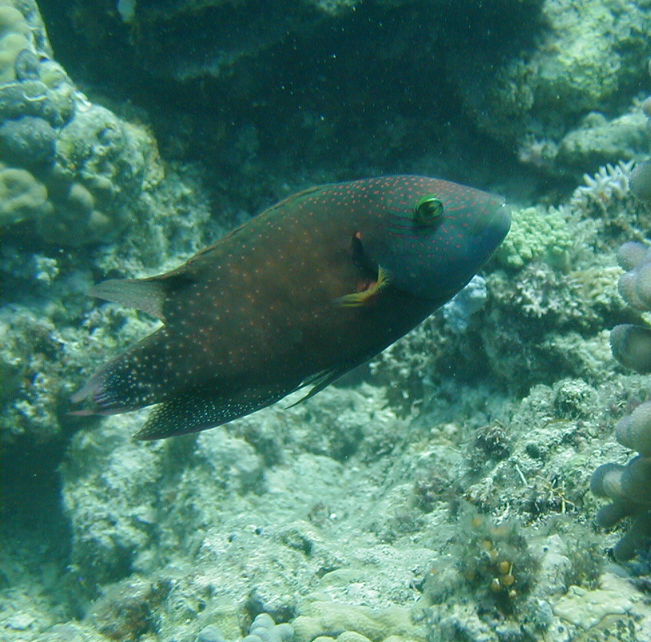
What are the most common types of fish?

Slide 10
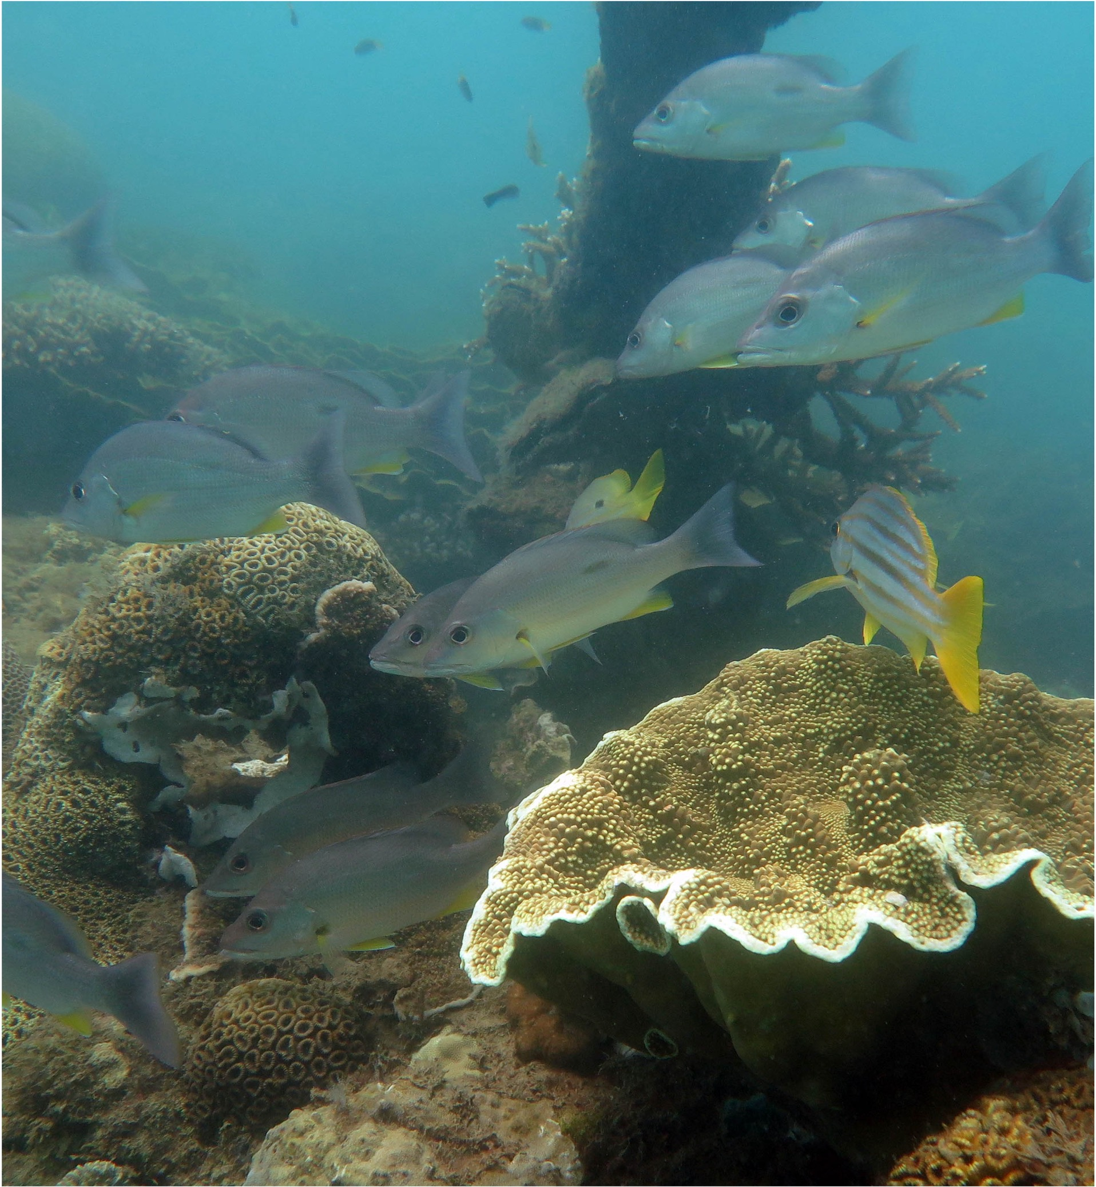
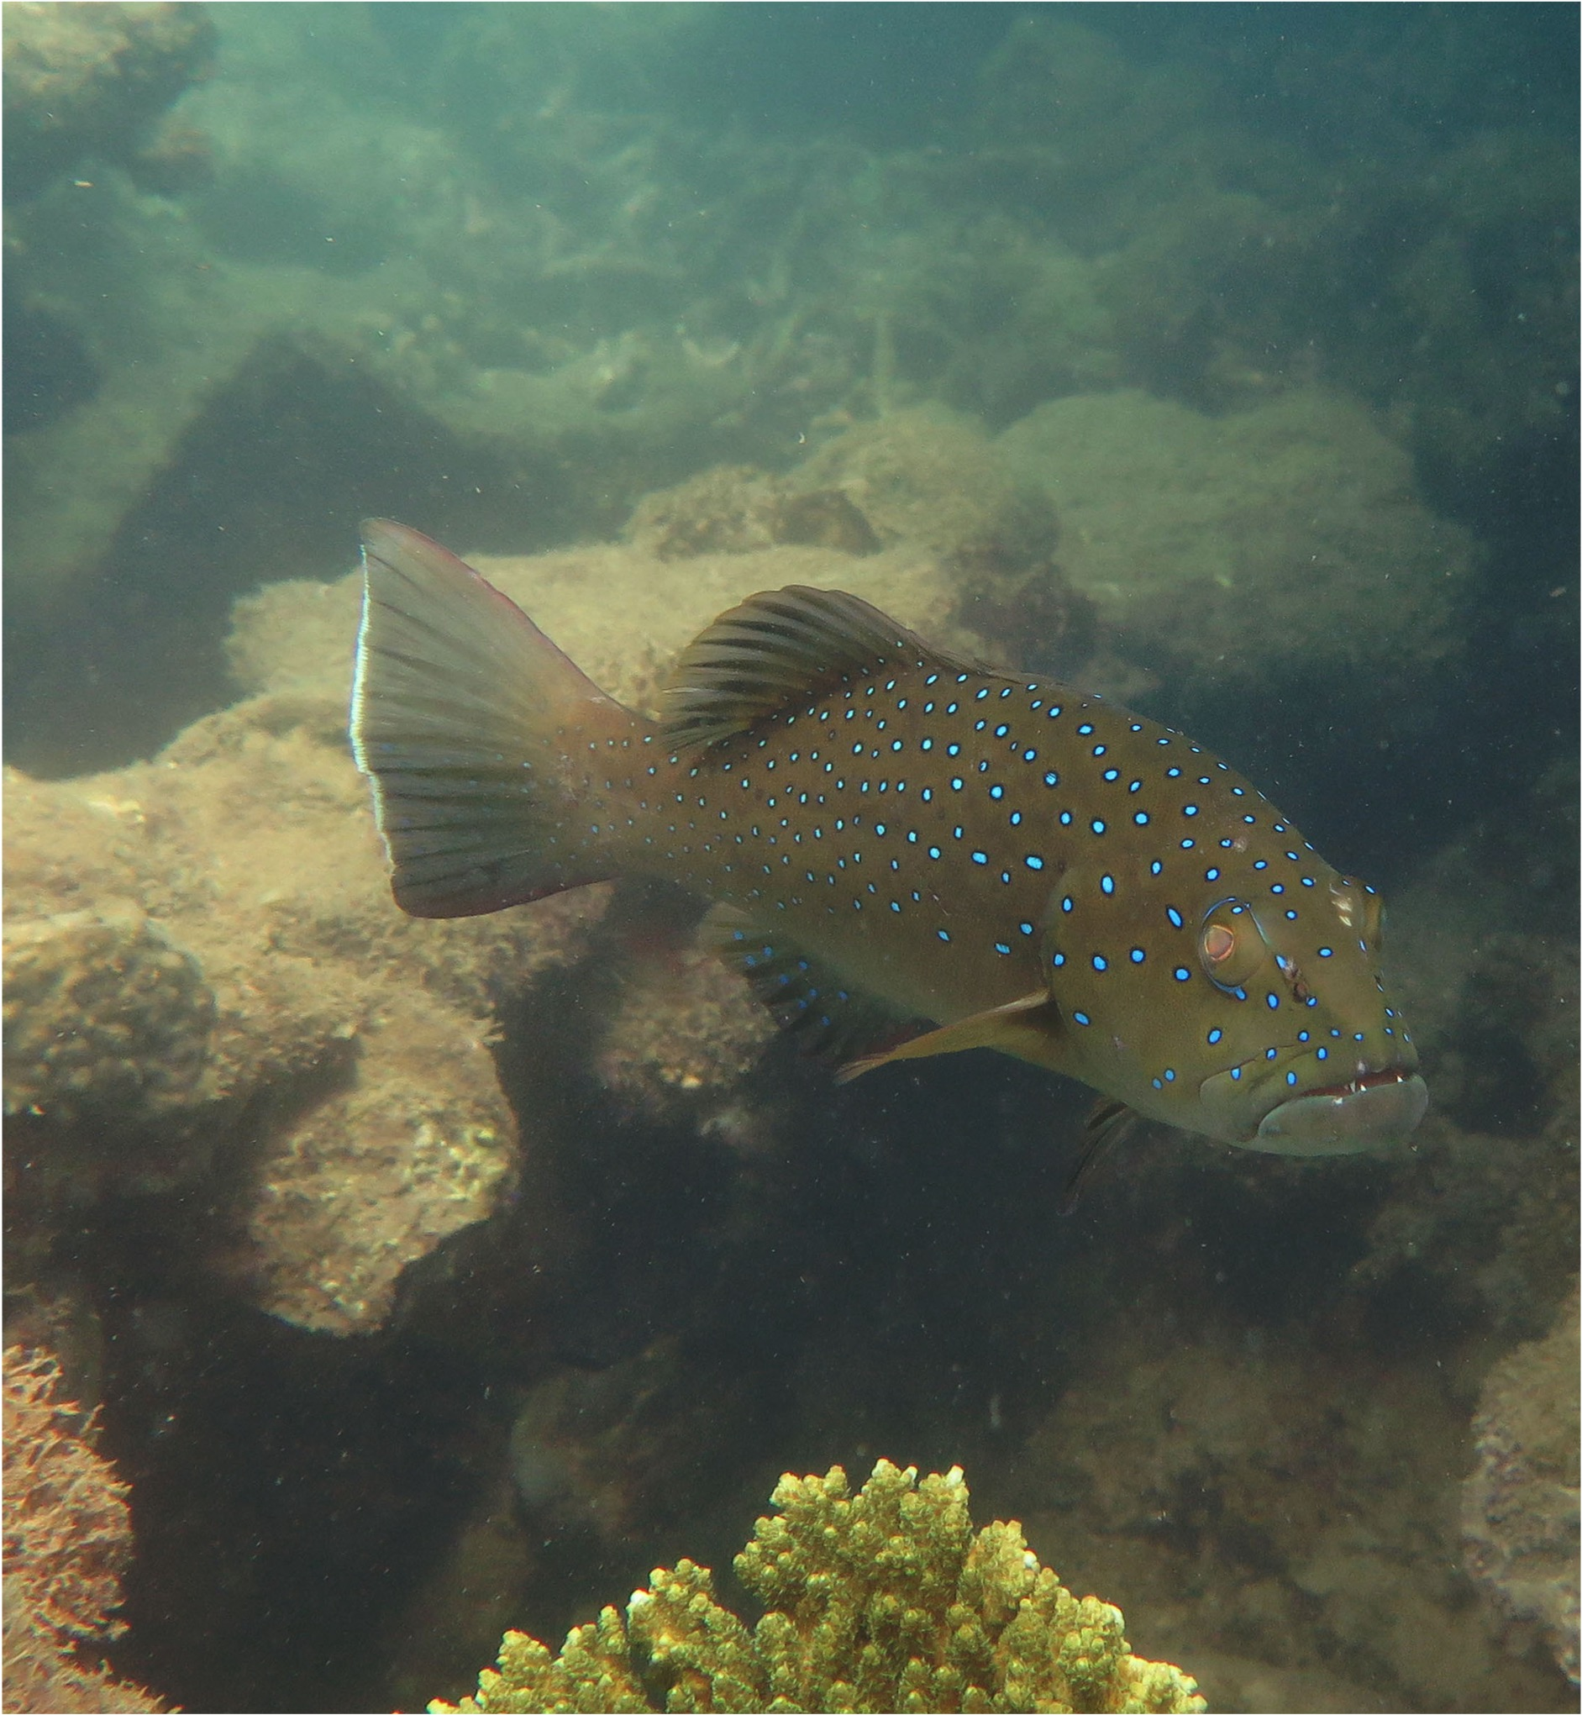
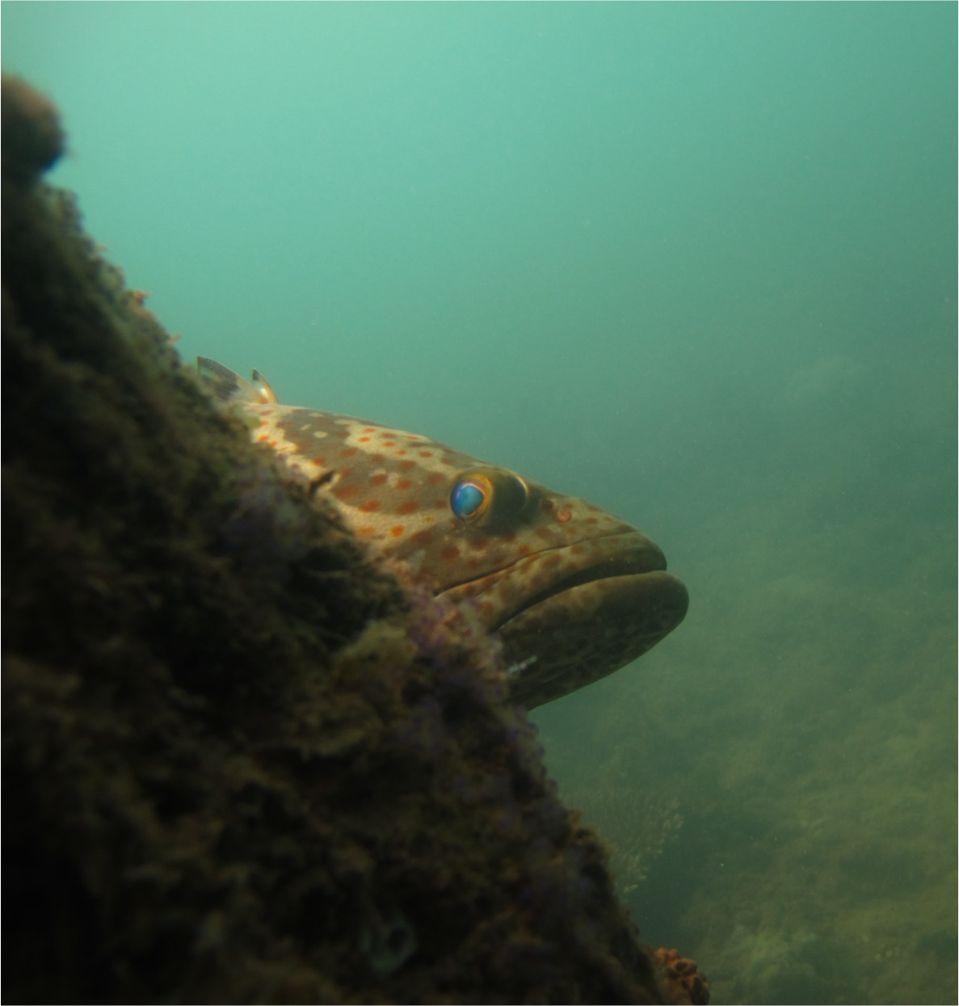
What are the most common types of fish?

Slide 11
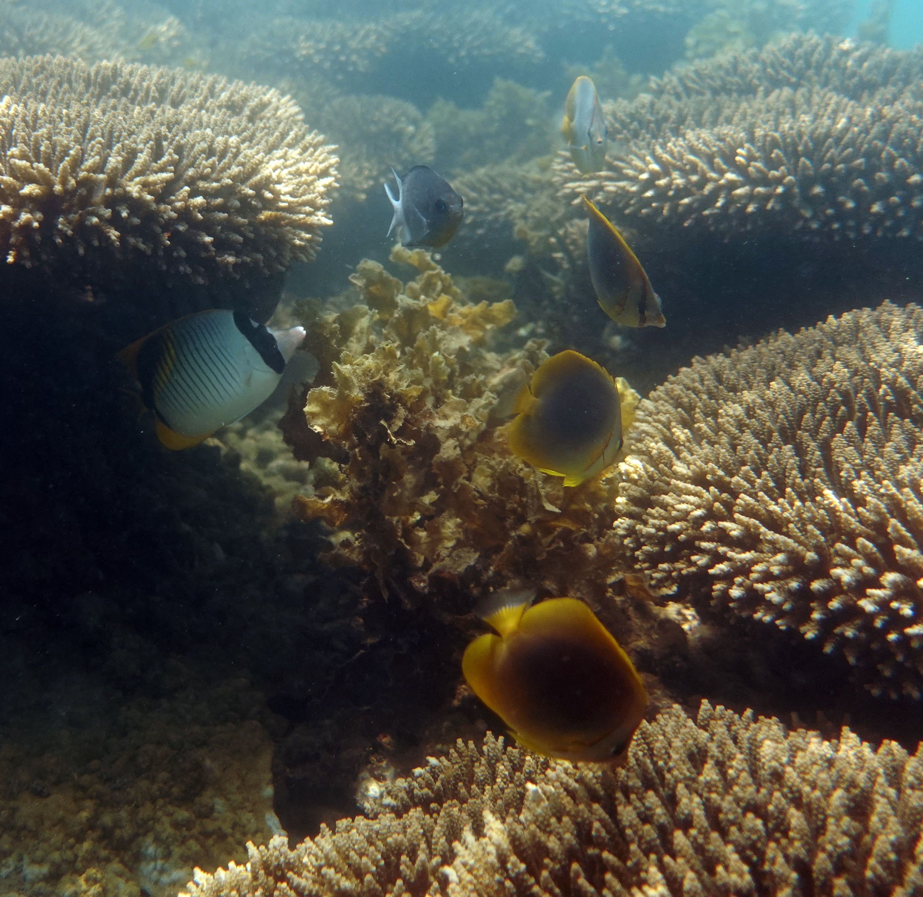
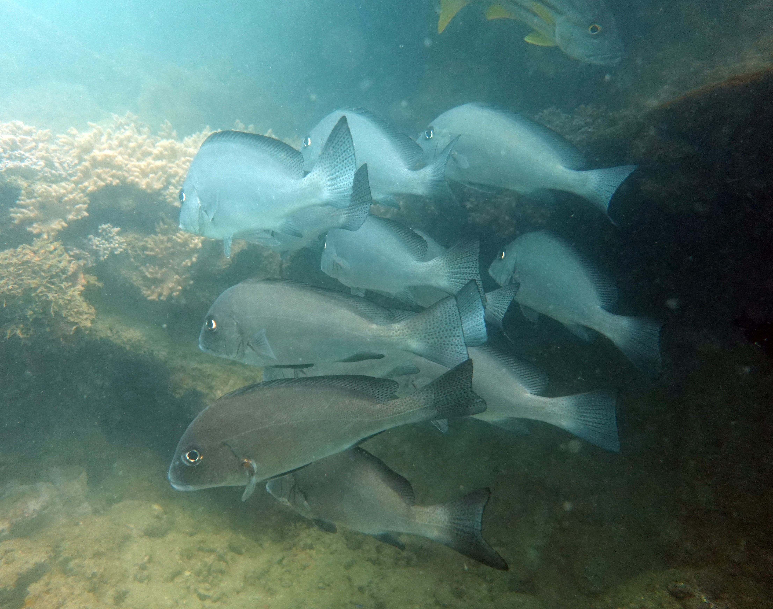
How have the fish changed over time?

Slide 12
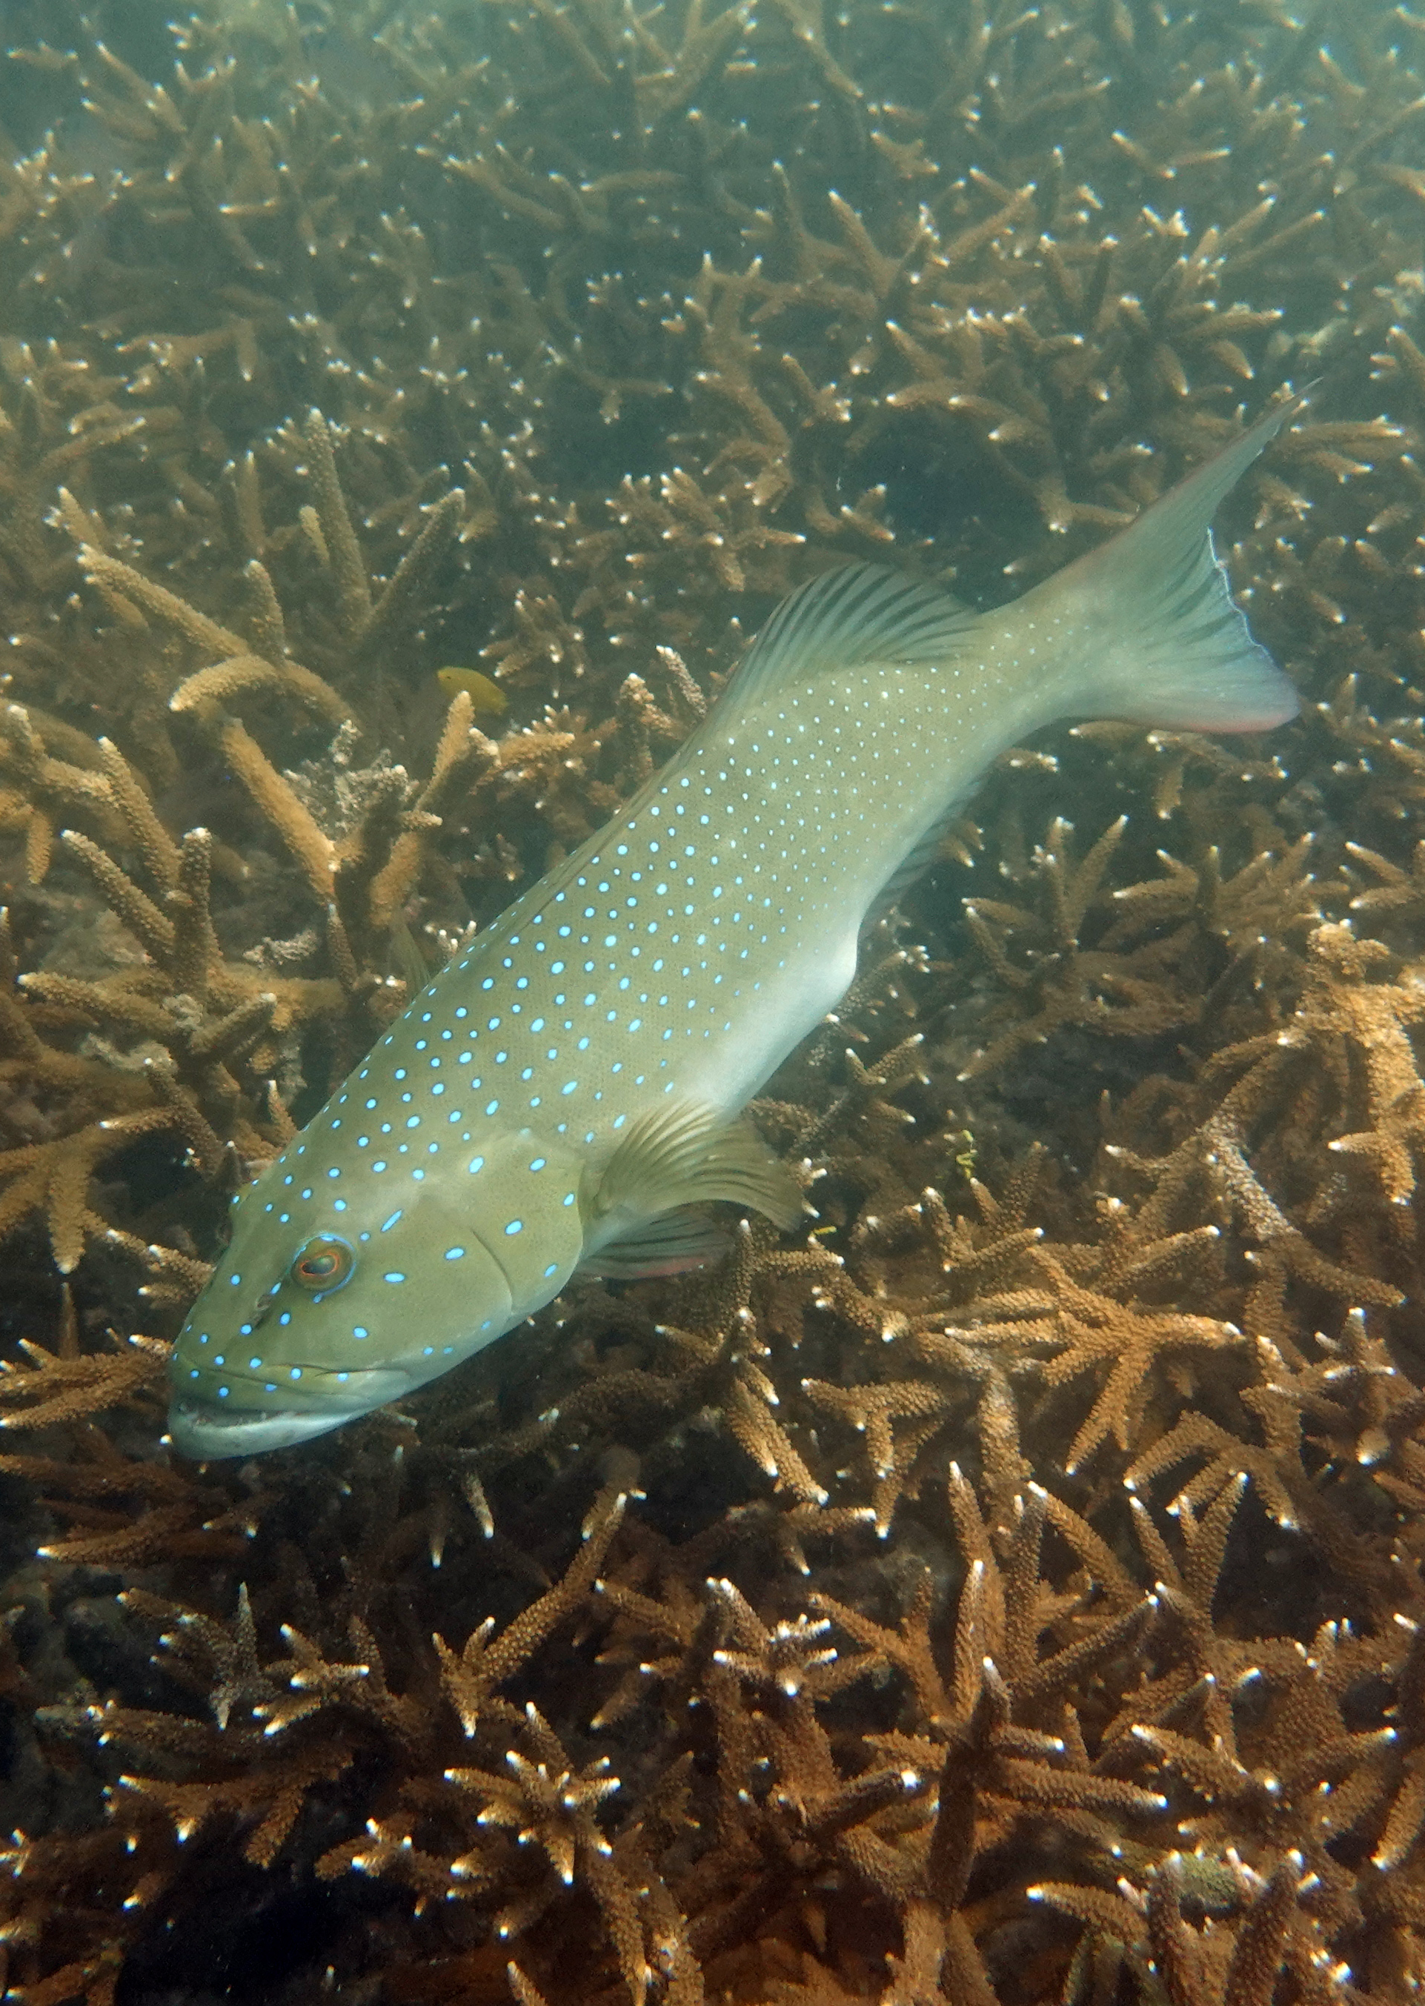
Coral trout – an indicator of fishing pressure

Slide 13
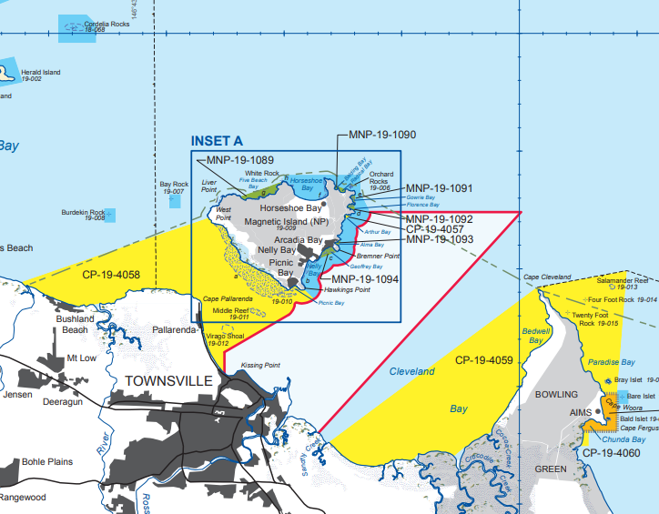
What’s the science behind Green Zones?

Slide 14
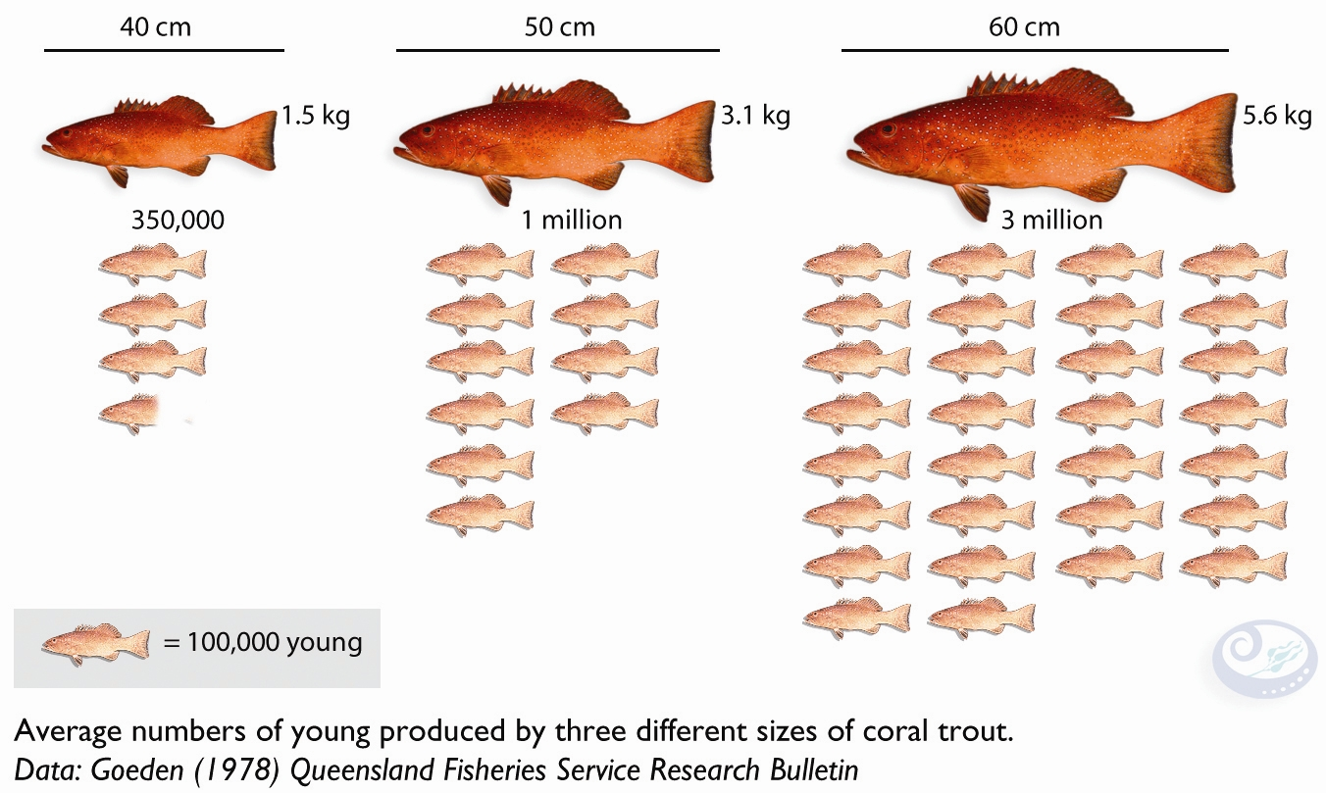
1. Bigger fish produce more babies

Slide 15
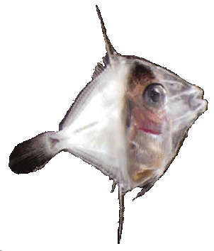
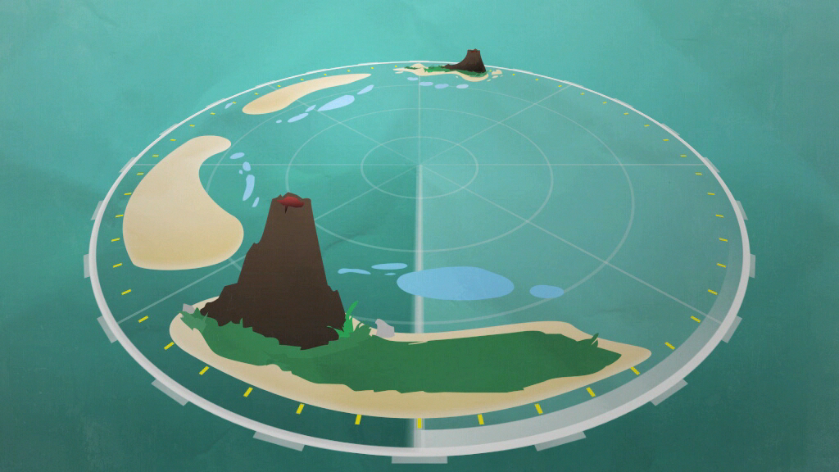
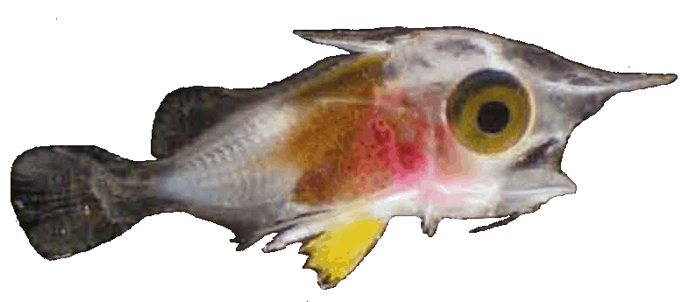
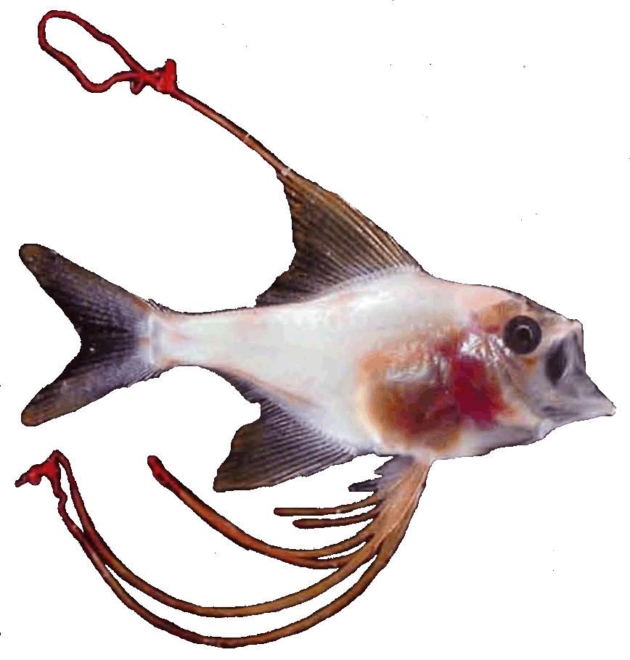
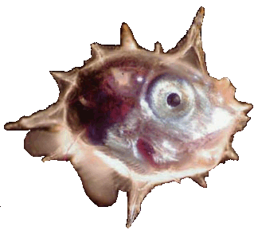
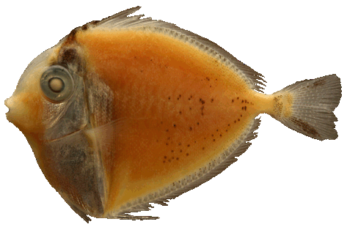
2. Most baby fish don’t stay at home with mum and dad
Pelagic larval phase – Ranges from several days to several months
Larval dispersal distances – From 10s of meters to 100s of km
Animation: Russell Kelley
Images: Bob Cowen

Slide 16

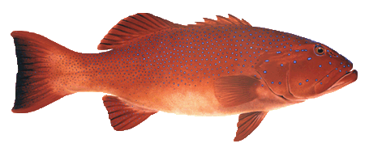
Where did the larvae come from?
Blue zones:
~ 57%
of juveniles
come from
Keppel Is.
green zones
Green zones:
~ 30%
of juveniles
come from
Keppel Is.
green zones
28% of
reef area
Harrison et al 2012 – Current Biology

Slide 17
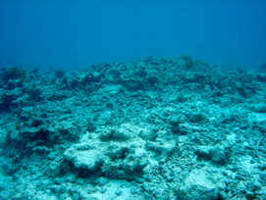
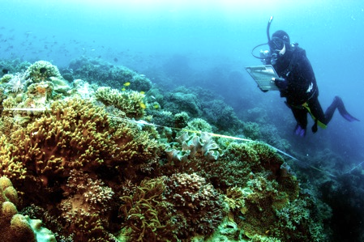
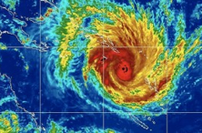
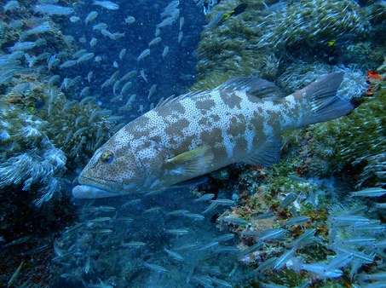
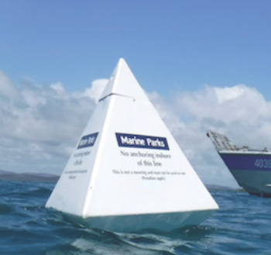
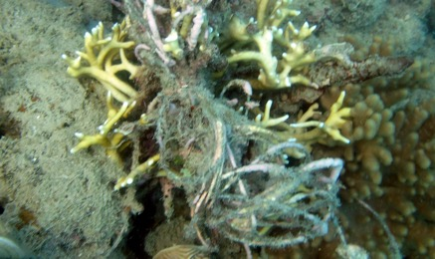
Contributions
Health of the reef and how it’s changing
Shows that the green zones are working to protect target fish
Stock assessments
Genetic work: green zones are exporting fish into the blue zones
Fishing line surveys: poaching hotspots
How cyclones and bleaching affect the reef
Where the reefs are more capable of resisting change and recovering after disturbance

Slide 18
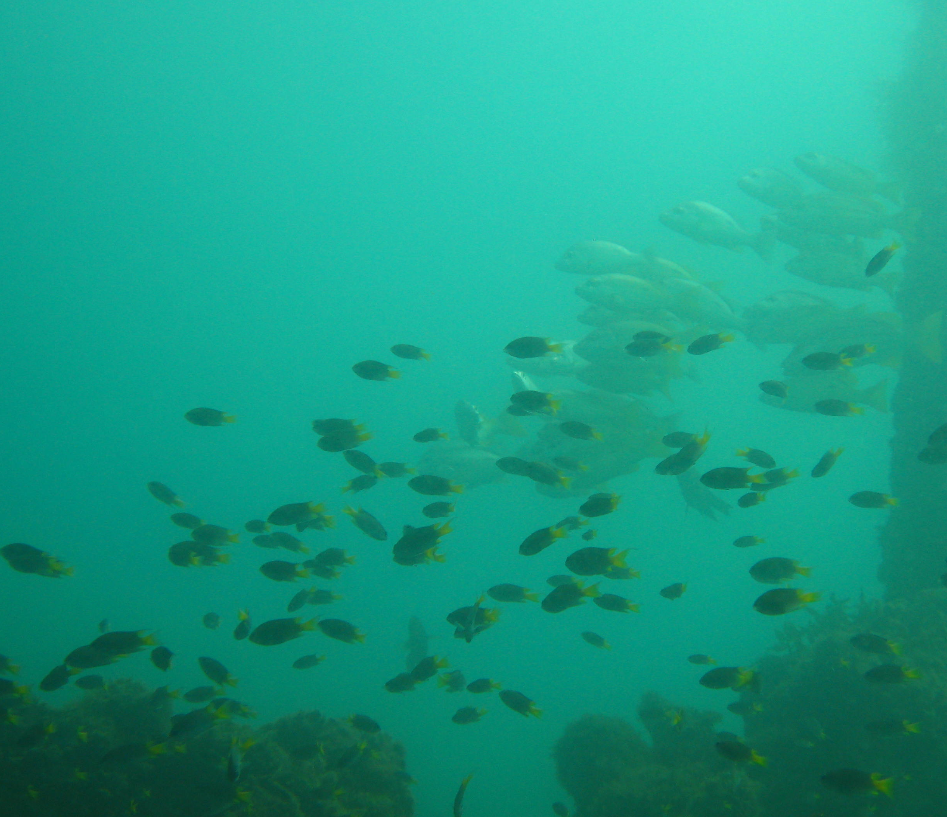
Where are the gaps?
How can we better protect the Green Zones?
Which species are being caught around the island?
How can we continue to document reef fish?
How can we share knowledge about the fish communities?
What are people curious about?
Which fish habitats are important or at risk?
How do our actions on land impact our marine fish?
Yunbenun
Fish

Slide 19
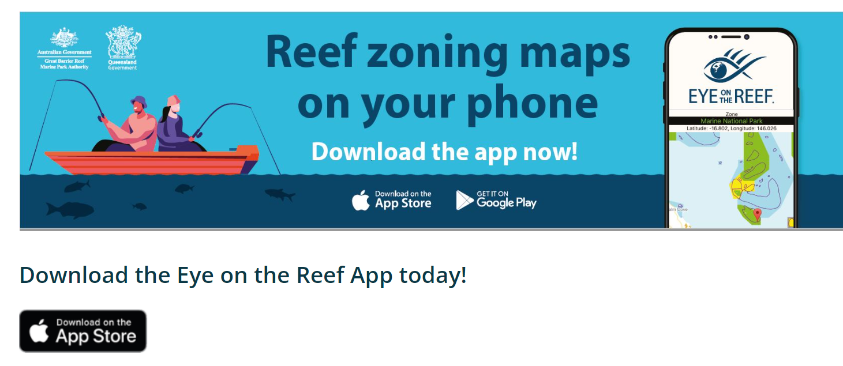
How can you get involved?
Eye on the Reef app
Yunbenun
Fish

Slide 20
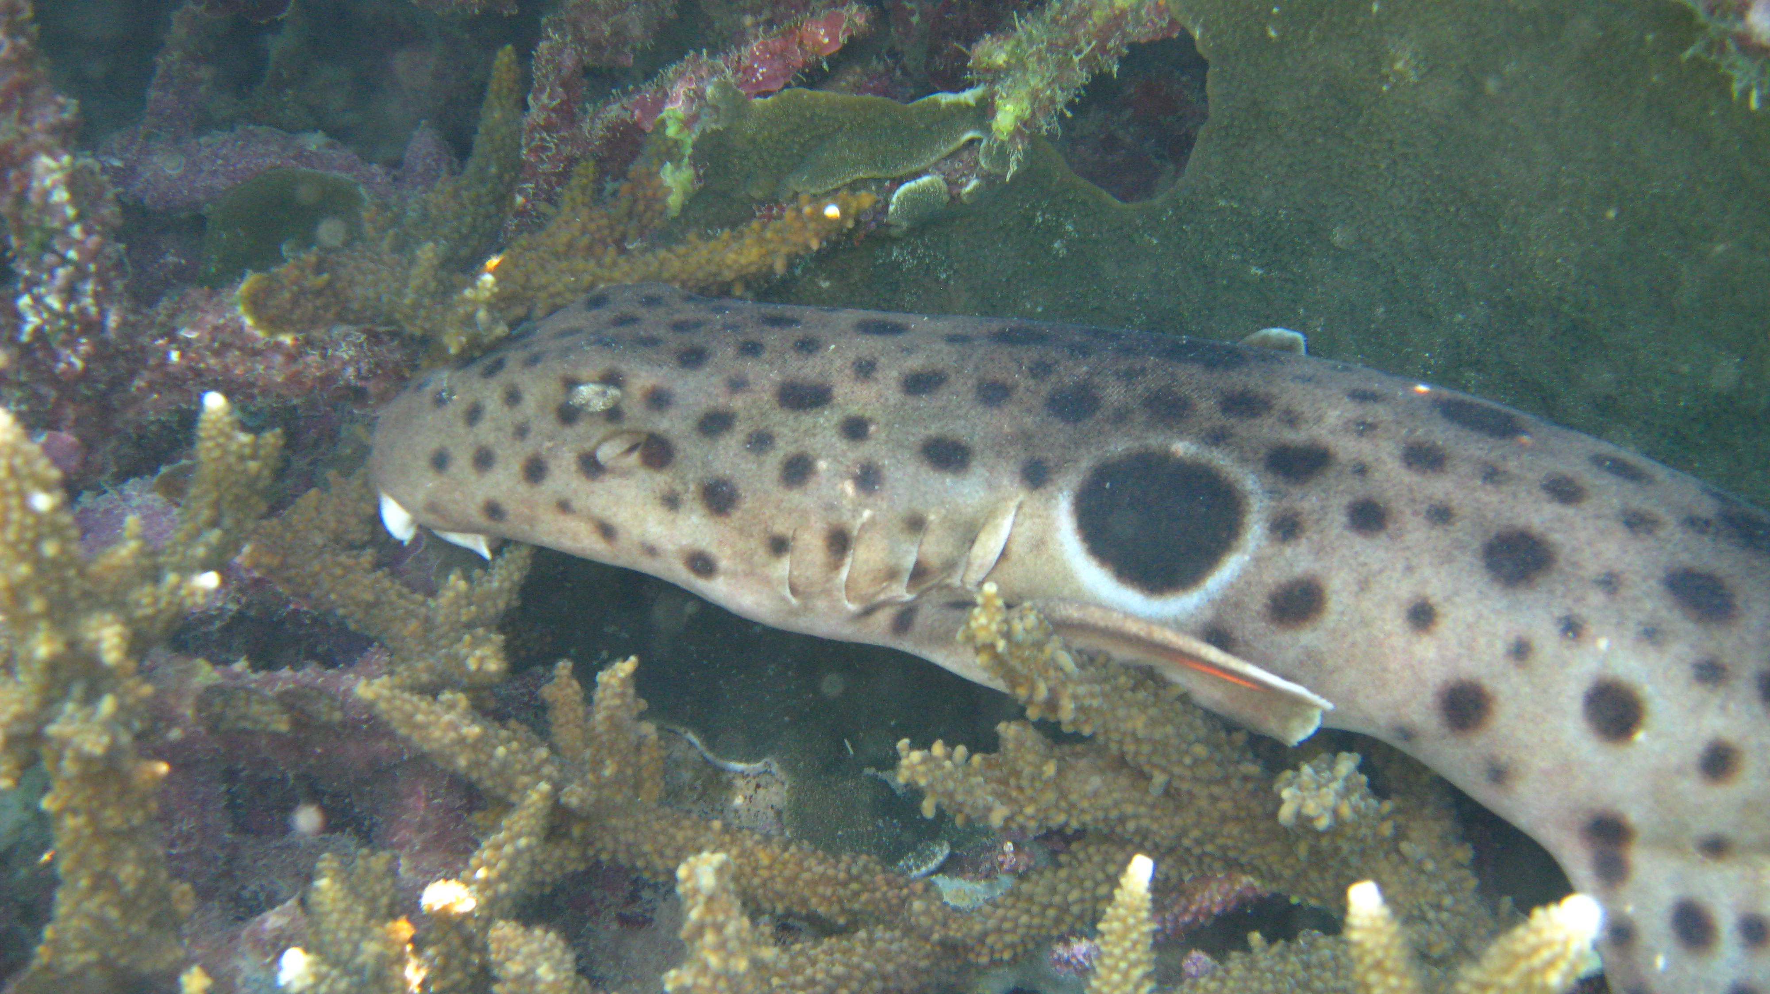
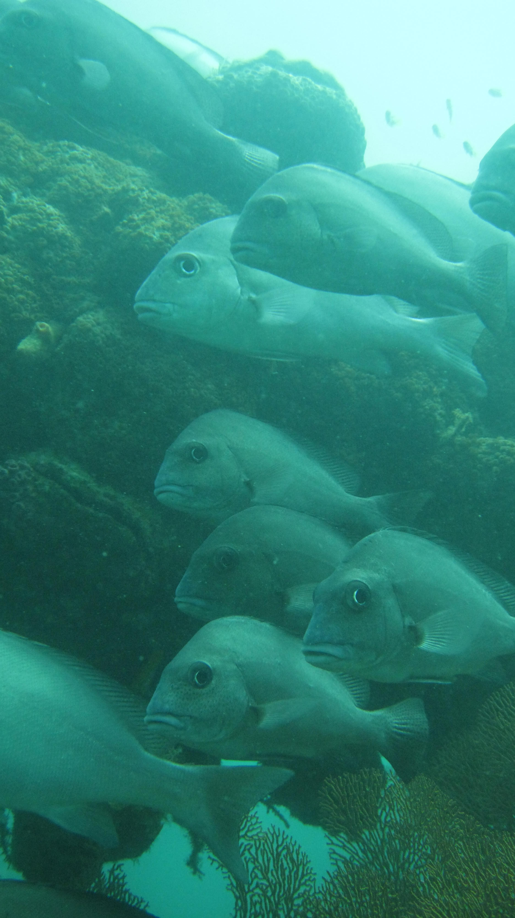
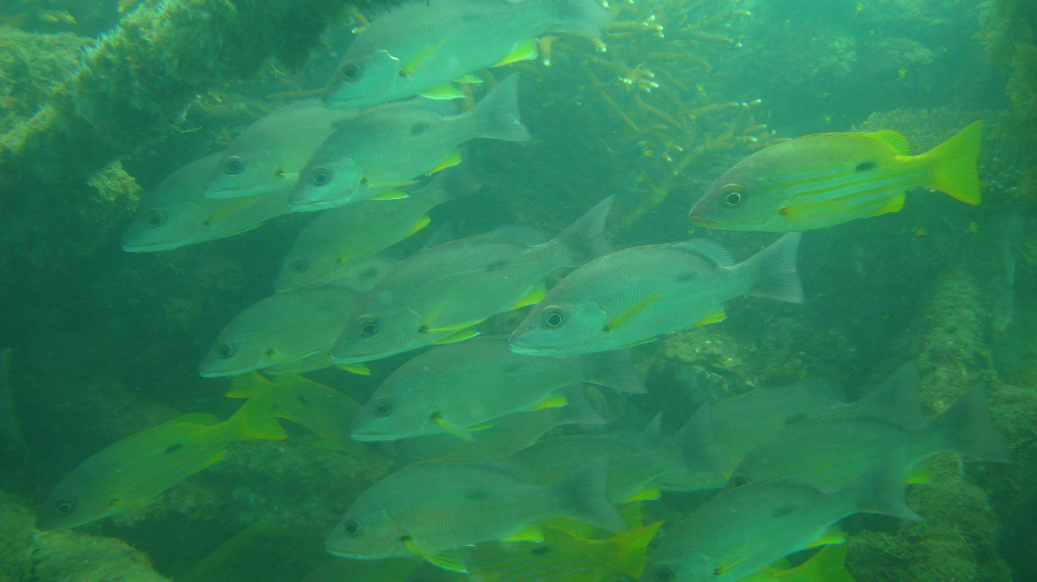
Dr. Daniela Ceccarelli
d.ceccarelli@aims.gov.au
0488510702
THANK YOU
@DanielaCeccar8

Slide 21
Dr. Daniela Ceccarelli
d.ceccarelli@aims.gov.au
0488510702
Additional slides
@DanielaCeccar8

Slide 22
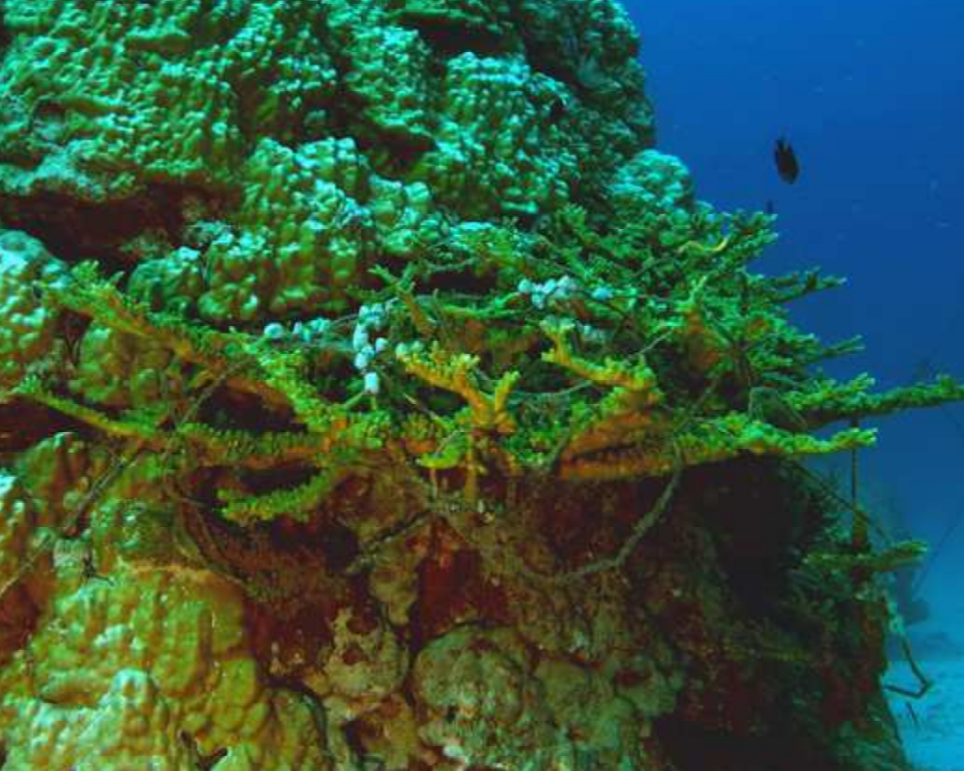
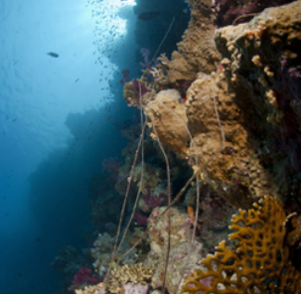
Poaching in Green Zones
Poaching erodes the benefits of Green Zones
Notes:
But – as we could see with our fishing line data – illegal fishing in green zones is a real threat to these mum and dad fish. In the Palm Islands, we counted the snagged lines, removed them all in 2012, and counted what had come back in two years, by 2014. The height of the dark grey bars shows how much line was removed, and the white bars shows how much came back. This is what happened in the blue zones, and here is how much line there was in the green zones. And here is the same for the Whitsundays. The main thing to note is that these lines in the green shouldn’t be there at all, and gives us a measure of how much people are fishing in green zones.

Slide 23
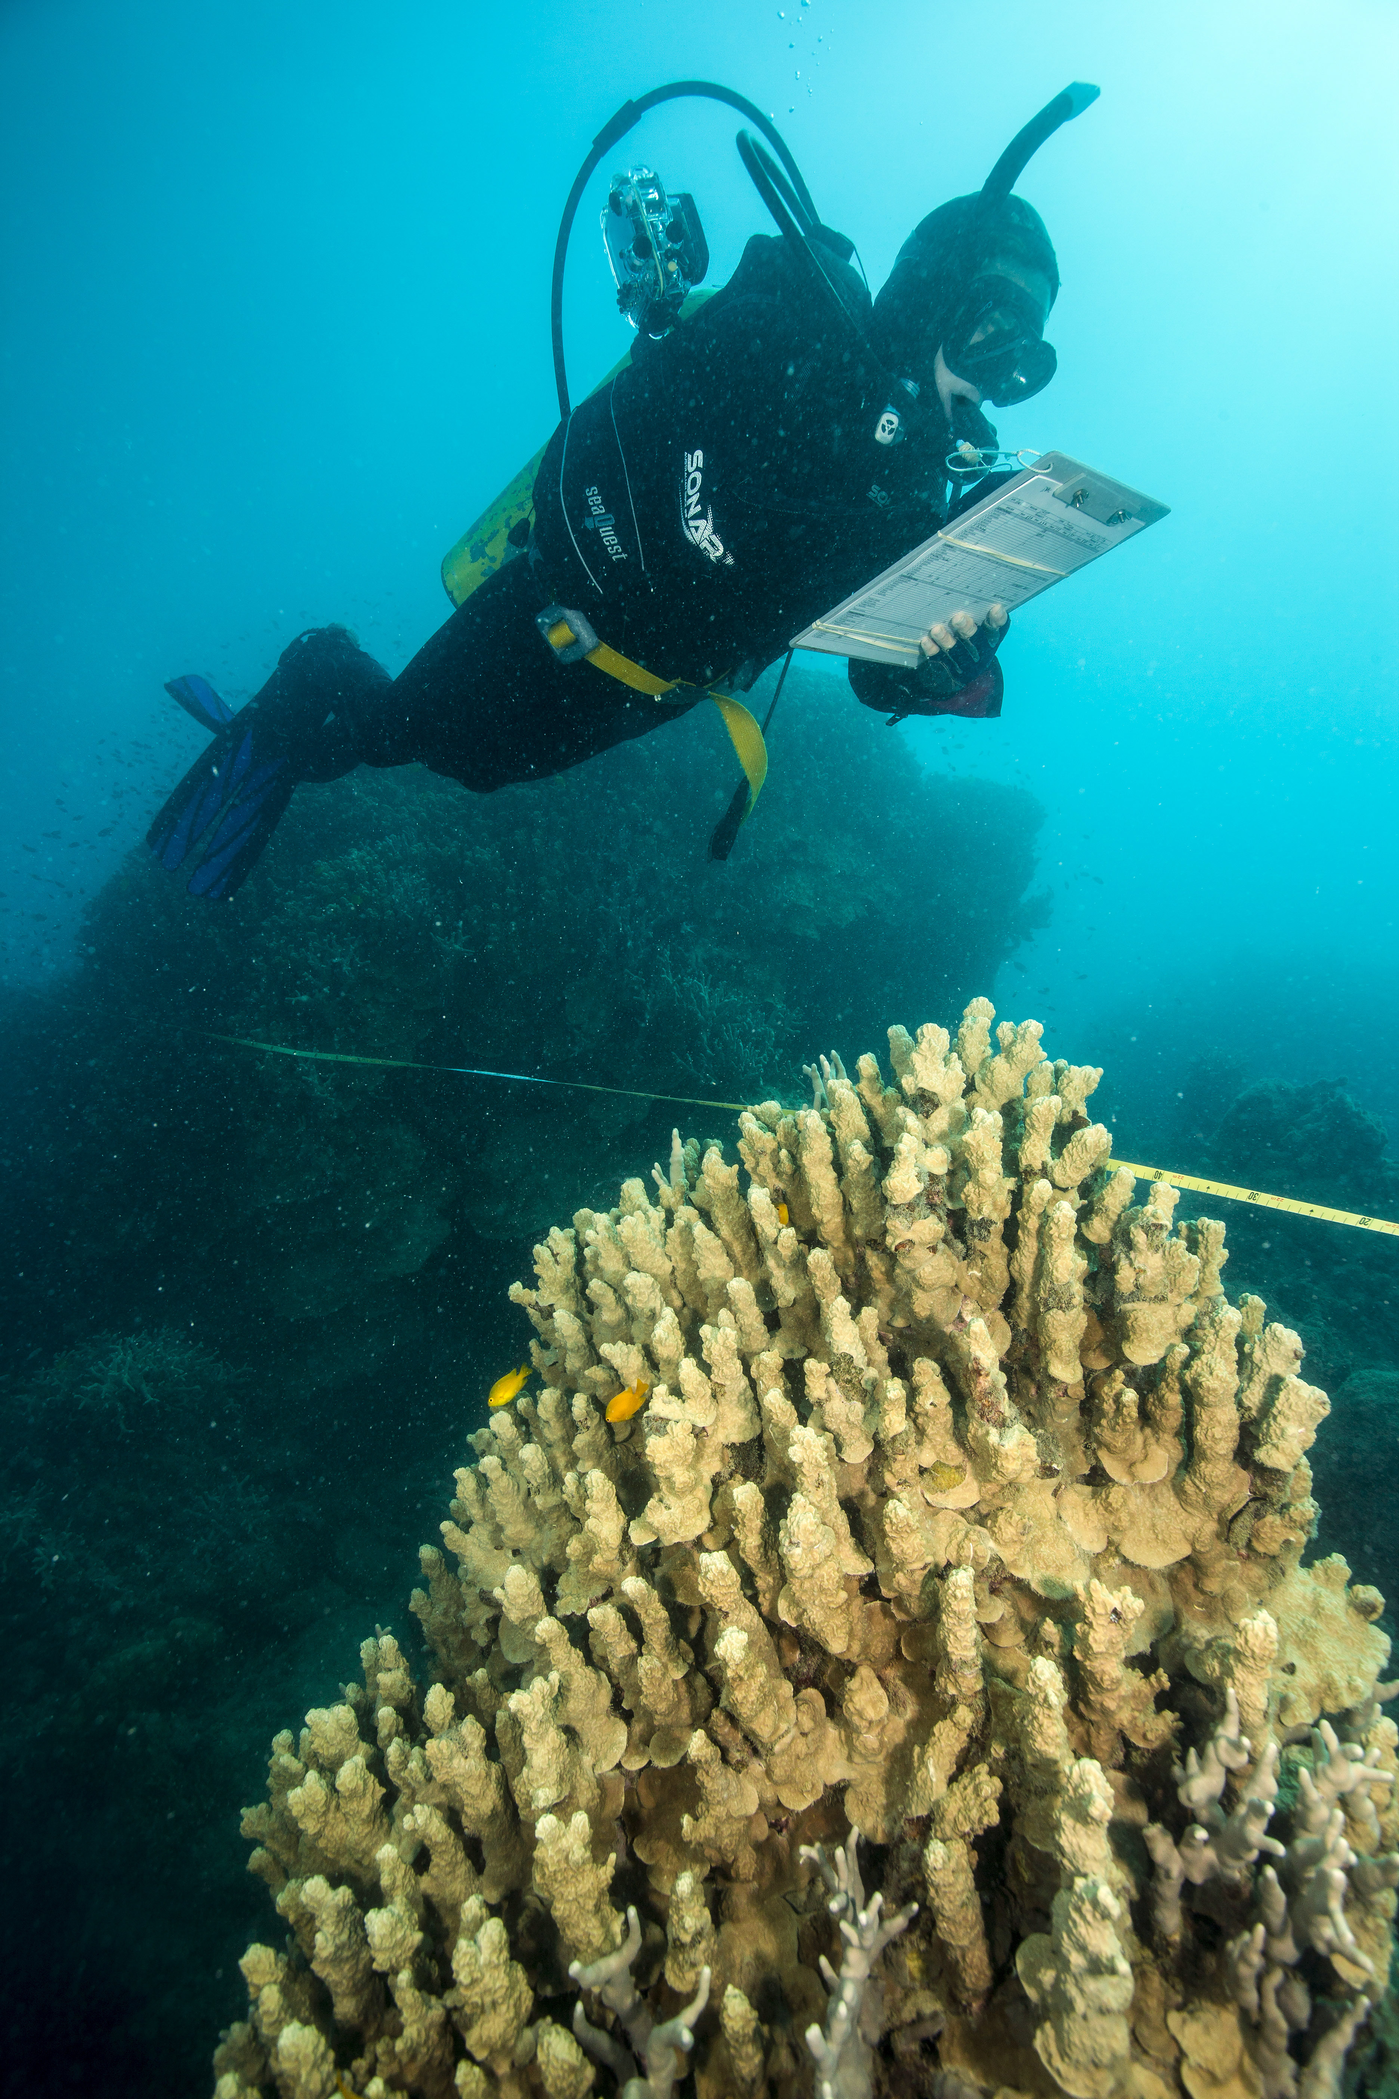
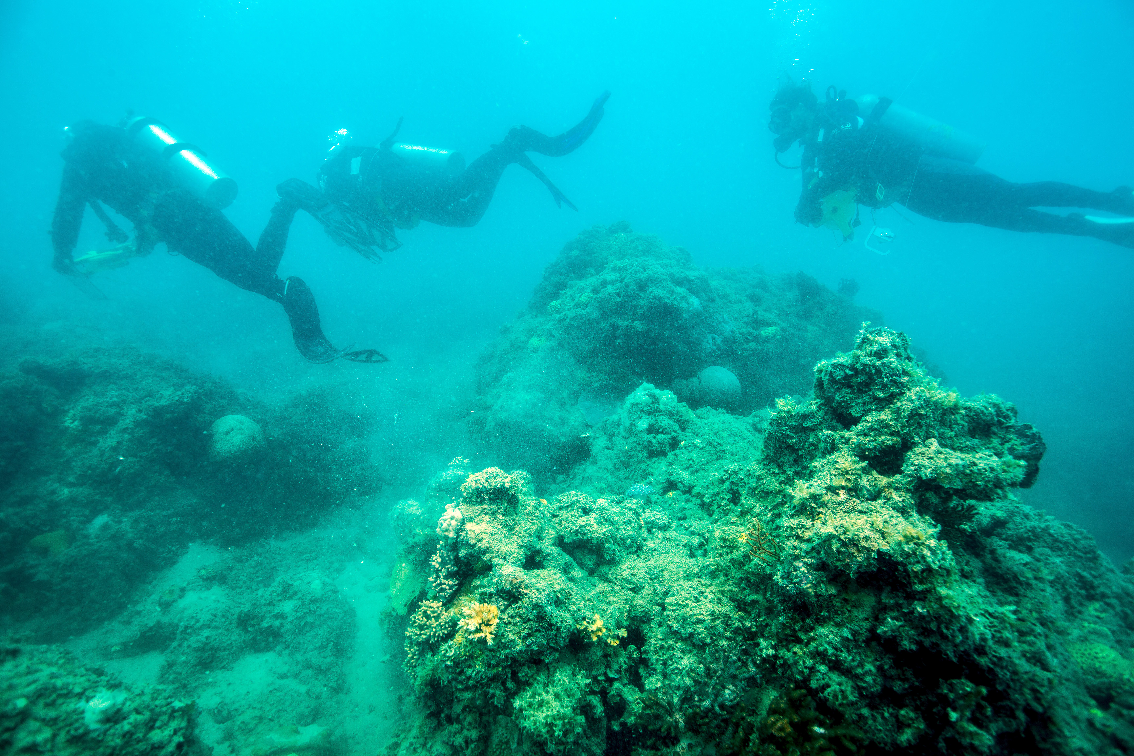
Sites and Methods
How do you study fish on the reef?
JCU Inshore Monitoring Program
Fish communities on the inshore fringing reefs of the Great Barrier Reef
Notes:
In reality, there are always a few of us working along the transects. Someone goes first and counts the big fish that are a bit more flighty, then the tape gets laid behind them, and people might come along the tape counting the smaller fish and the corals and other things that grow on the bottom. We also tally bits of fishing line snagged on the reef.

Slide 24
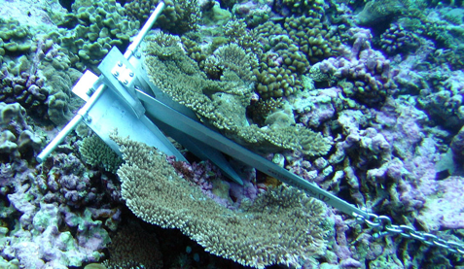
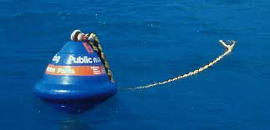









New moorings & reef protection markers – Keppels 2017

Slide 25
Discarded fishing gears
Palm Island group
Whitsunday Island group
Widespread poaching is occurring in both regions
* Potentially inflated accumulation rates in Palms
Bergseth et al. (2017) - FREE. 15, 67-73
Notes:
Dotted horizontal lines are the mean line densities for the entire region
These hotspots are suggestive of night fishing – which has been acknowledged as a rising problem by GBRMPA

Slide 26
Prevalence of poaching by recreational fishers
Boat ramp surveys conducted in Townsville, April 2015 – December 2016
Specialized questioning techniques that employed several methods
682 total surveys collected
Poaching level estimated at 3 - 13% of GBR recreational fisher population
Overall, 13% of fishers surveyed knew someone who had poached in the last 12 months
2009 non compliance estimate = 10% (via RRT and perceived poaching; Arias & Sutton 2013)
More direct methods (RRT, SAQ, & UCT) used in this study are likely prone to underreporting
Bergseth et al. (2017) - FREE. 15, 67-73
Notes:
RRT gave the highest estimate

Slide 27
Perceived motivations to poach
Fishers perceive poaching as opportunity-based rather than an act of protest or rebellion
  ie. better catches and low risk of detection
Overall, little difference between line fishers and spearfishers except defiance and acts of rebellion
Extolling the benefits of reserves (i.e. bigger and more fish) may encourage poaching when enforcement is limited
Fishers may use short-term planning when deciding to poach, so further information about larval subsidies, etc. may not deter poaching
Agree
Disagree
Social influence approaches should therefore aim to influence people’s perceptions of the occurrence and social unacceptability of poaching
Bergseth et al. (2017) - FREE. 15, 67-73

Slide 28
What research has been done here?
James Cook University / ARC CoE Reef fish surveys at 8 sites on the eastern side of the island to measure the effects of zoning on fish communities, 2004-2019.
James Cook University Tagging of blacktip reef sharks in Cockle Bay, 2008-2011.
University of Queensland Ciguatera study, 2006-2007.
James Cook University Experimental and observational research to test the effects of farming damselfish on corals and algae, 1998-2004.
Environ-Ecological Engineering Institute Diets of fishes inhabiting the seagrass beds of Cockle Bay.
Notes:
I’d like to quickly show you what these four studies found, and then spend some more time talking about this program, the long-term monitoring of fish in green and blue zones, because that’s where I think we can think about useful ongoing information gathering where the community can get involved.

Slide 29


Population structure and residency patterns of the blacktip reef shark Carcharhinus melanopterus in turbid coastal environments
Mating between December and April
Birth from December to March
Highly resident population with a recapture rate of 21% and a mean recapture distance of 0·8 km
Important ecosystem functions performed by coastal habitats in sustaining blacktip reef shark populations.
Cockle Bay
Notes:
Here, some scientists at JCU caught blacktip reefs sharks at Cockle Bay, measured them, determined what sex they were and whether they were juveniles or adults, tagged them and released them. They then spread the information about this far and wide and had fishers report back if they caught a tagged shark.
They discovered that the sharks tend to mate between December and April, and give birth between December and March. A large proportion of the sharks were recaptured close to home. So now we know that this is a very important habitat for these populations of sharks, and that there are times during mating and giving birth that they might be more vulnerable to disturbance.

Slide 30


Ciguatera study
High nitrogen concentrations - nutrient enrichment
Dinoflagellates on the leaves of macroalgae on inshore reefs not as conducive to ciguatera as those offshore
Arthur Bay
Geoffrey Bay
Nelly Bay
Notes:
In 2006, scientists from the University of Queensland studied ciguatera on the Great Barrier Reef, and included some sites around Yunbenun. Ciguatera is a type of poisoning that comes from a toxic dinoflagellate – a microscopic organism that lives in algae and ends up in the flesh of fish like trout.
They found out that where there was a lot of runoff from the rivers cause high levels of nitrogen or nutrient enrichment.
However, it seems that closer to the coast there’s not as much ciguatera as further offshore. This fits well with the high level ciguatera poisoning out in the Pacific, compared with Australia in general.

Slide 31




Territorial damselfish, the farmers of the reef
Notes:
Here’s something that’s close to my heart – I did a lot of my Ph.D. here on Yunbenun, studying the group of fish that cultivate little gardens or farms in territories that they weed, care for and vigorously defend against intruders. I counted them, observed their behaviour and studies what they were growing and eating. I also did an experiment where I put some ceramic tiles on the reef, inside and outside their territories, some caged and some open, to find out exactly what it is they do.

Slide 32
Territorial damselfish, the farmers of the reef
They can occupy up to 50% of the reef
“Derail” the development of large macroalgae (Sargassum)
Cultivate farms with tasty seaweeds that benefit other grazers
Different species cultivate different gardens
Influence the growth of corals, seaweeds, invertebrates, the grazing behaviour and intensity of other fish
Notes:
Here are some of the things I discovered, both here and elsewhere. Their territories can cover half of the reef in some places. This species, Stegastes apicalis, stops the big seaweeds from developing and growing. They keep everything looking like a think but tidy lawn. Even though they defend the territories, other fish can gang up and raid the farms, so effectively the farming fish are providing important nutrition for a whole bunch of other species. Overall, they control the growth of corals, algae, little critters that live in the seaweed and corals, and the behaviour of other fish.

Slide 33









Feeding relationships among juveniles of abundant fish species inhabiting tropical seagrass beds in Cockle Bay, North Queensland, Australia
Cockle Bay
Notes:
The last study I’ll share with you before talking about monitoring is one that studied the diets of a whole bunch of fish species in Cockle Bay.

Slide 34
Feeding relationships among juveniles of abundant fish species inhabiting tropical seagrass beds in Cockle Bay, North Queensland, Australia
Smaller species consumed small crustaceans and crab larvae.
Larger species ate worms, shells and larger crustaceans.
Diet was correlated with mouth length and width of the fish (species with larger mouth dimensions tended to have broader diets).
These differences in diet reduce competition for resources within the fish community.
Cockle Bay
Notes:
They discovered that diet was related to the size of the fish and the shape and size of their mouths, and that they all had slightly different preferences, which allows them to all coexist. Understanding the diets of fish, especially those that we might want to catch for food, or protect because they’re endangered, is one piece of the puzzle that helps us look after their habitat.

