Slide 1
Monitoring on Magnetic Port of Townsville
27th May 2022

Slide 2
Acknowledgment of country
We acknowledge the Gurambilbara Wulgurukaba people as Traditional Custodians of the land and sea over which the Port operates, and of Yunbenun on which we gather today.

Slide 3
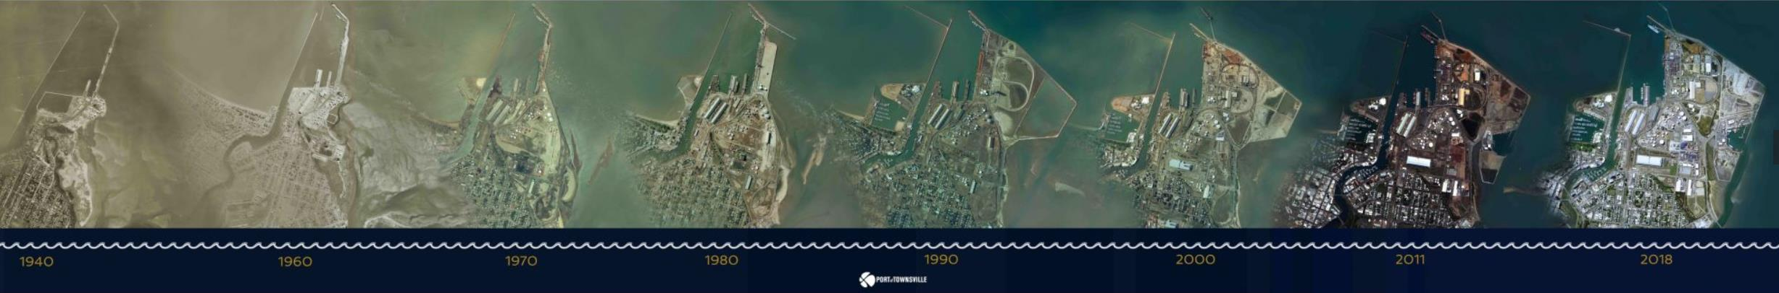
Port of Townsville
History
The port of Townsville was first established in 1864 for wool exports, Townsville city developed 2 years later.
As supply demand increased, the size of the port also increased.
The Port and our individual tenants all have environmental licences, approvals and conditions in order to operate.
Many of these conditions require environmental monitoring to occur to ensure we avoid or minimise environment nuisances or harm by our actions.
Whilst there is an exclusion area for the Port, we recognises the significant environmental and social values of the area, including the GBRWHA values.
Cleveland Bay is an environmentally significant area, with numerous sensitive receptors, so by monitoring our activity we can ensure we can operate sustainably within such a unique environment.

Slide 4
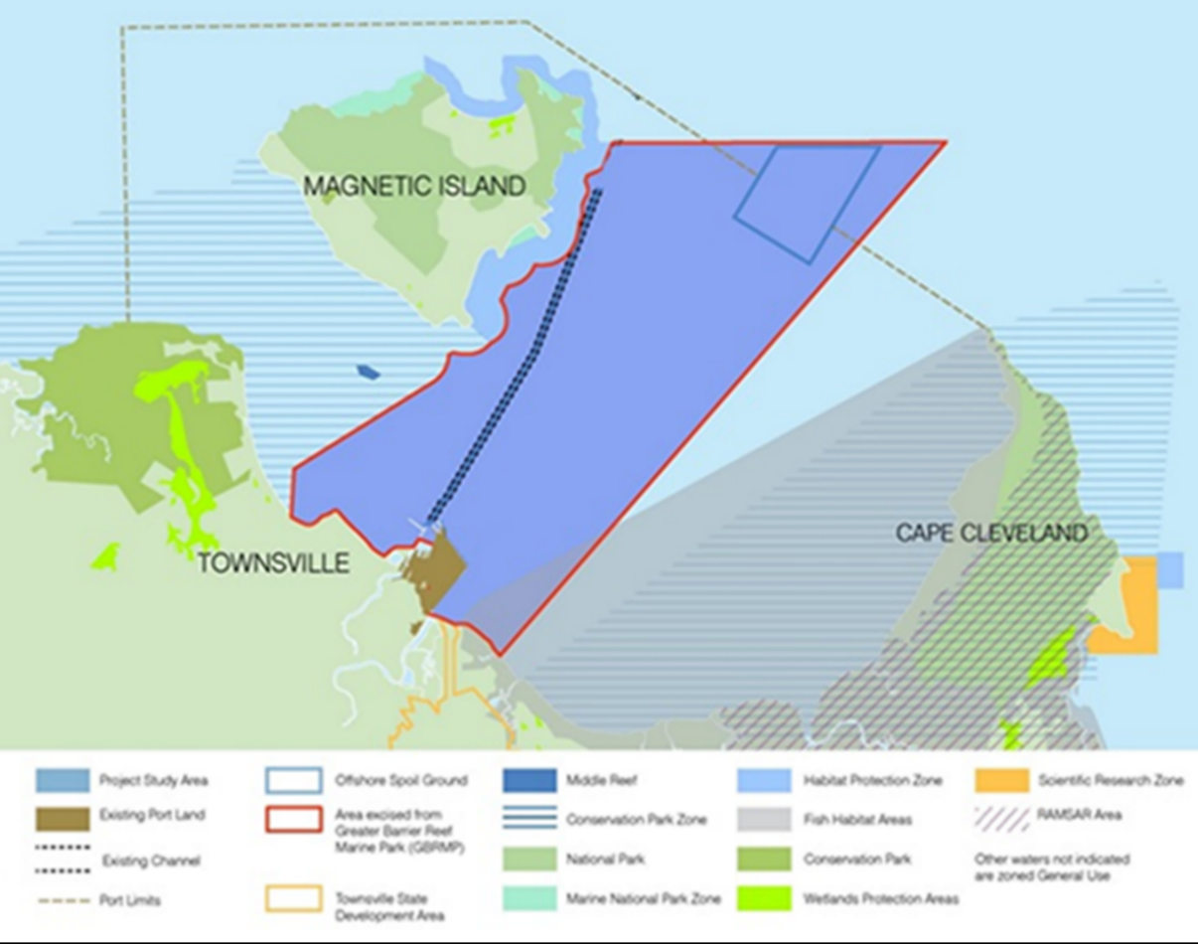
Cleveland Bay Sensitive and Protected areas
Great Barrier Reef WHA & MP
Marine Park Zones
Seagrass meadows
Coral reefs
National parks
RAMSAR wetland
Wetland protection areas
Dugong protection area
Declared Fish habitat area
Home to marine megafauna: dugong, turtles, whales, dolphins; and significant migratory bird species

Slide 5
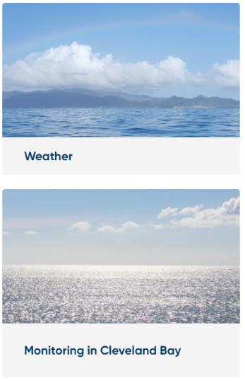
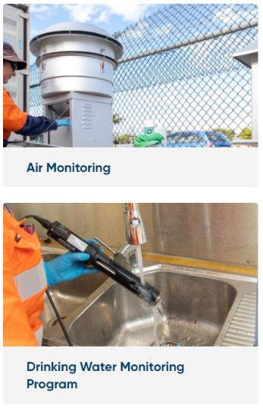
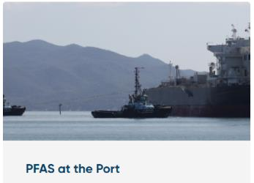
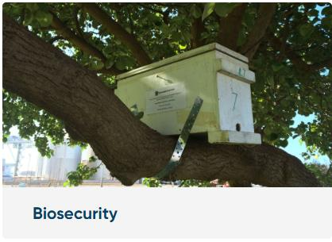
Port Monitoring
We monitor for a range of reasons:
  Compliance with permits and conditions
  Boundary monitoring for buffer zones with the surrounding community
  Understanding trends from port uses – ambient
  Project work monitoring (e.g. EIS)
  General good diligence
  Research purposes
At the port we monitor:
  Air quality, Groundwater, Trade waste, Potable water, PFAS, Stormwater, Noise
  Marine water, Marine sediment
  Biosecurity (marine/landside) as First-Point-of-Entry Port
  Seagrass
Around the bay and Magnetic Island:
  Marine sediment – NAGD, ambient
  Marine water – buoys, ambient
  Seagrass
  Major Project monitoring – Seagrass, Marine water, marine sediment, coral monitoring & marine megafauna
https://www.townsville-port.com.au/environment/monitoring/

Slide 6
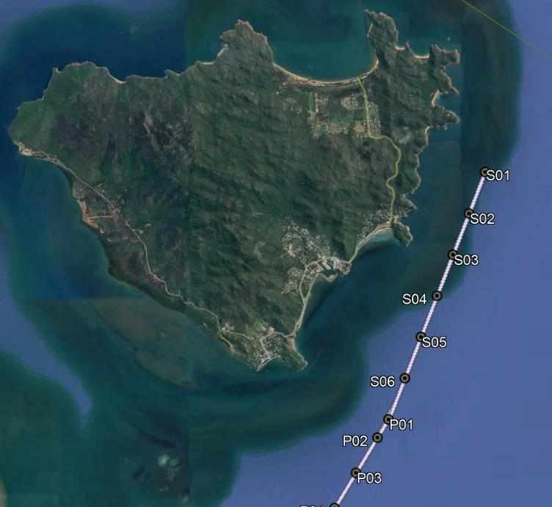
Monitoring locations around Magnetic Island
Marine Sediment Monitoring
Sediment Sampling and Analysis Plan (SAP)
Every 5 years as per the NAGD (2009) – test and analyse maintenance dredging sediments for suitability for sea placement
Results reviewed by DAWE and DES
Ambient marine sediment monitoring
Ongoing since ~1995
Within and in the vicinity of operational areas
Characterises marine sediments on a regular basis
Identify trends across a range of parameters
Approx. 213 locations across the port and channels
Undertaken May and October
Data is stored at the Port and used for permit applications, baseline studies, and for third party requests (port users) and regulator reviews

Slide 7
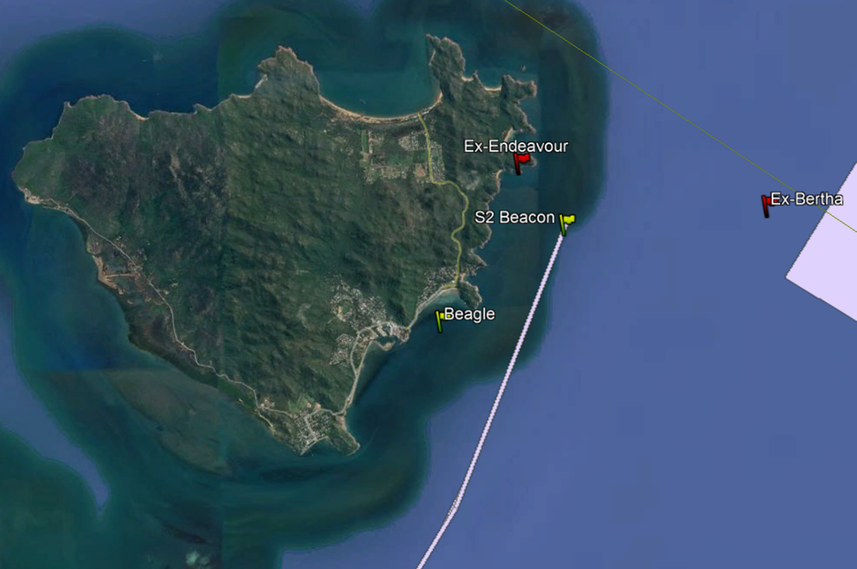
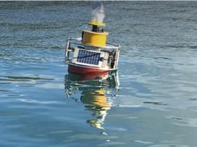
Marine Water Monitoring
Ambient Marine Water Monitoring
Closer to Port in Platypus Channel
Ongoing since ~2004
Characterise ambient marine water within and immediately surrounding the Port
Identify Trends across a range of parameters
Undertaken quarterly
Beagle and S2 Beacon
Near real-time water quality monitoring buoys
Temperature and NTU
Public dashboard on website
Data is stored at the Port, used for third party data requests (research grants, research papers), public awareness, permit applications and regulator reviews
https://www.townsville-port.com.au/environment/monitoring/monitoring-in-cleveland-bay/
https://public.eagle.io/public/dash/gi7cxkl9yo9atkv

Slide 8
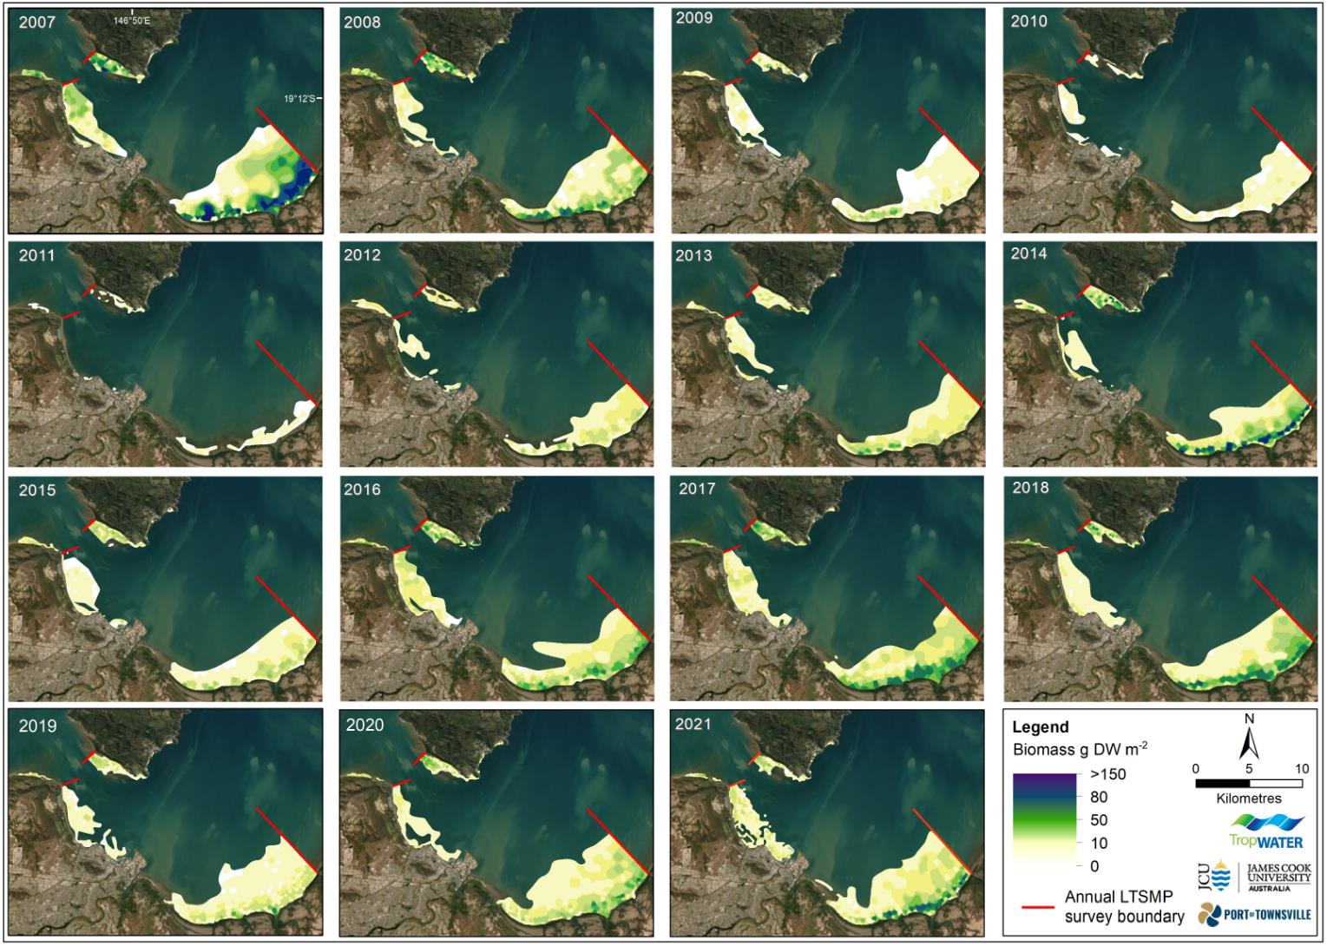
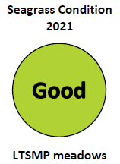
Seagrass Monitoring
Annual monitoring since 2007
Indicator of change
11 species of seagrass in Cleveland Bay
Turtles, Dugongs & their feeding trails were abundant in the meadows in 2021
Post Cyclone Yasi
Post 2019 floods

Slide 9
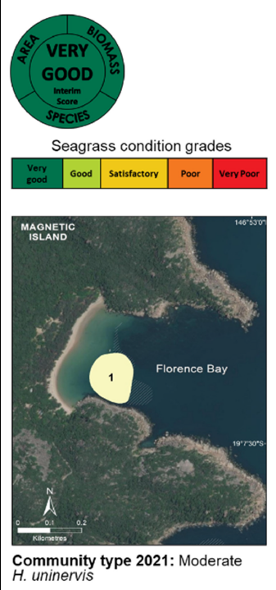
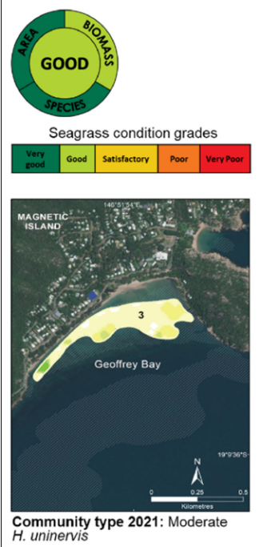
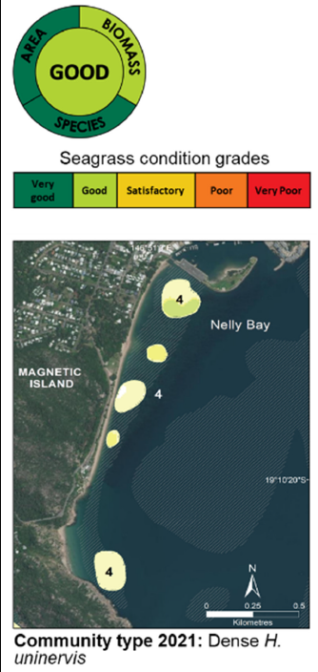
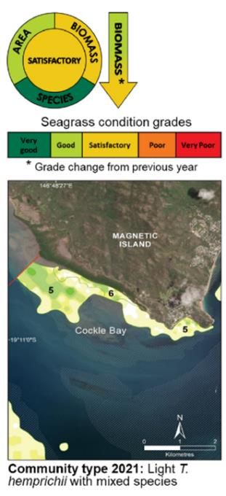
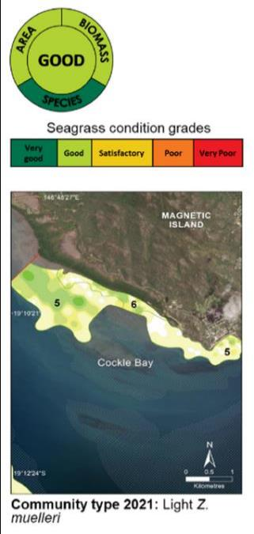
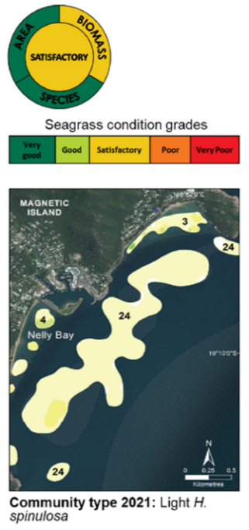
2021 Magnetic Island seagrass meadows
Meadow 5
Meadow 6
Data is used in Port publications, research programs (including JCU studies) NESP Programs, Dry Tropics Partnership for Healthy Waters; and Report is on our website
https://www.townsville-port.com.au/environment/monitoring/monitoring-in-cleveland-bay/

Slide 10
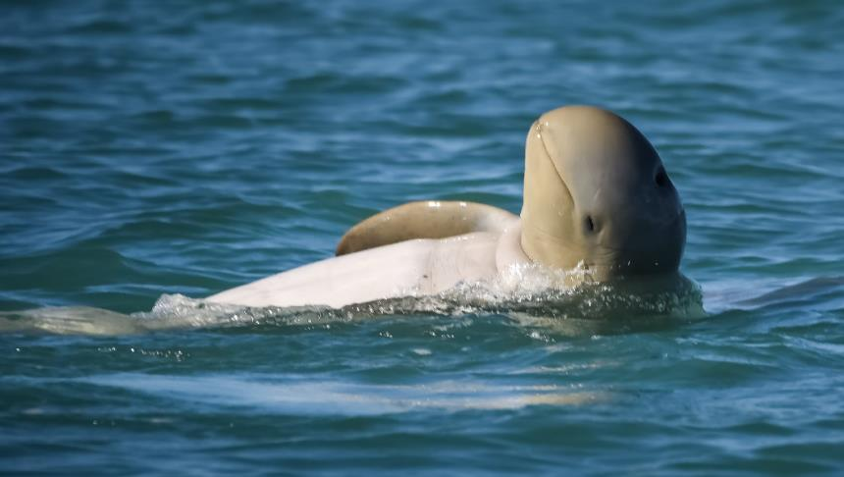
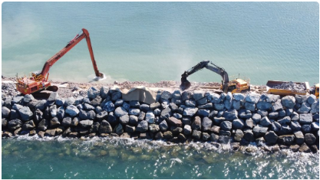
Major Projects Monitoring
Recent major projects:
Port Expansion Project / Channel Upgrade
Townsville Marine Precinct
Previous Capital Works (Sea channel expansion 1993/94)
Large scale monitoring before, during and after works:
Dolphins and Marine Megafauna
Shorebirds
Seagrass
Coral
Water Quality
Underwater Noise
Marine Sediment
Data currently used for managing capital dredging works, through the ITAC
Permit Condition Compliance, Traditional Owner and Stakeholder Engagement
Some reports available on website, more will be released publicly as they are available
https://www.townsville-port.com.au/projects-development/channel-upgrade/
https://www.townsville-port.com.au/projects-development/channel-upgrade/approvals/

Slide 11
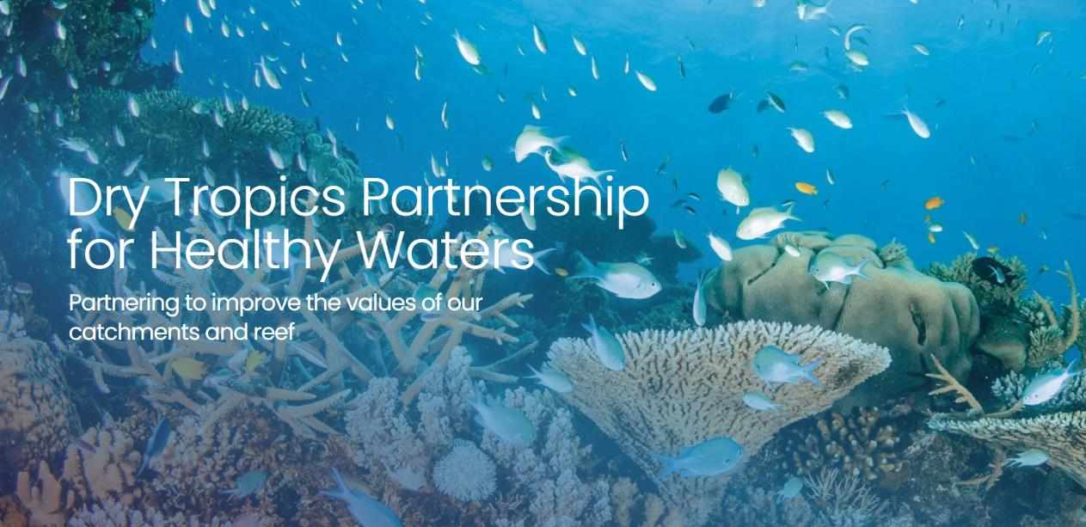
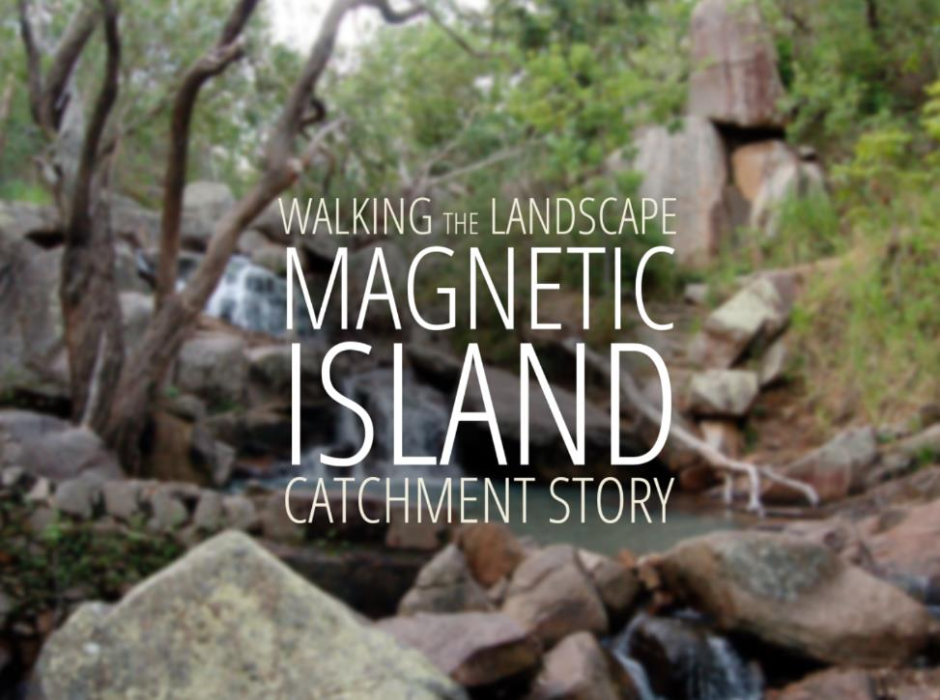
Dry Tropics Partnership for Healthy Waters
The Partnership is made up of stakeholders from industry, scientific groups, education, community and the all levels of government.
The Partnership produces an Annual Report that provides our community with an independent picture on the health of our waterways and Reef.
This looks at freshwater, estuaries and coastal waters that link the land to the Great Barrier Reef.
The aim of the Annual Report Card is to help guide future planning and investment into waterways, marine catchments and marine health.
The Partnership have undertaken ‘Walking the Landscape’ which includes Magnetic Island
https://drytropicshealthywaters.org/
https://drytropicshealthywaters.org/2019-2020-report-card/
https://drytropicshealthywaters.org/about-us/our-catchments/
https://qgsp.maps.arcgis.com/apps/MapJournal/index.html?appid=db22f5427e284c0f99379a470b3f72f8#

Slide 12
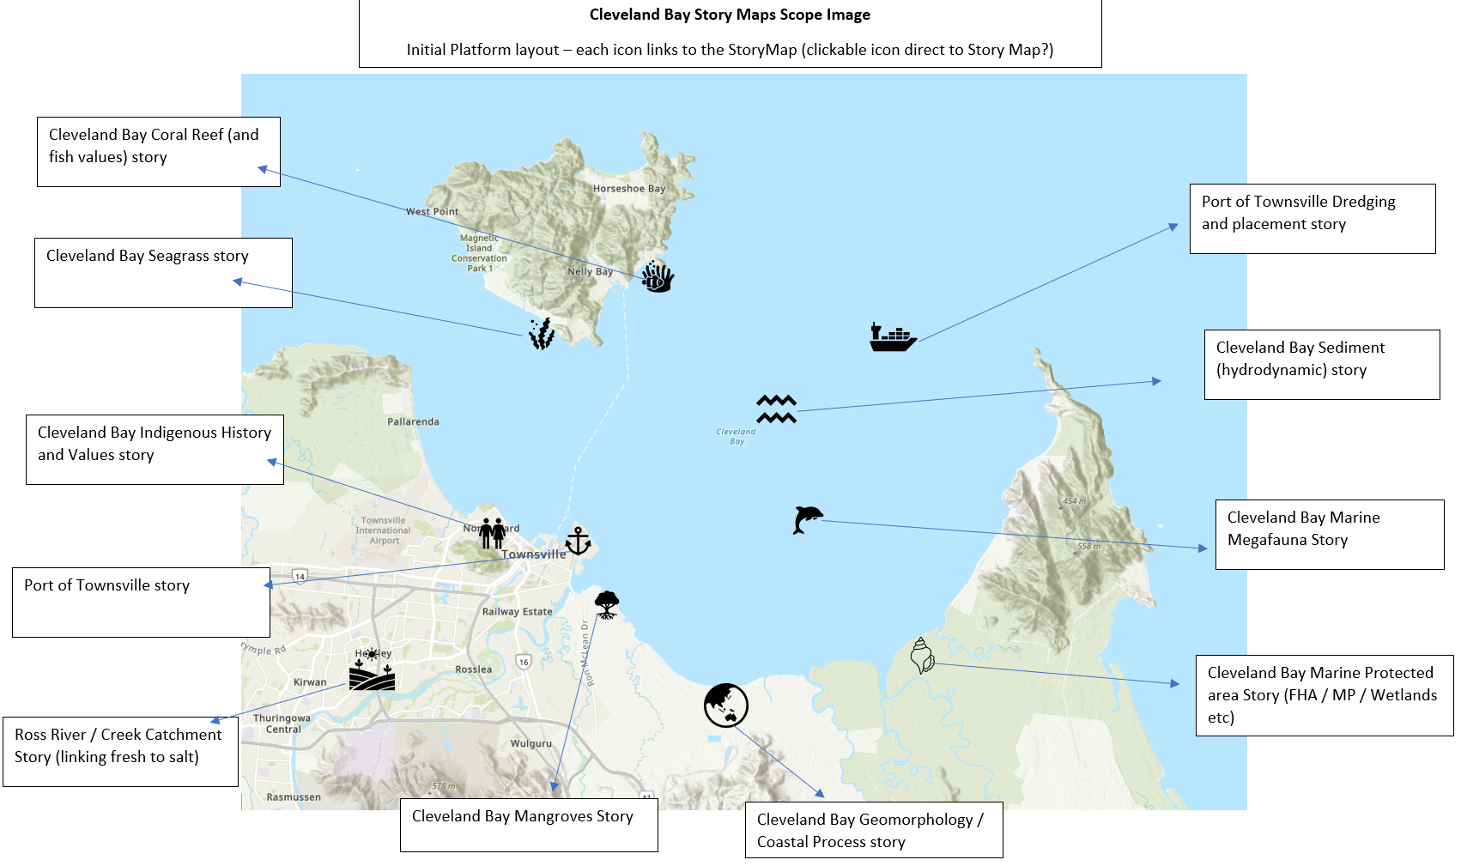
Story Maps
The Partnership are looking to develop a series of Story Maps about Cleveland Bay
The aim is to have a pubic knowledge sharing platform that brings together research and monitoring (science and knowledge) in one place. Story Maps brings together GIS and story telling.
Cleveland Bay as been extensively studied, but the information is often hard to find or too technical/complex.
These story maps will allow for a single place of easy access to key information with links to where the data/knowledge has come from.
First Story Map – Seagrass, Guardians of the Bay is expected to be released with the Partnership’s 2021 Annual Report Card.
Initial Concept

Slide 13
Summary
Port of Townsville Limited monitors for a range of reasons:
  Compliance with permits and conditions
  Boundary monitoring for buffer zones with the surrounding community
  Understanding trends from port uses – ambient
  Project work monitoring (e.g. EIS)
  General good diligence and Research purposes
Around the bay and Magnetic Island, the Port monitors the marine environment:
  Marine sediment – NAGD, ambient
  Marine water – buoys, ambient
  Seagrass
  Major Project monitoring – Seagrass, Marine water, coral monitoring & marine megafauna, noise
Dry Tropics Partnership for Healthy Waters
  Provides an Annual Report on the health of freshwater, estuaries and coastal waters that link the land to the Great Barrier Reef
  Walking the landscapes ‘Magnetic Island’
  Community, industry, research monitoring data can feeds into the Report Cards
Story Maps
  Excellent story telling tool – using GIS to create a knowledge sharing platform.
  Seagrass, Guardians of the Bay StoryMap coming soon!

Slide 14
Thank you

