Slide 1
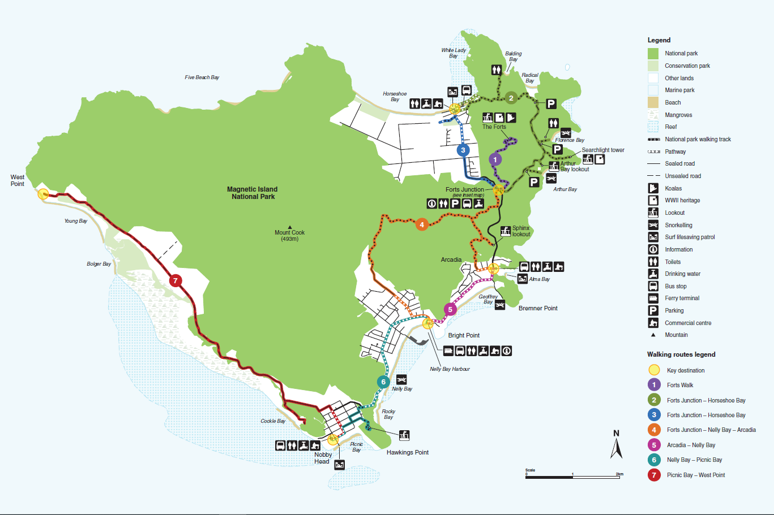
What is the future of Magnetic Island?

Slide 2
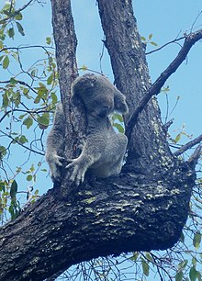
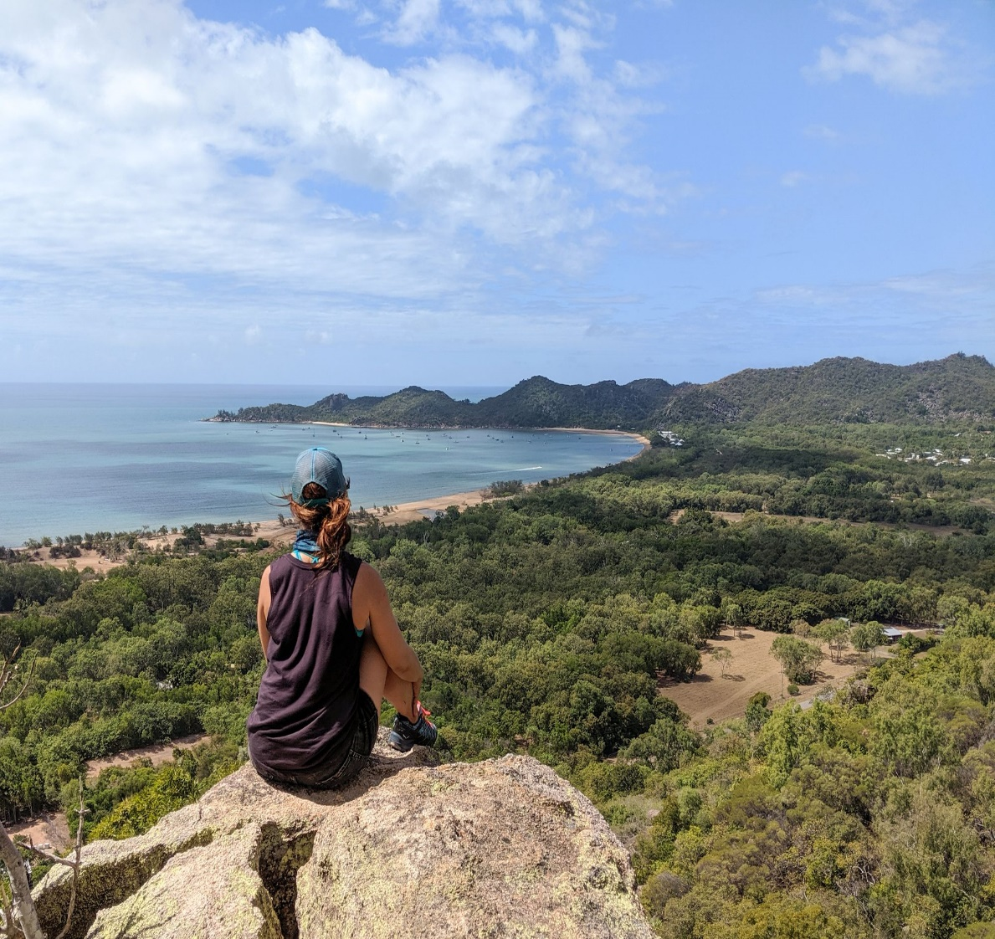
We have diverse Stakeholders

Slide 3
What’s our Community saying?
Tourism Survey
Sustainability & Resilience
Workshop
Decarbonisation Audit
Community Action Plan

Slide 4
Tourism Survey
I love the Island very much but I feel sad for the natural values we have lost.
If (tourism generated) resources were put into road improvement, sustainable transport options
(e.g. electric and hybrid vehicles, safe walking tracks on roads). Promote MI as Clean and Green
holiday destination. Reduce motor vehicles by increasing reliable public transport.
MI should be an ecotourism location. It could be a model community where solar power and
sustainable water solutions are highlighted. Tourism developments should put environmental
management in the forefront. The Island should provide a clean, safe and sustainable holiday option
for families where a slower way of life and less consumerism are promoted.
Our community needs to be asked a lot more about the future of our island.
No more development, Maintain the village atmosphere. Encourage more shops and more seating.
Maintain the unique trees. Keep it nature based, ensure plenty of shade.
Australia and the world is in need of more models of sustainable living and development. Magnetic Island
is a unique location with a strong community base that wants to support its future growth but in a
manner sensitive to the environment, cultural history and sustainable lifestyles for its residents.

Slide 5
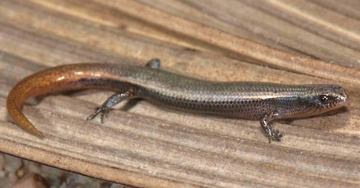
Key Points
In the last decade there has been a major shift in approach to Tourism Planning. It is away from a focus on identifying resources and the needs of tourism businesses.
Towards emphasizing the Destination, its residents and the wellbeing and quality of that Environment.
The Survey reflects this new approach to tourism planning which places destination resident needs and aspirations at the centre of the planning process.
Residents views on tourism are clear and consistent. While they are generally supportive of tourism, they want a very specific and controlled approach.
There is clear support for further development of walking/trekking style experiences, boat and vessel based ecotourism/educational tourism and attention to be paid to the transport system to discourage tourist use of cars.
That is:
Marketing our Destination based on a Sustainable Quality Environment

Slide 6
Sustainability & Resilience Workshop
Full independent electrification of homes and vehicles, Smaller Buses
Micro Grid to Macro Grid to Natural Grid, No Waste, Green Energy, Hydrogen
Restore our Beaches and our Wetlands
Carrying capacity set, Passport to the Island, Rehabilitate our environment
Become certified global “Centre of Excellence” in tropical design and sustainability
Island is sustainable and self-reliant, Gardening is dramatically enhanced in urban areas for self-sufficient
Maggie is a case study for the rest of Australia United Community taking local action for climate change resilience
Healthy reefs, reef restoration, protecting our species (e.g. turtle hatchings)
Reduce pressure on our natural, social and cultural values, Sustainable economic growth that doesn’t impact
Cleveland Bay is cleaner, full of sea life, maintenance dredge spoil in deeper water and no impact on the Island
A cyclone shelter that doubles as a Community Centre with performance space, food co-op, garden, etc.
Biodiversity is treasured at the highest level as the prime determinant of community and culture

Slide 7
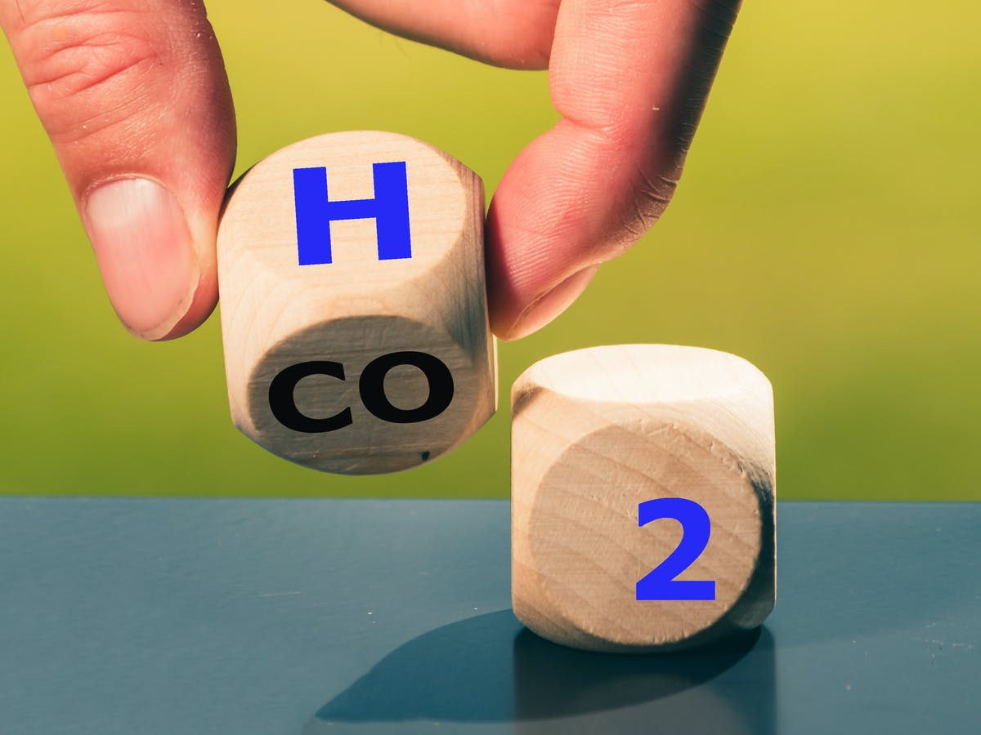
Decarbonisation Audit!
Energy:
Energy Efficiency Retrofits
Green Hydrogen Transport Demo Project
Energy Demand System Incentive Scheme
Solar hot water systems
Solar PV rooftop systems
Micro grid study
Transport:
Electric bicycle rental service
Low emission shuttlebus
Pathway networks and support active transport
Low emission marine transport
Water:
Water Smart Demonstration Community
Waste:
Sustainable and Environmental Education
Solar PV Waste Transfer Station
Organic Waste recycling study
Glass recycling study
Resilience:
Native Plant Nursey
Aquaculture Production study
Tourism Master Plan

Slide 8
Community Action Plan
To identify a range of practical strategies to help maintain and restore the island’s marine and coastal world heritage values, and to contribute to Great Barrier Reef resilience. Five strategies and with specific roadmaps are the outcomes.
Promote awareness of Magnetic Island’s World Heritage Values.
Community Partnerships for Ecosystem Monitoring (Coastal & Marine).
Protect and strengthen Traditional Owner Cultural Heritage.
(a) Develop, communicate and implement a community vision and actions for Magnetic island’s marine and coastal world heritage values (Previously labelled World’s Best Practice), (b) Community-led Dredge Spoil action strategy.
Develop Magnetic Island as a model for community-driven Energy alternatives and Energy efficiency.

Slide 9
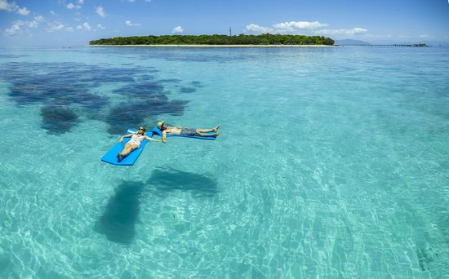
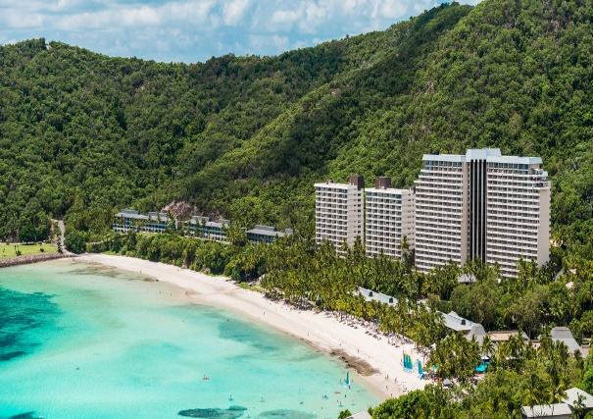
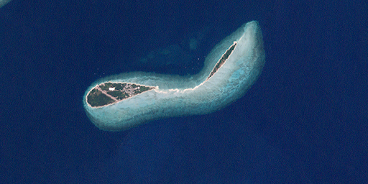
Other Islands
All Australian islands – be they resort islands, eco-friendly resort islands, residential islands or non-residential islands, face comparable issues to Magnetic Island.
Green Island resort: desalination plant, tertiary sewage treatment plant, some waste management, a food digester and a glass crusher, building design feature is with the purpose to conserve the island’s environment and World Heritage values.
Hamilton Island resort: reverse osmosis seawater desalination plant.
Lindeman Island climatically responsive building minimise energy consumption.
Lady Elliot Island solar hybrid power station, reduced diesel consumption 70%.
Heron Island: 100% renewable energy in 2020, Waste Management on-site composting.
Lord Howe Island: Island Board (LHIB), 10 year Strategic Plan, Waste Management.
Norfolk Island, Rottnest Island, Kangaroo Island, King Island, etc….
Palm Island and Masiq Island – Decarbonisation Audit

Slide 10
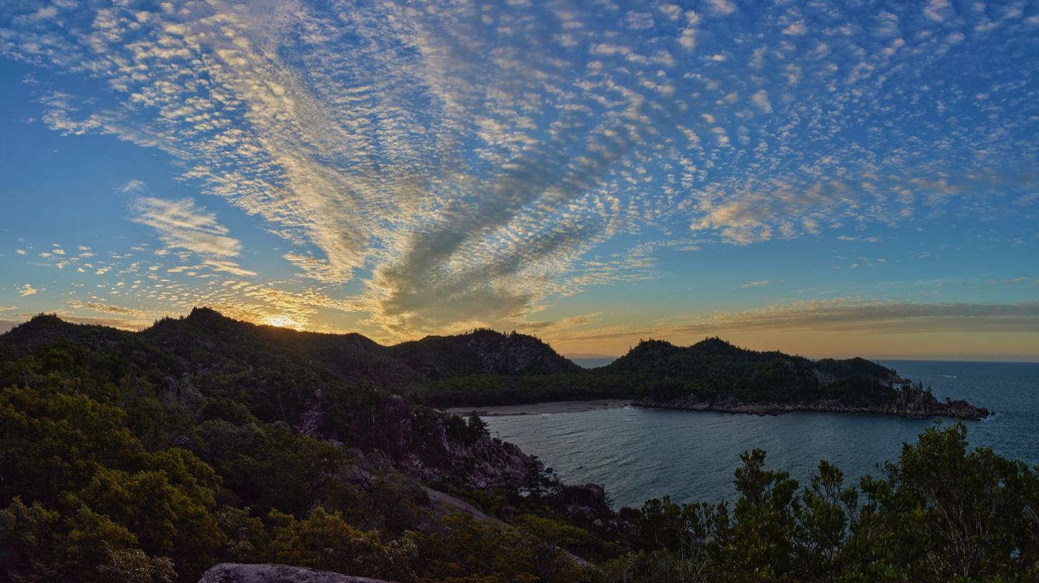
The Leading Sustainable island Community

Slide 11
A Whole of Island Approach
State Govt.
Other
Community Members
MICDA
MIRRA
Traditional
Owners
MICDA
MIRRA
Other Community
Members
Townsville
City Council
Traditional Owners
MINCA
TMI
MINCA
TMI
Key Stakeholders
Federal Govt.

Slide 12
The Leading Sustainable Island Community
Working Groups
Energy
Transport
Water
Waste
Island Natural Social & Cultural Values
Traditional Owners Values
Ecosystems Monitoring
Tourism
Health Services
10. Sustainable Development Planning
The Whole of Island Plan
NOTE:
Integrate into all working groups are Infrastructure, Resilience and Technology.

Slide 13
Working Groups
Role:
Each Working Group to develop a Vision, Roadmap and Implementation Plan.
People:
Community members and relevant Key Stakeholders.
Process:
Visioning Workshop and Draft Roadmap - Forming
Testing the Roadmap with the Community and Stakeholders - Storming
Agreement and input into the Whole of Island Plan - Norming
Priority Implementation steps and Funding sources - Performing

Slide 14
The Leading Sustainable island Community

