Slide 1
Magnetic Island and Marine Debris
Kara-Mae Coulter-Atkins
AMDI Project Officer - Townsville
Notes:
Acknowledgment of Country
Acknowledge the “insert traditional owners” as the Traditional Custodians of the land, seas, and waterways on which we stand today.
Pay respect to their Elders past present and emerging.
We would also like to acknowledge that this land – which we benefit from occupying – was stolen, and that sovereignty was never ceded.
Introduction of speaker
Here on behalf of Tangaroa Blue – AMDI Project Officer
Our job is to clean-up beaches and count all the rubbish that we clean-up.

Slide 2
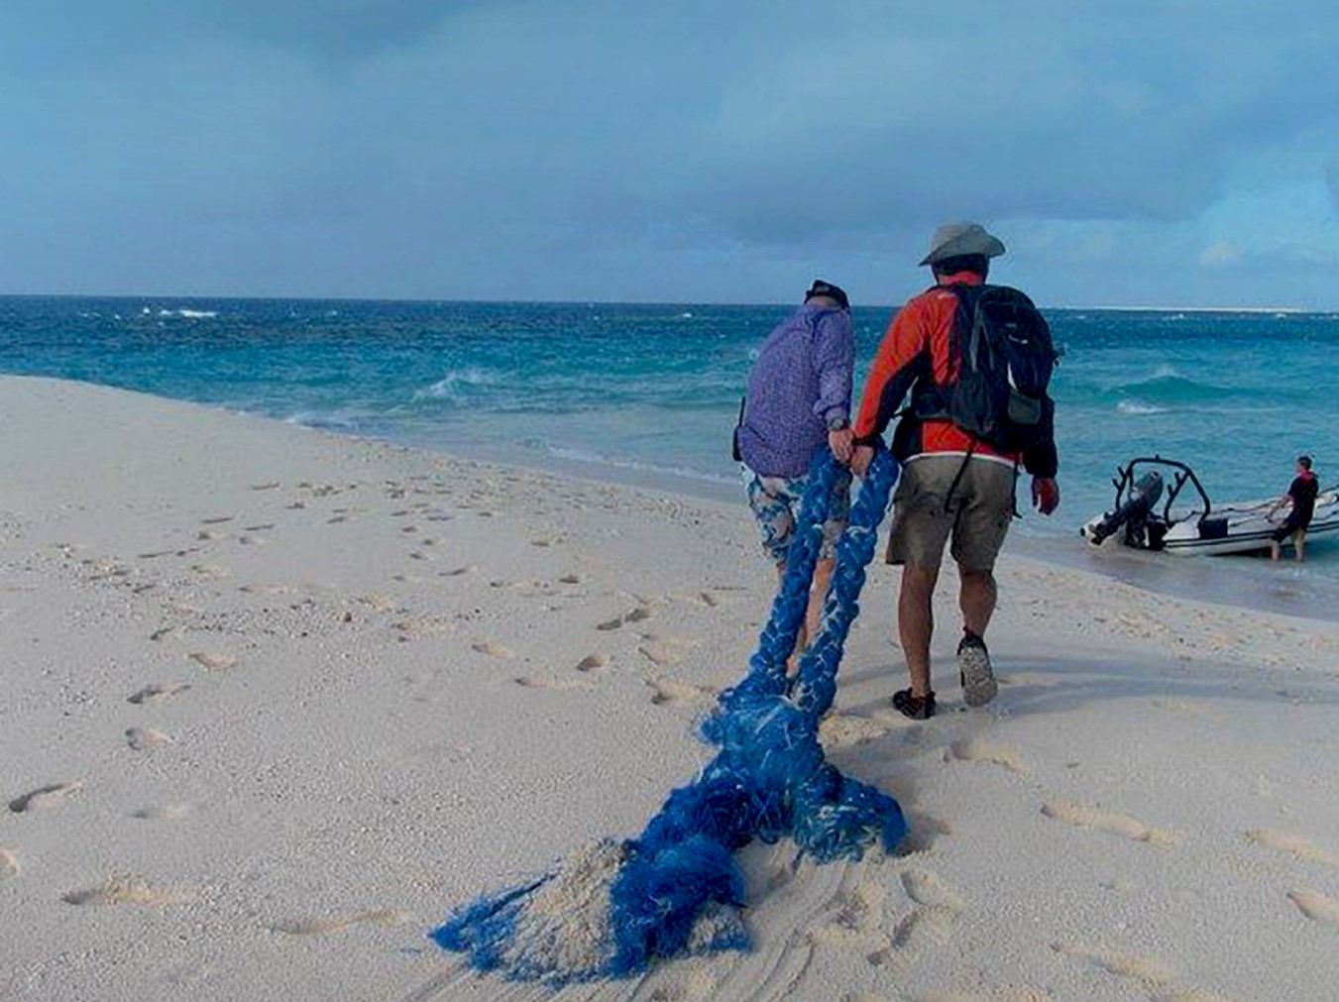
Tangaroa Blue Foundation
Established in Western Australia in 2004
“If all we do is clean-up, that’s all we’ll ever do”
Step 1: Clean up beach
Step 2: Count all rubbish
Step 3: Record the rubbish type in AMDI
Step 4: Find where it came from
Step 5: Stop it from there
Notes:
Who is Tangaroa Blue Foundation?
Started in Western Australia in 2004
In Maori and Polynesian mythology, Tangaroa is the god of the ocean - If you look after me, I’ll look after you
Tangaroa Blue’s motto “If all we do is clean-up, that’s all we’ll ever do”
Created AMDI – Australian Marine Debris Initiative

Slide 3
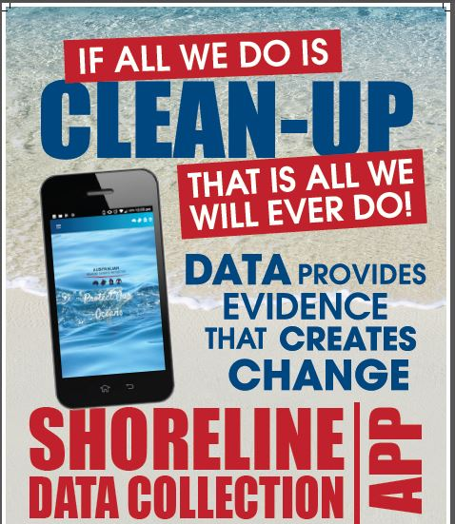
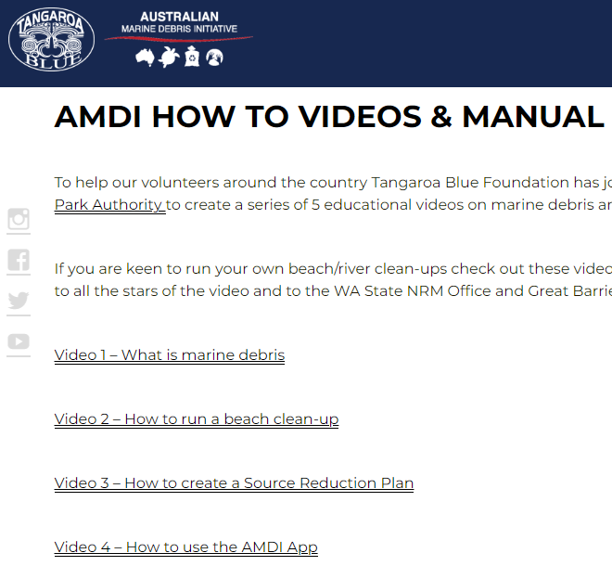
Project title
Secondary title
AMDI Database and App
Notes:
AMDI App
Get it on the app store (both Android and Apple)
Anyone can upload to it (data is checked for quality before going online) and it is an open access database (open to the public)
Resources on how to use it on our website
Citizen science tool

Slide 4
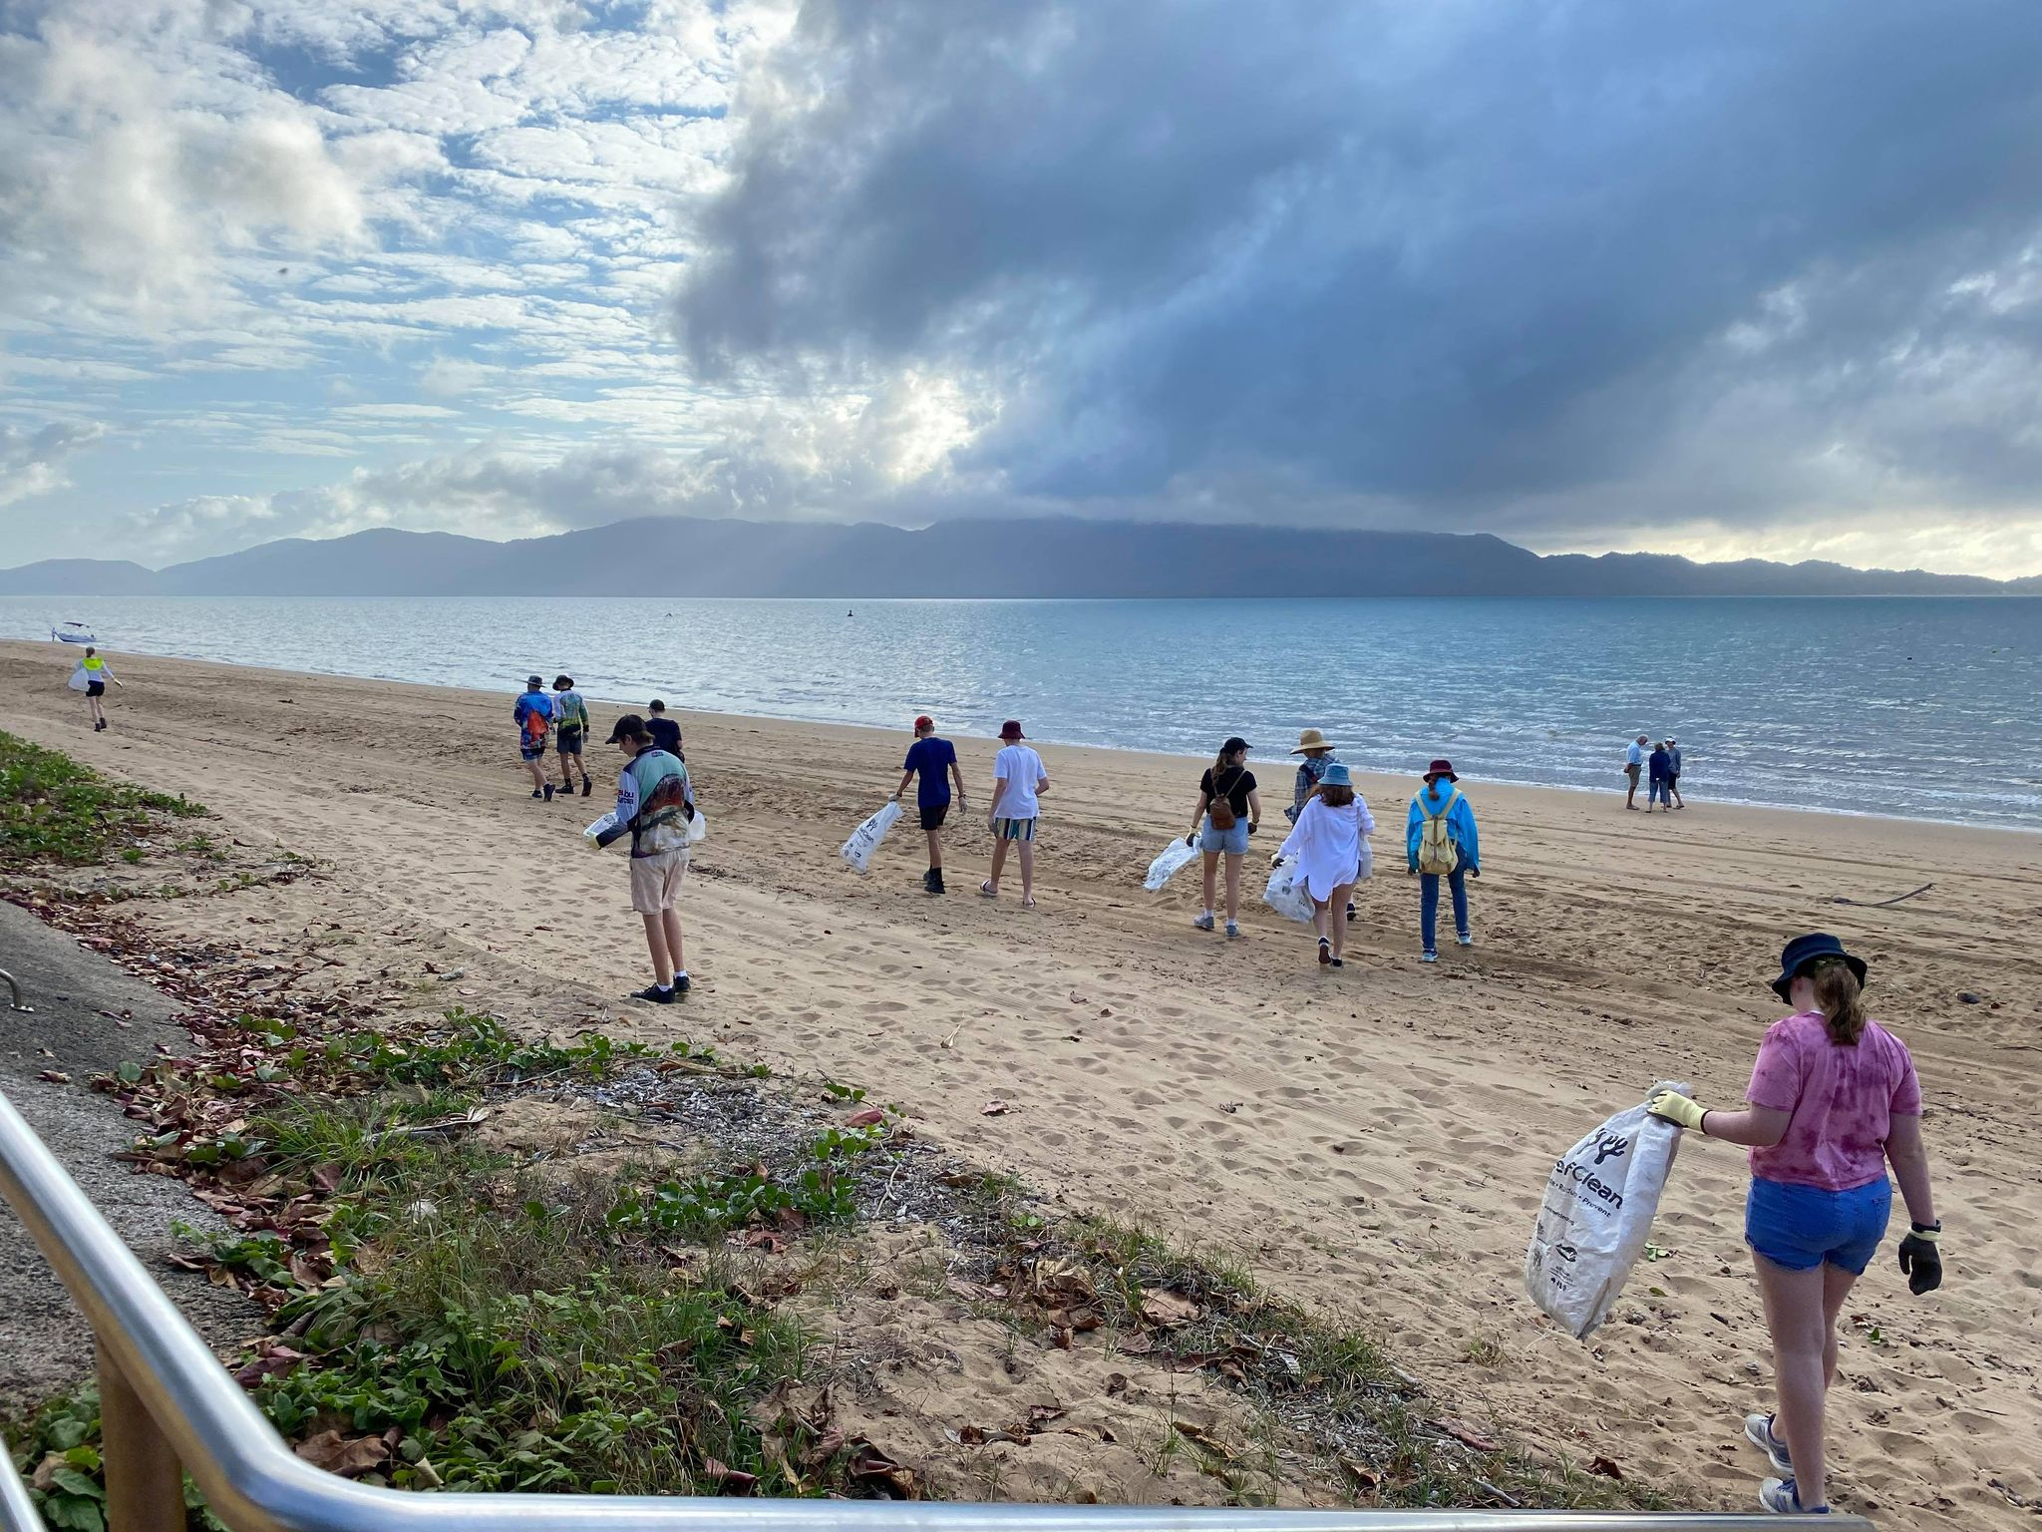
???
AMDI Database – Magnetic Island
26,769 items collected (2014-2021)
473.25kg of rubbish removed
11 clean-up sites
59 clean-up events
19,946 volunteers hours
522 volunteers
(data current as of 25th May 2022)
59!
2.5 years!
Notes:
Volunteer hours
578,556 volunteer hours. Standard pay would be $41.25 x ~578556 vol/hrs = $23.9 million dollars in volunteer hours contributing to the health of our environment
Economic contribution from vols / community framework
GOV couldn’t afford these efforts
Partners (clean up sites & events)
TB is a not for profit organisation, the entity hosting AMDI
AMDI is a program that provides a platform for everyone to contribute and use

Slide 5
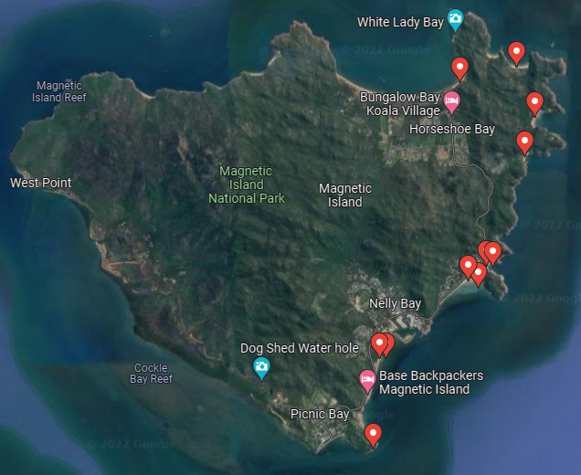

Slide 6
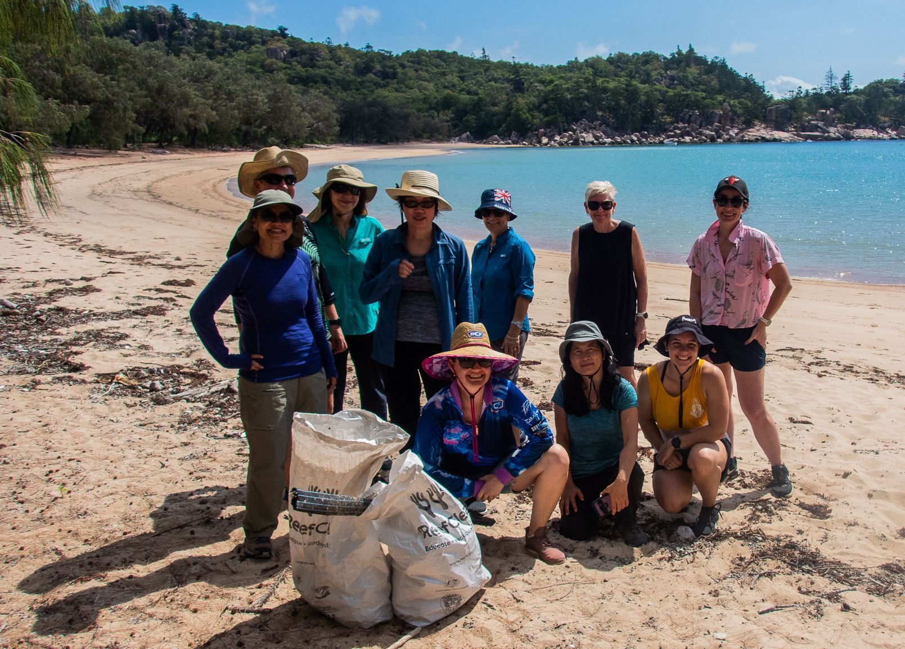
What can you do to help?

Slide 7
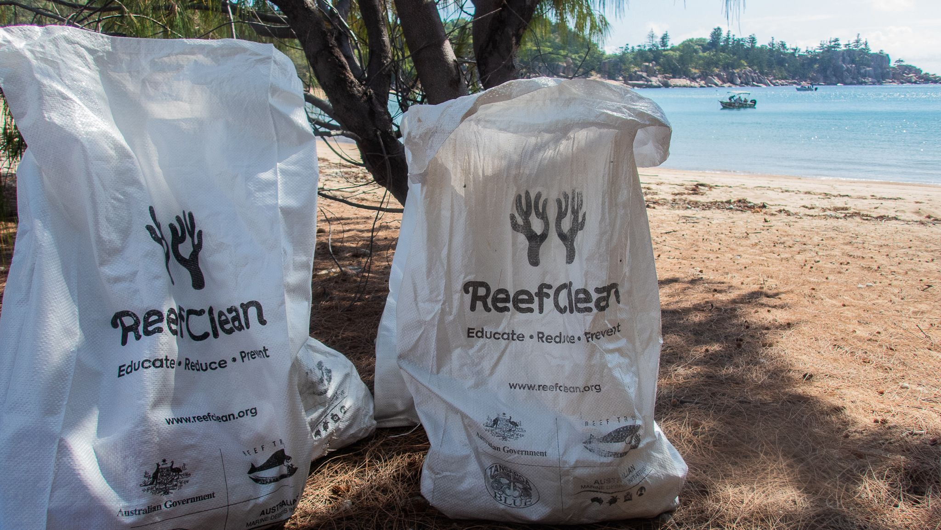
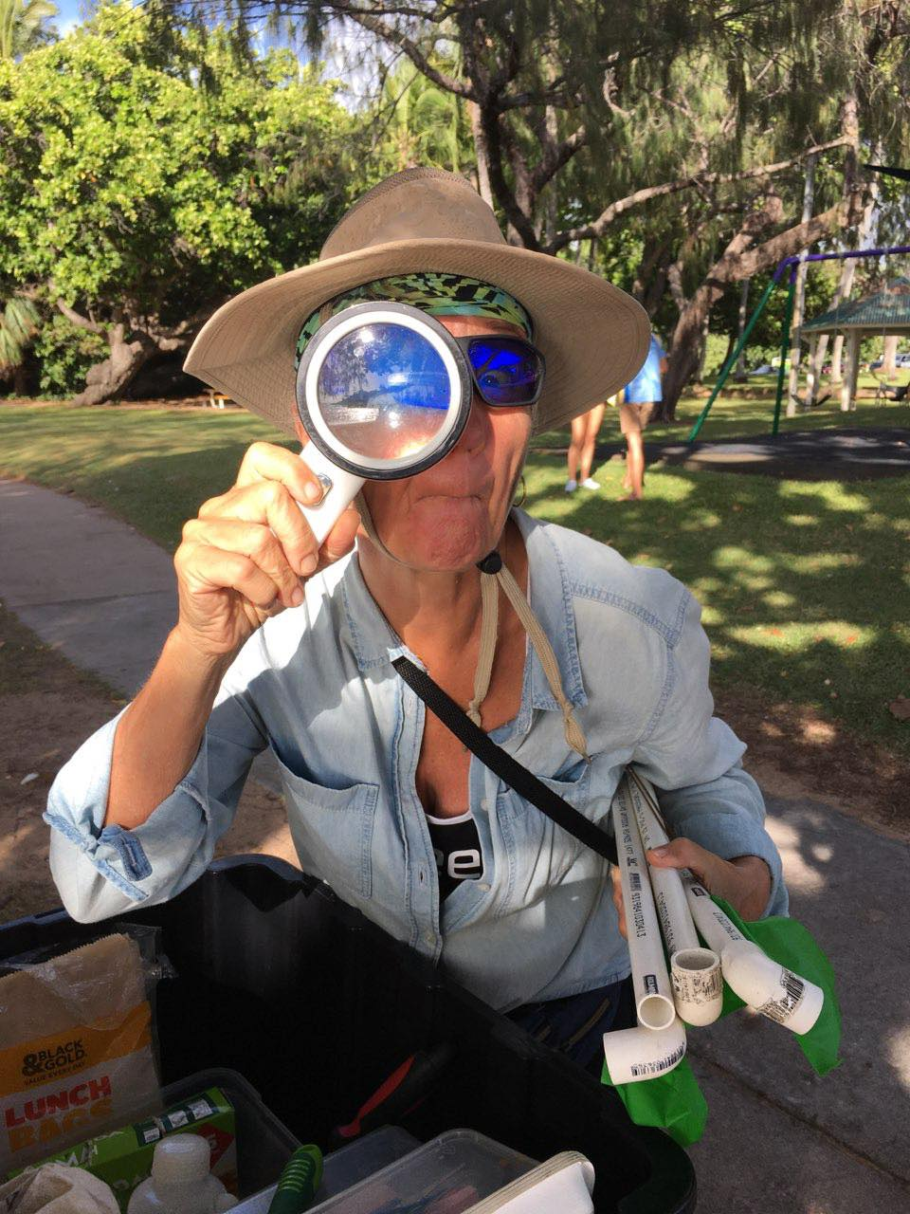
You can host or participate in a clean-up and add to the AMDI Database!
Local Community Group – Townsville Hike and Explore

Slide 8
In Summary
Tangaroa Blue Foundation host a platform for the AMDI Database, a citizen science tool where data can be collected or accessed by everyone
Majority of regular clean-up sites are along the East coast of Magnetic Island
KNOWLEDGE GAP: West and North West coastline
THE PROBLEM: Difficult to reach without a marine vessel
- Visit www.tangaroablue.org for education materials on “how to run a clean-up” and “how to use the AMDI Database”
Contact: kara-mae@tangaroablue.org

